Slide 1



In aftermath of 16th – 17th June 2013 ‘Himalayan Tragedy’
‘Rebuilding Faith’
A Rehabilitation Programme for affected people in Uttarkashi District, Uttarakhand
Complete Statistics and Summary
July 2013-August 2016

Slide 2
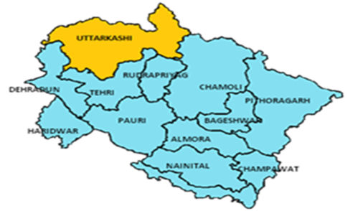
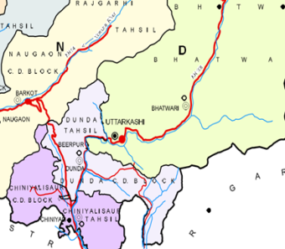
Geographical Location
Fig : Map of Uttarakhand state
Fig : Map of Uttarkashi district
3 blocks-Chinyalisaur, Dunda and Bhatwari of Uttarkashi District in the state of Uttarakhand

Slide 3
Reach Out Summary
Activity | Target Group | School/ Village | Reach Out
 |  |  | Community |  | Students |  | Teachers |  | Total
 |  |  | M | F | M | F | M | F
School Bag Kit Distribution | School & non-school going children | 61 schools | - | - | 914 | 1086 | - | - | 2000
Umang | School & non-school going children and teachers | 90 schools | - | - | 4409 | 4232 | 444 | 179 | 9264
Spirulina distribution | Community people | 14 villages | 530 | 480 | - | - | - | - | 1010
Disasters tips firefighting, first aid info/ Mock drills | School students | 60 schools | - | - | 910 | 1090 | - | - | 2000
Village DRR Programmes | Community people | 15 villages | 930 | 1030 | - | - | - | - | 2000

Slide 4
Activity | Target Group | School/ Village | Reach Out
 |  |  | Community |  | Students |  | Teachers |  | Total
 |  |  | M | F | M | F | M | F
VCP Preparation | Village Community, Gram Pradhans & local leaders | 5 villages | 290 | 335 | - | - | - | - | 625
DRR School Programmes & SDMP Preparation | School students & teachers | 50 schools | - | - | 1430 | 2070 | 120 | 180 | 3800
Teachers’ Training Workshops | Education Dept. & teachers | 3 blocks | - | - | - | - | 57 | 31 | 88
Workshop for Gram Pradhans | Gram Pradhans, Panchayati Raj Institutions & local leaders | 3 blocks | 10 | - | - | - | - | -
Training of School DMC | School students | 50 schools | - | = | 680 | 820 | - | - | 1500
Training of Village DMC | Community people | 5 villages | 130 | 70 | - | - | - | - | 200

Slide 5
Activity | Target Group | School/ Village | Reach Out
 |  |  | Community |  | School Students |  | Teachers |  | Total
 |  |  | M | F | M | F | M | F
WASH, ODF awareness | Community people | 15 villages | 570 | 930 | - | - | - | - | 1500
Awareness on menstrual hygiene, pregnancy and pre natal care | Women and adolescents girls | 15 villages | - | 500 | - | - | - | - | 500
Celebration of International and national days | Community people | 5 villages | 470 | 494 | - | - | - | - | 964
Awareness programme on waste management in Gangotri | Tourists at Gangotri | - | 15 | 25 | - | - | - | - | 45
TOTAL |  |  | 2945 | 3864 | 8343 | 9298 | 621 | 390 | 25,461
 |  |  | 6,809 |  | 17,641 |  | 1,011

Slide 6
S.No. | TARGETS | ACHIEVEMENTS
1 | Psycho social care provided to around 2,000 students in Uttarkashi district. | 8641 school and non-school children were provided psychosocial care and support.
2 | 2000 children get school kits to resume education and refreshment. | 2000 school bag kits were distributed to school children.
3 | Above 100 teachers got trained on psycho-social care, disaster response, WASH, recovery and rehabilitation needs, teaching and learning disaster preparedness in schools. | 200 educated youths were trained in psychosocial care programme ‘Umang’ as teachers to help in restore education in the district. 423 teachers were trained in psycho-social care and support and DRR preparedness in schools.
4 | More than 5,000 students addressed. | More than 7,000 students have gained knowledge of DRR, CC, SMD and WASH.
5 | More than 10,000 population of 15 villages addressed for awareness on sustainable mountain development. | More than 6,000 populations of 15 villages are aware of DRR, CC, SMD and WASH. The target was set based on an estimation of 700 average population in each village. Also it was decided that DRR awareness will be conducted in all the 15 villages but other programme would concentrate on a cluster of 5 villages in Mustiksaur cluster, Bhatwari block.
6 | More than 100 teachers trained. | 104 teachers including officials from Education department were trained on disaster preparedness and mainstreaming DRR into school curriculum. 300 teachers were trained in disaster preparedness and school safety through DRR school programmes.

Slide 7
S.No. | TARGETS | ACHIEVEMENTS
7 | At least 50 schools will have their ‘School Disaster Management Plan’ developed. | 50 School Disaster Management Plans (SDMPs) prepared by school students and teachers.
8 | At least 5 villages will have ‘Village Contingency Plan’ of their villages. | 5 Village Contingency Plans (VCPs) prepared by village community itself.
9 | Personnel of concerned Government Departments oriented to include CEE-JSW programme in the programme of their Department, to make use of and sustain it. | Personnel of concerned Government Departments such as Education Department, District Disaster Management Authority, Frorest department etc. were oriented to include CEE-JSW programme in the programme of their Department, to make use of and sustain it. Collaboration with local ngos namely, Azim Premji Foundation, Red Cross Society and Shri Bhubaneshwari Mahila Ashram were established and these were part of programmes conducted by CEE-JSW. The State of Uttarakhand has made it compulsory for all villages to make their VCP and to schools to make their SDMP. CEE-JSW’s awareness, education programme has much bearing in triggering this action.

Slide 8
Key Achievements
Increase in the sensitivity of people towards climate change issues.
People are taking actions at local level to address the same.
Communities have realized that reducing hazard risk is a long term process for which successful collaboration is necessary among the community and intervening agency.
VCP preparation and meetings have helped the community to understand local situations and to determine actions to be taken.
15 members from each village can judge how vulnerable the village is to risks and threats posed by climate change effects and natural disasters. They can contribute to the contingency plan and can serve as resource persons for neighboring village.
Students are better prepared for dealing with a hazard that occurs when they are in school and share DRR information with their families.
10 teachers and students from each school are equipped in preparation of school disaster management plans.
Youth have found avenues to learn about and practice sustainable livelihoods.

Slide 9
Key Achievements
Women are equipped in administering first aid and can also identify cases requiring psycho-social support and care.
School students have adopted complete and correct hand washing.
School children are acting as messengers and passing the information to their families and friends.
Village have started giving importance to basic hygiene practices.
Various IEC material such as DRR booklets, Risk land game, book labels, year planner have made learning more interesting and increased awareness.
Increase in the number of trees especially traditional species.
Villagers have started to use organic compost in small sections of their land to see the changes and benefits. They have also started maintaining compost pits so that organic compost can be used in their fields.
Appreciating the efforts put in by CEE-JSW, communities are coming up with other issues requiring facilitation and intervention from CEE-JSW

Slide 10
Contributions from Outside CEE
Four interns pursuing Masters in Disaster Management from Tata Institute of Social Science (TISS), Mumbai joined CEE Uttarkashi office from August 2015 to October 2015 and contributed in DRR awareness and disaster management plan preparation.
For the period of May 2016 to June 2016, two interns pursuing Bachelors in Social Sciences from TISS Guwahati joined ‘Rebuilding Faith’ at CEE Uttarkashi office.
Two interns from Masters Programme in Ecology, Environment & Sustainable Development at TISS, Guwahati worked closely with CEE Uttarkashi team on Rebuilding Faith Programme.

Slide 11
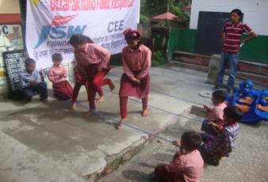
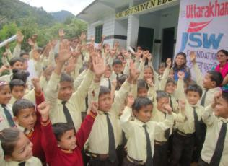
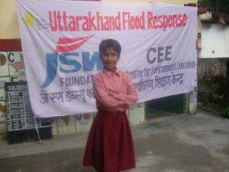
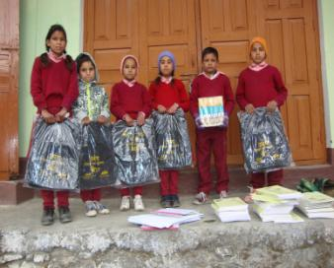
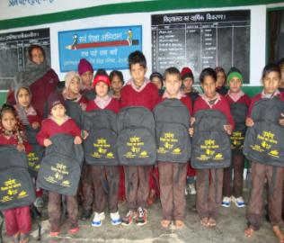
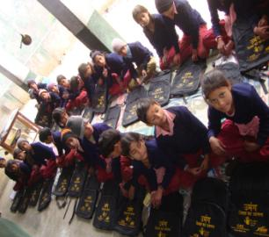
Photographs
Various activities under ‘Umang’ Programme
School Bag Kit distribution

Slide 12
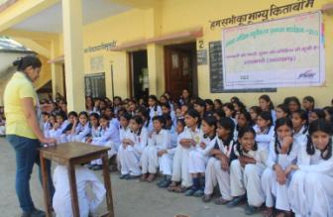
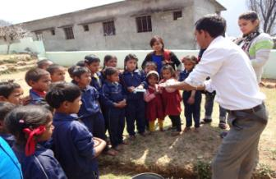
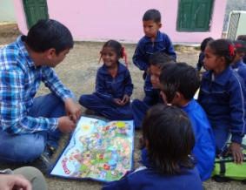
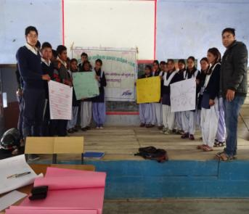
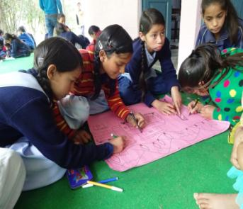
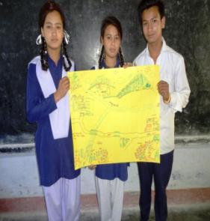
Photographs
DRR Awareness Programmes in Schools
Students preparing their School Disaster Management Plan

Slide 13
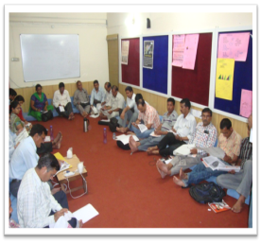
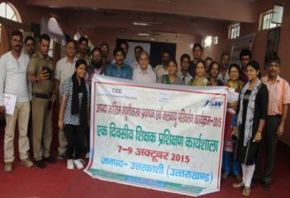
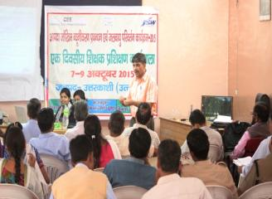
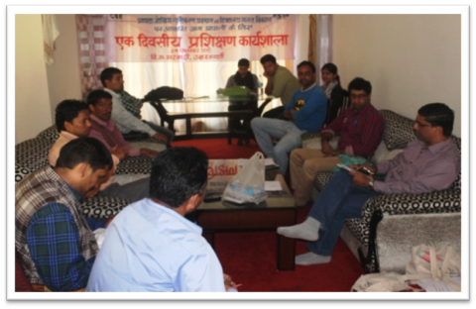
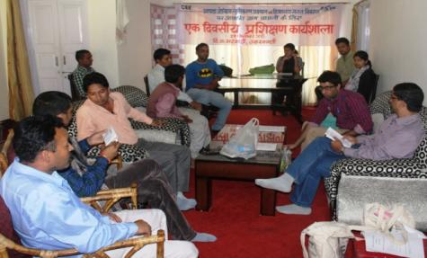
Photographs
Teachers’ Training Workshop
Workshop for Gram Pradhans and Panchayati Raj Institutions

Slide 14
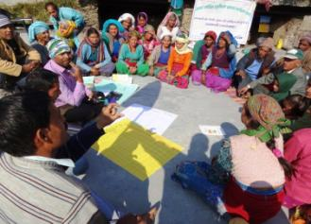
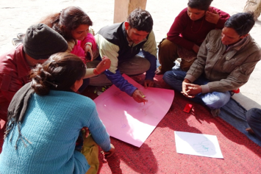
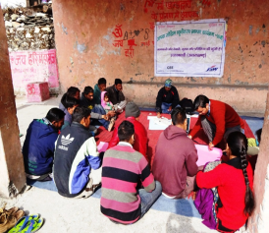
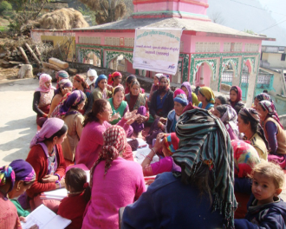
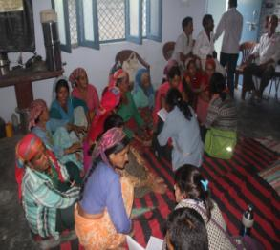
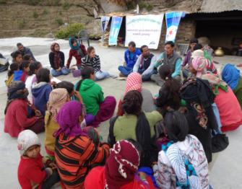
Photographs
Community people preparing Village Contingency Plans
Village Awareness Programmes

Slide 15
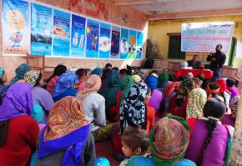
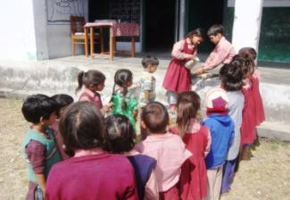
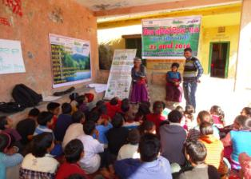
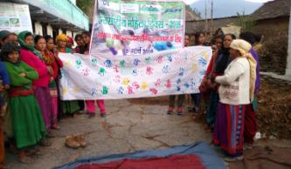
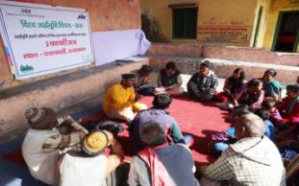
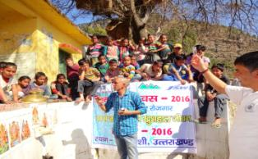
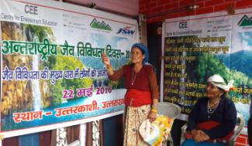
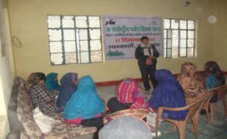
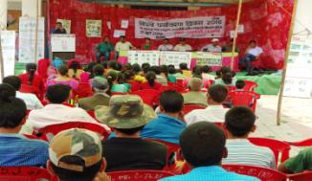
National Science Day
Global Hand washing Day
International Day of Forests
International Women’s Day
World Wetlands Day
World Water Day
International Day for Biological Diversity
International Mountain Day
World Environment Day

Slide 16

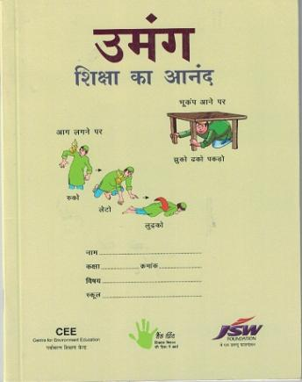
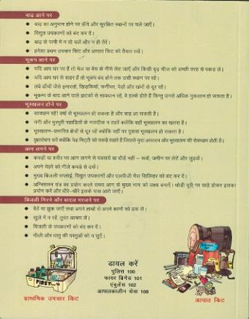
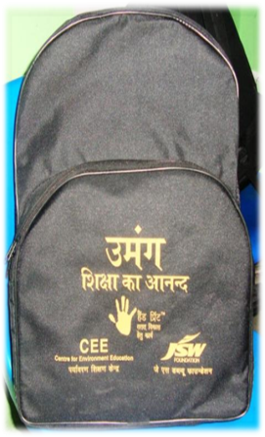
School bag kit containing a bag, English Notebook, Hindi Note Book,
Math Note Book, Pencil Set (10 Pencil, 1 Sharpener & 1 Eraser)

Slide 17
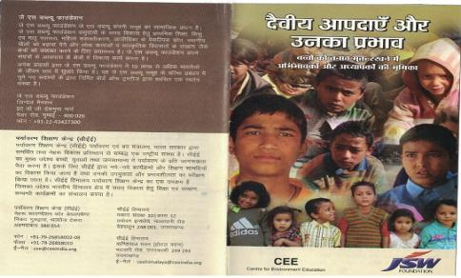
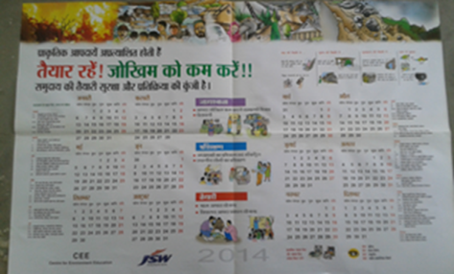
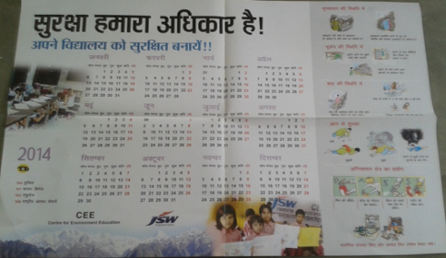
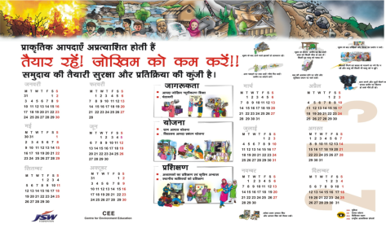
Psychosocial Brochure
Community year planner, 2014
Year planner for school, 2014
Community year planner, 2013

Slide 18
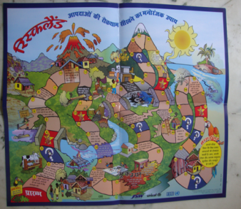
Risk land Kit

Slide 19
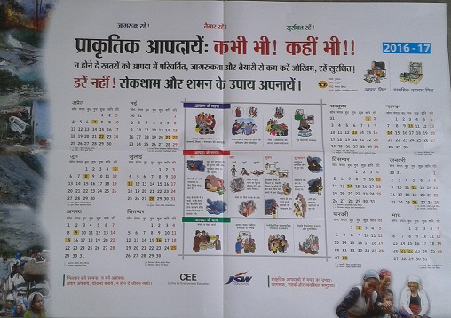
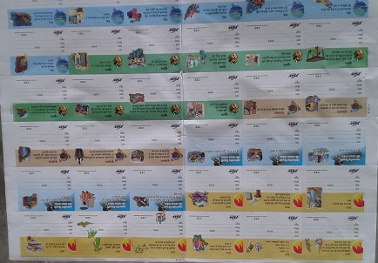
IEC material developed & distributed
Year Planner for school & community
2016-17
Book labels

Slide 20
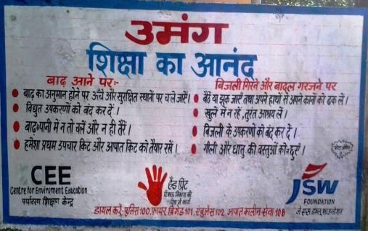
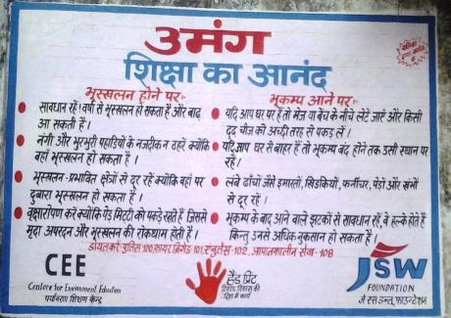
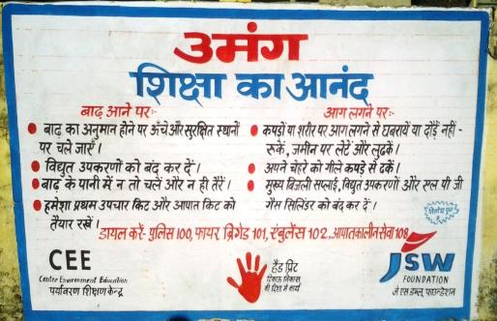
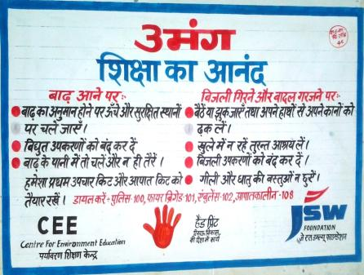
Wall Writings

Slide 21
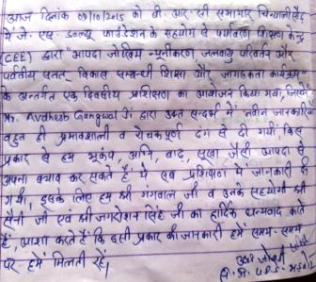
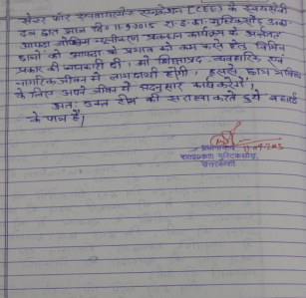



FEEDBACK

Slide 22






Media coverage

