Slide 1
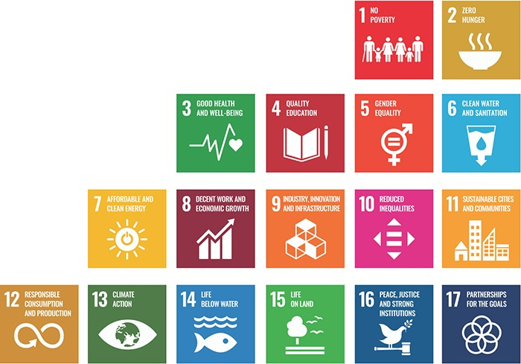
Welcome back to our Faculty Learning Community: Teaching with the
UN Sustainable Development Goals!

Slide 2
FLC Objectives
Through our participation in this FLC we will:
Expand our shared understanding of Education for Sustainable Development (ESD) and the UN Sustainable Development Goals (SDGs).
Build a shared “library” of Education for Sustainable Development resources.
Build community with and learn from colleagues also engaged with the UN SDGs.
Advance a personal objective (be it unit/course/program/university level or professional development).

Slide 3
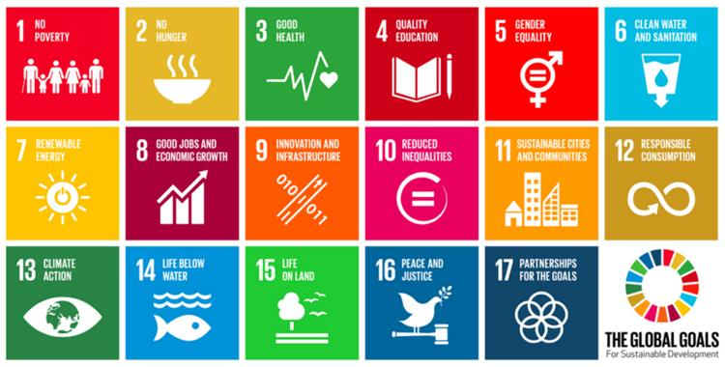
ESD and Student Learning Objectives (SLOs):
What do we want students to be able to do as a result of our unit/course/program (short and long-term)?
How do we go about integrating existing and SDG-oriented SLOs?

Slide 4
SMART SLOs
Specific and Student-Centered
Measurable
Action-Oriented & Achievable
Results-Based
Time-Bound

Slide 5
Are these SLOs SMART?
By the end of the lesson, students will be exposed to these topics:
Bonding in materials, the crystal structure of metals and ceramics, and defects in materials.
By the end of the course, students will:
Critically evaluate public messaging about climate change and design a media campaign grounded in climate science and evidence-based public communications techniques.
Students will understand how they can apply their disciplinary skills to advance climate solutions, including advanced solar technologies.

Slide 6

What are “portable” SLOs and how are they related to SDG integration?
Course level SLOs
Portable SLOs
High-level SDG SLOs
Higher-order thinking and skills you want students to develop by the end of your course
Higher-order thinking and skills you want students to take with them to the next class, into their careers, and onto a lifetime of learning.
Higher-order thinking and skills that help students connect disciplinary knowledge/skills to complex societal challenges and solutions.
EXAMPLE: Describe and provide examples of how laws and regulatory policy can foster or hinder emerging technologies.*
EXAMPLE: Predict the likely effects of proposed laws and regulatory policy on the dissemination and impact of emerging technologies.
EXAMPLE: Evaluate alternative energy regulatory policies with respect to their impact on the expansion of renewable energy and climate vulnerability in the U.S.
*From Eric Overby’s “Analysis of Emerging Technologies” course

Slide 7









For reference:
What characteristics of ESD will we prioritize?
BROAD
ENGAGING
COMPLEX
ALIGNED
CULTURALLY AFFIRMING
TRANSDISCIPLINARY
INCLUDES VALUES & ETHICS
EMPOWERING
TRANSFORMATIVE

Slide 8
Options: SDG SLO integration can be at lesson, unit, and/or course levels
Possible integration with an SDG SLO:
Identify opportunities to reduce energy and water use and the creation of toxic byproducts in _________ industry. (SDG 9)
Course SLO: Design experiments using statistical methods, for the purpose of building models and designing chemical processes*
Course SLO: Formulate and solve process design problems, based on economic analysis and using mathematical models of chemical processes*
Unit SLO: Identify and effectively employ appropriate statistical tools for a variety of experiments.
Unit SLO: Apply appropriate economic analysis tools to evaluate…
Unit SLO: Evaluate alternative solution methodologies with respect to energy, waste, and health impacts. (SDGs 3,6,7,9)
*Course SLOs from Yoshiaki Kawajiri’s “Numerical Methods in Chemical Engineering”

Slide 9
Options: Consider different kinds of SLOs
Cognitive/intellectual:
The learner can explain historical reasons for current settlement patterns.*
The learner appropriately applies basic principles of sustainable planning and building in their designs.**
Socio-Emotional/dispositional:
The learner can articulate ways in which their natural, social, and technical environment has shaped their own identity.*
Students will value scientific expertise in decision making and demonstrate this by using evidence appropriately.**
Behavioral/practical:
The learner is able to plan, implement, and evaluate community-based projects in collaboration with others.*
Students will implement effective search strategies and evaluate sources of information for relevance and authority.**
*Adapted from SDG 11 Learning Objectives (p. 32) in Education for SDGs Learning Objectives (UNESCO 2017)
**Adapted from Learning That Matters, Ch. 4

Slide 10

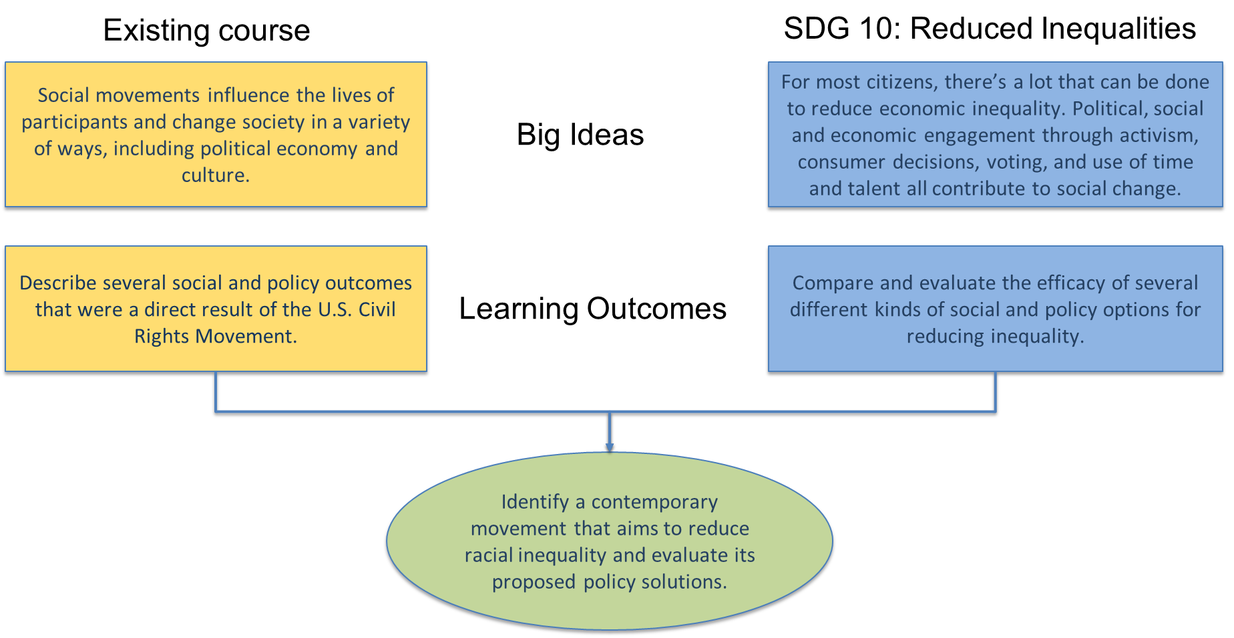
Options: Adding or Integrating SDG SLOs?
Add this as another course SLO?
Or, integrate original and SDG SLOs?

Slide 11
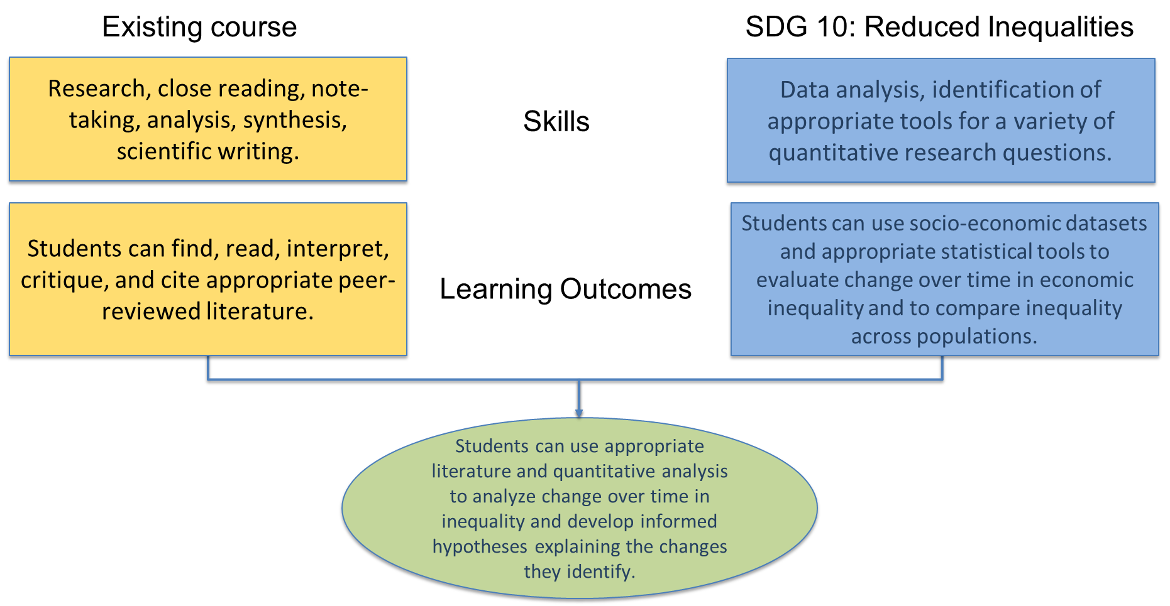
Options: Adding or Integrating SDG SLOs?
Add this as another course SLO?
Or, integrate original and SDG SLOs?

Slide 12

Chat storm prompt
For my course or program, I think it will work best to incorporate SDGs into SLOs at the lesson/unit/course/program level
and prioritize
cognitive/socio-emotional/behavioral SLOs
(specify your tentative choices).

Slide 13

Resource Walk-Through (see today’s folder)
These reports have detailed information about the SDGs including SLOs (not all are SMART—consider them as starting points or idea generators):
  Sustainable Foundations: A Guide for Teaching the SDGs
  Education for the SDGs_Learning Objectives
These worksheets can support your planning, from thinking through big ideas and skills to integrating an SDG SLO with an existing course SLO:
  Resources for Teaching with the SDGs
  Framework for Planning SDG Course Integration
  SDG Worksheet
  SLO Integration Template

Slide 14
Try it Out!
Are you working on re-designing a course or unit?
  You may find it helpful to use this worksheet and this template.
Are you working on SDG integration across multiple courses (or an entire school or college)?
  You may find it help to refer to examples of portable SLOs LTM p.68) and then think through big ideas and key skills or competencies for your field.
For all-- once you have a draft, ask:
  Is your SLO student-centered and specific?
  Is it measurable?
  If course or program-level, is it higher-order or portable?
Post your work here.

Slide 15
Thanks!
Next meeting is October 11

Slide 16
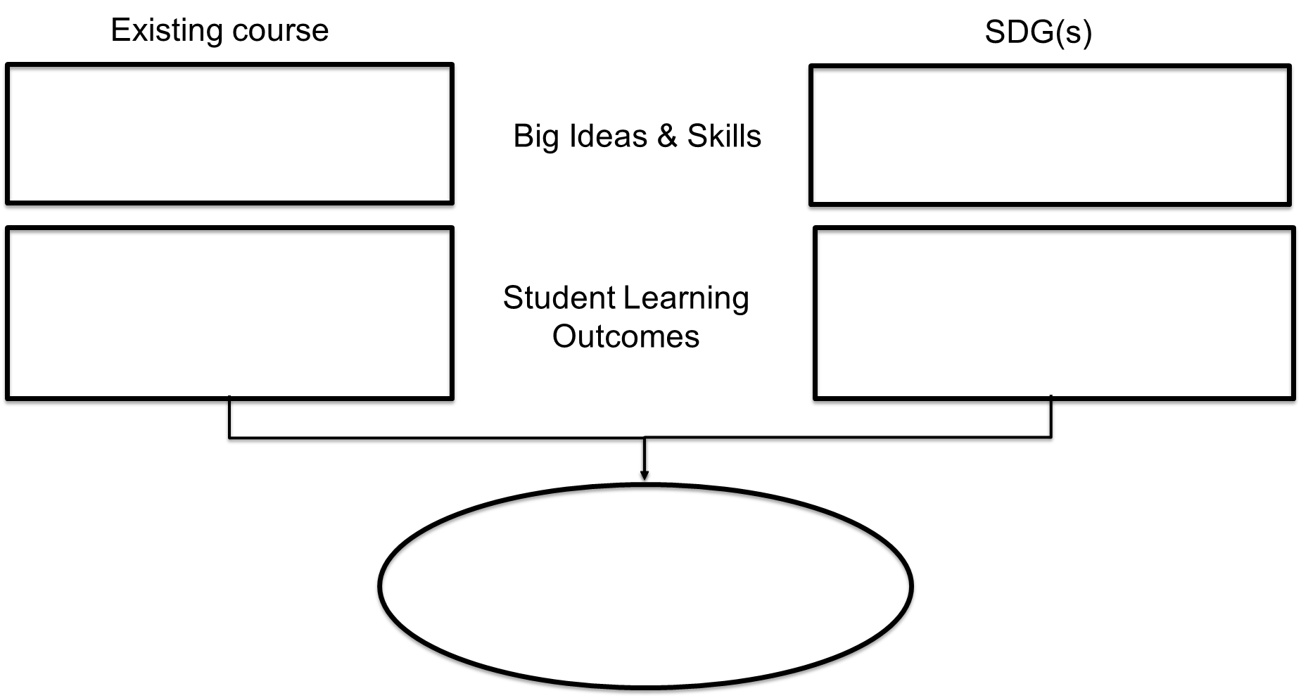
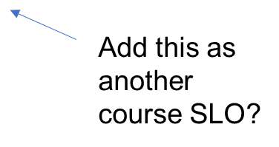
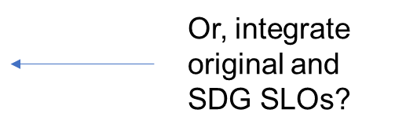
Adding & Integrating SDG SLOs

