Slide 1
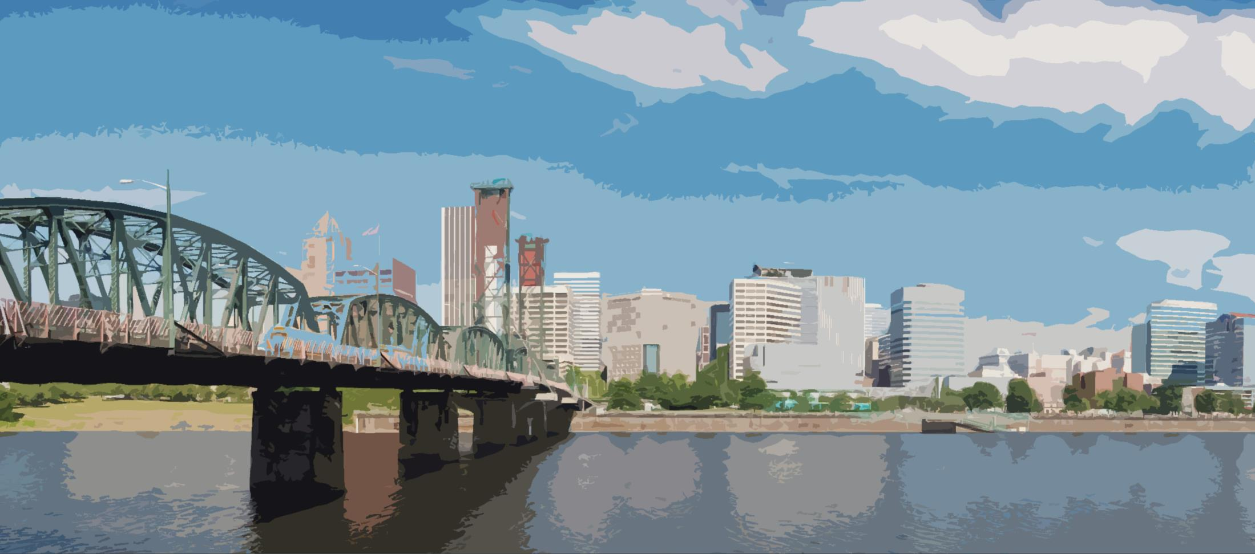
Funding Development Project
Greater Portland Sustainability Education Network
June 10, 2015
Authors Mariah Dula (PM) and Kevin Gerhard

Slide 2

Background
History
The Greater Portland Sustainability
Education Network (GPSEN) creates
connections between partners to provide
formal, nonformal, and informal educational opportunities and achieve sustainability goals in the Portland region.
As a regional network with international connections and United Nations Regional Center of Expertise (RCE) status GPSEN serves a vital role to coordinate efforts and leverage resources across sectors to reach a broader audience through research, training, and outreach.

Slide 3
Background II
Need
GSPEN is nearing the end of initial funding and while the network has grown rapidly, financial support for operations and staffing has not kept pace. To achieve financial stability and growth goals GPSEN must establish sustainable funding.
Potential
As a network organization GPSEN builds capacity in the education community and brings together diverse partners to achieve sustainability goals of regional importance. This entrepreneurial network has garnered regional, national, and international interest from universities, regional governments, non-profits, and major forward-thinking technology companies.

Slide 4
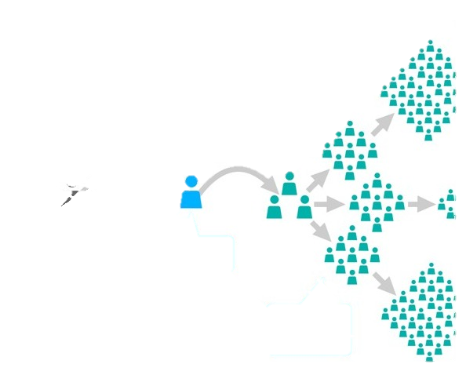
Project Selection
We See Potential
Our interest in this project:
Impact: education has a multiplier effect
Mission: supporting the success of a local,
socially-minded organization
Profile: GPSEN is a part of a high-profile United Nations University network and has the potential to be a model program
Skill Development: fundraising skills are desirable

Slide 5

SCOPE
The team will work with GPSEN stakeholders to establish funding priorities and research practices of similar sustainability, education or network organizations to identify appropriate funding model(s) and opportunities for support. GPSEN may continue with the project to implement development activaties to support operations and key initiatives.

Slide 6

Project Goals
  Identify resource needs
  Identify funding priorities
  Create a staffing strategy utilizing volunteer assets
  Develop a partner fee structure that meets revenue and partnership expectations
  Identify grant opportunities
  Research network funding models
  Secure funding to support operations and grow GPSEN regional network

Slide 7
Deliverables
Deliverable | Due | Acceptance Criteria
1. Fundraising Priorities | Apr 20 | Draft list of needs tied to org. objectives
2. Staff Support | Apr 27 May 1 Mtg | Discussion of support for fundraising
3. Partner Fee Draft | May 1 | Aligns with GPSEN goals
4. Regional Matrix | May 11 Jun 11 Mtg | Summarizes regional govt. ESD linked initiatives
5. Funding Opportunities | Jun 4 | List of grants linked to GPSEN objectives
6. Coordinating Committee Presentation | Jun 11 | Presentation with summary of research

Slide 8

Stakeholders
Stakeholders
Role
GPSEN Coordinating Committee Kim Smith, Coordinator | Friendraiser-in-Chief
Lin Harmon-Walker | Governance Lead
Laura Kutner | Development Lead
Briar Schoon, Grace Taylor, Jacob Morton, Gary Obermeyer, others | Bridge to key partners.
Sandra Fowler-Hill | Campus President PCC, supporter.
Institutional Partners: Metro, Portland Community College, Portland State University, Lewis and Clark College | Institutional backers. Potential partners on grants. Benefit from projects.
Organizational Partners: such as Intertwine, Coalition for a Livable Future | Program-based partnerships. Benefit from network. Potential partners on grants.

Slide 9
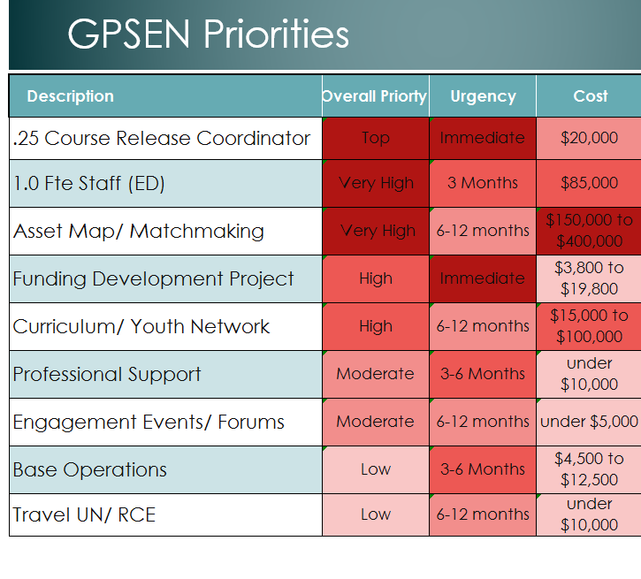
Funding Priorities Next 12 Months

Slide 10

Top Priorities
Asset Map/ Matchmaking
Support for the Director &
Operations
+ Other network orgs have been successful in funding
+ & - Demonstrates need, delays growth
-Immediate need
Base $115,000 per year goal $350,000
Central to GPSEN objectives
+ Innovative
+ Community need, business interest
Resource intense, new
Goal $400,000 over three years scalable
Youth Network/ Curriculum
+ Multiplier Effect, Proven Model
+ Inclusive focus aligns w/civic priorities
Typically institutionally based
Limited support for overhead
Base $45,000 ($15,000 secured) scalable
Funding Development
+ Necessary, to reach other goals
- Resources (volunteer time) not available for other projects
Base $3,800

Slide 11

Business Environment
- The bar for innovation in this field is high.
+ Partnership opportunities abound.
Portland-Based Sustainability Non-Profits
Date Founded
Eco Trust 1991 (environment, economy,)
Northwest Earth Institute 1993 (community education)
Coalition for a Livable Future 1994 (policy, planning, housing)
Sustainable Northwest 1997 (environment, economy)
Eco Districts 2009 (policy, planning, economy)
Intertwine Coalition 2010 (conservation, policy)
Center for Diversity and the 2010 (social equity)
Environment

Slide 12
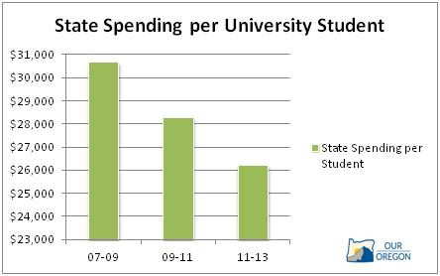
Business Environment II
All major universities in Oregon have academic sustainability programs or college-wide initiatives
However, likely Higher Education partners reeling from reduced support and rising costs in recent years.
…wait there’s good news too

Slide 13
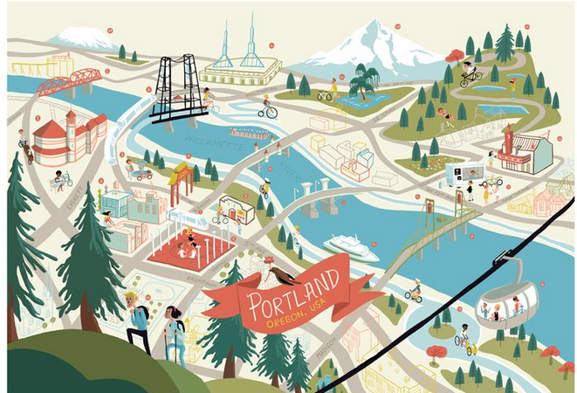
Opportunities
City/ Regional planning processes = opportunities
GPSEN can help government agencies meet sustainability goals through education programs and network services.
Plans in development:
City of Hillsboro
City of Portland
City Plans with ESD Related Initiatives
City of Beaverton (2014) environment, education
Metro (2010) economy, environment
City of Gresham (2015)
equity, economy
Clark County (2010) sustainable communities

Slide 14

Regional Grantmakers
The Gray Family Foundation
  Awards $3,000 – 75,000
  Interest: stewardship education, Oregon focused,
  community capacity building, social justice
  Projects: Curriculum, informal and non-formal education
Murdock Charitable Trust
Awards $100,000 to $500,000
Interest: Environment, education formal & informal, quality of life in NW communities
Projects: general program support, capacity building, youth
Bullitt Foundation
Awards $25,000 to $80,000
Interest: NW only. Education, leadership, youth
Projects: general program support, Youth Network

Slide 15
Suggested Grantmakers
The Surdna Foundation
Awards between $25,000 and $600,000
  Interest: Education, Sustainability, Capacity Building
  Projects: whole organization start-up funding (Eco Districts)
Park Foundation
Awards between
Interest: Education, STEM, environmental leadership, youth
  Projects: Education partnership, Curriculum, Youth Network
Kresge Foundation
Awards between:
Interest: Emerging / innovative social programs, resilience
  Projects: Formal & informal education, Network, Asset Map

Slide 16

Partner Fees
Purpose: provide a base of support for operations and staff
Goal: $20,000 to 30,000 in year 1
10-20% of operations budget thereafter
Levels:
  Individual $30 ($15 student)
Partners $50 and up
Institutions $2000 to 5000
Key Assumptions:
  Fees are scalable
  Higher sponsorship encouraged
  Partners will not be excluded due to inability to pay
  Partnership exchanges available

Slide 17
Development: What is the ROI?
Description | Effort | Hours/ Cost | Projects/ Operations | Return
Non-Profit & Individual Fees | Targeted communications | 66 hours $240 | O | 30% Yield= $1000-3000
Organizational fees | Meetings, value presentation, face to face ask | 30 hours $2035 | O, P | 50% Yield= $20,000
Foundation Solicitation | Outreach, proposal writing high effort, lower thereafter | 440 hours $9370 | O, P | Unknown Goal $150k in 1 year
Private Sector Solicitation | Outreach and engagement, proposal writing | 60 Hours $4071 | P | Unknown Goal $50k In 1 year

Slide 18
Focus
Building Connections Following Opportunities
Focused Programs Fundraising
Portland Social Venture Partners—consulting and donor matching services for nonprofits. Strong Interest in sustainability, capacity building.
Funders Network for Smart and Livable Communities

Slide 19
Support Models
Model 1: Sponsored
  Government or Institution sponsored. Nearly all RCEs’
  Stable support, impact can be limited by org. culture
  Fit: GPSEN has not found a viable institutional backer.
Model 2: Fee for Service
  Eco Districts, U of O Sustainable City Year
  Typically recipients of large start-up grant
  Must have a viable service to sustain, serve cities, government
Model 3: Patchwork/Project-Based
  Intertwine, Coalition for a Livable Future, Washington Non-Profit Coalition
  Combination charitable and project-based grant support, member fees are common
  Very low overhead, partially volunteer

Slide 20
Project Implementation
Responsibilities
Kim Smith GPSEN Coordinator, Accountable, Responsible (Funding Solicitations)
Coordinating Committee members, Consulting
Briar Schoon and Grace Taylor, (Partner Fees) Responsible
Laura Kutner, Development Cmte., (Grants) Responsible
Lin Harmon-Walker, Responsible (Governance), Consulting
Institutional Partners, Informed
Stakeholder Group active participants, Informed

Slide 21
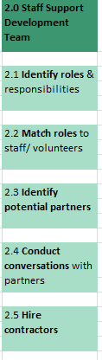
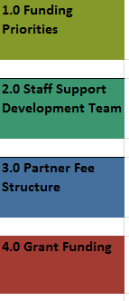
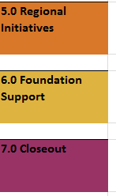
Work Breakdown Structure
Example
Of
Complete
Activity
Break-down
Each of the work breakdown activity is linked to a milestone in the Project Charter.

Slide 22
Planning Schedule
Planning: 8 weeks
1.0 Prioritize needs.
1.1 Determine needs
1.2 Prioritize & order
1.3 Select top 5 & budget
1.5 Tracking and review
2.0 Fund raising team
2.1 Identify Roles & Responsibilities
2.2 Match Roles to Volunteers
2.3 Research & Identify Partners
3.0 Partner fee model
3.1 Research Partner Fee Structure
3.2 Establish Rates
3.3 Communicate Policy
3.4 Collect fees
4.0 & 6.0 grant & foundation opportunities
4.1/6.1 Develop Criteria for Search with GPSEN
4.2/6.2 Research & Screen
4.3/ 6.3 Revise
4.4/6.4 Develop Ranked List
5.0 city Initiative Funding
5.1 Develop Criteria
5.2 Research Opportunities for Projects
5.3 Match to GPSEN Objectives
7.0 Project Close out
7 .1 Draft Project Budget
7.2 Write up Funding Model
7.3 Report and Hand-off

Slide 23
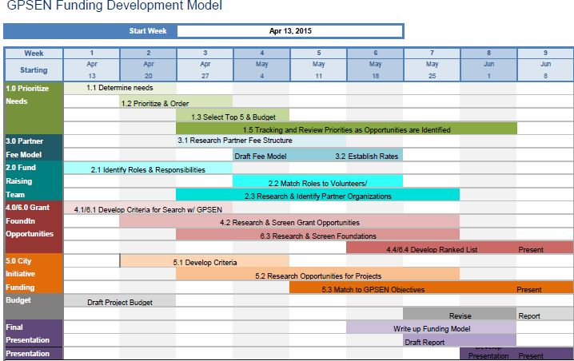
Planning Schedule

Slide 24
Project Schedule: 52 Weeks
Phase 1 Planning (8 weeks)
Phase 2 Engagement (weeks 7-16)
Phase 3 Solicitation
Prioritize Needs
Identify Funders
Set Fees
Identify staff
Fee Collection
Partner Outreach
Prospective Funder Outreach
Grant Writing
Solicitation

Slide 25
Project Budget
Funding Development is a Top Priority
Note: hours include volunteer hours and paid rates vary
Activity |  | Cost | Hours
Design & Planning |  | $ - | 84
Fee Implementation |  | $ 240 | 66
Grant Writing |  | $ 3,600 | 360
Fund Raising |  | $ 8,333 | 168
Administration |  | $ 4,167 | 84
Supplies/Support |  | $ 800 | 8
Travel |  | $ 1,200 | -
Contingency |  | $ 917 | 0
Total |  | $ 19,257 | 790

Slide 26
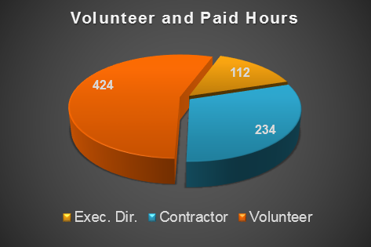
Project Budget
Total budget $19,257
Executive Director $10,000
  Tech Support $440
  Other staff time $7,920
90% Of project costs are staffing
Volunteer & intern support is essential to keeping costs low

Slide 27
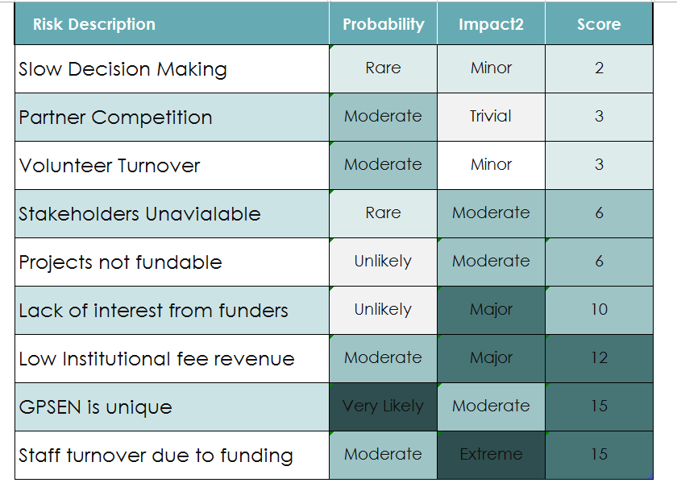
Risks
Risk Analysis

Slide 28
SWOTT Analysis
Strengths Public interest Growing fast Diverse partner network Strong volunteer interest Intl. connections/ UN status Positioned as leader in field Independent non-profit Community values services | Weaknesses Growing too fast for funding Management structure still new Lacks Institutional Sponsor Few precedents for funding model Does not fit traditional grant categories | Opportunities Federal/State grants Charitable funding Partner fees Fee-for-service Private business sponsorship Higher Education partnerships Partnership with other non-profits
Threats Lack of consistent funding Management turnover Volunteer burn-out Competition from other non-profits US/ UN conflict of interest Tax law changes | Trends Hot topic of the time Municipal sustainability planning on rise Govt. agencies have new ESD directives New strategies/ methods in fund raising
SWOTT
JEFF

Slide 29

Recommendations
Strategic Choices
Prioritize Securing Institutional Partner Fees—fees from institutions are a likely source of operating funds while GPSEN pursues sustaining funding. Communicate value to organizations.
Prioritize projects with high visibility and/or high ROI
Utilize the project plan to reduce workload—approving fundraising volunteers to work semi-independently may reduce required meetings and staff workload.
Document & distribute unfunded staff responsibilities temporarily distribute unfunded duties, while funding is secured. Consider stipend for overload duties. Document the scale-back of services as a part of making the case for support.

Slide 30
Recommendations
Development Best Practices
Track contacts with potential funders—sharable format such as google docs (who, date, description)
Implement a Fundraising Agreement—Require staff and volunteers to sign an agreement expectations/ responsibilities.
Idea File—develop variety of project concepts, scalable levels of sponsorship.
Document program metrics—metrics that demonstrate program effectiveness will be useful for funding solicitations
Write-in operations—while tempting to trim costs to create an impressive budget for a funder, including overhead and staffing costs helps sustain the organization.
references Social Venture Partners, Council on Foundations, Foundation Center

Slide 31
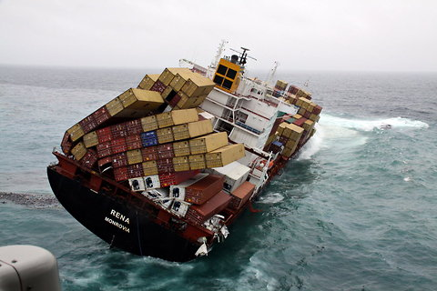
Lessons Learned
While each organization is unique, GPSEN is really unique
Innovative network organizational structure is a new model with promise.
Result: Less certainty than desired. Additional research.
Concurrent Planning and Implementation—
  Organizational agility enabled GPSEN to initiate activities during planning including: staffing & fund development
  Result: a shortened project schedule, updated drafts, altered deliverables.

