Slide 1
Governance and Coordination of RCEs
Abel Barasa Atiti
Research Fellow, UNU-IAS

Slide 2
Governance in RCE Network
Governance in RCE network (networked governance) refers to the coordination of interdependent actors from public, private and local community stakeholders for the purposes of developing and implementing ESD programs.
Networked governance structure is designed to capture decision-making processes, which are decentralised and characterised by fluidity
Trust, mutuality and common identity are critical.
An RCE is expected to produce the maximum possible ESD value, greater than the sum of what each single stakeholder could achieve without collaboration.
Provides integrative, unrestrained and open-ended approaches to addressing environmental issues

Slide 3
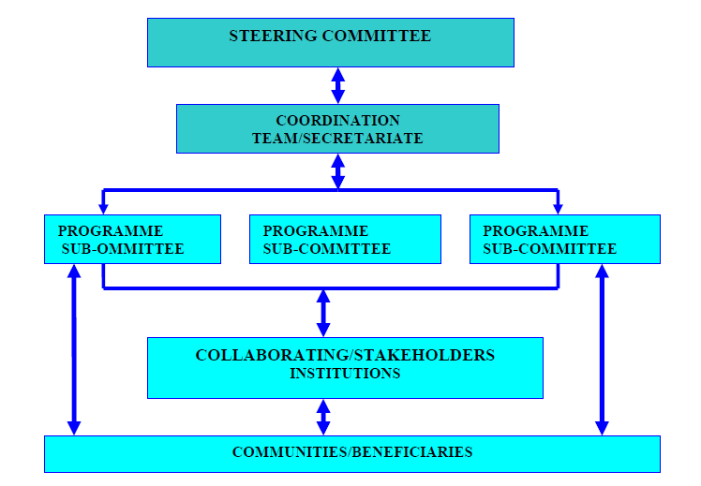
Examples….
Management/Governance
  Steering committee acts as the overall governing and decision making body.
  An RCE management team/secretariat in liaison with programme sub-committees runs day to day activities.
  Each stakeholder appoints a desk officer for RCE activities.

Slide 4
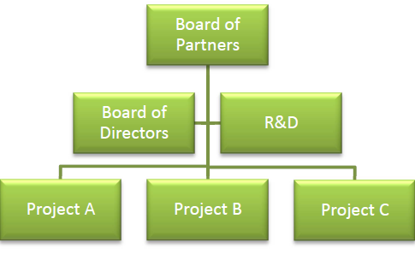
Examples….
  Management/Governance
    An evolutionary governance structure in place, i.e. no legal entity will be constituted.
    Structure consists of a Board of Partners comprising all the key partners.
    Board of Directors made up of a smaller group – one representative from the identified sectors.

Slide 5
Drawing upon Ubuntu Philosophy
“Ubuntu is a concept that brings to the force images of supportiveness, cooperation, and solidarity. It is the basis of a social contract that stems from, but transcends the narrow confines of the nuclear family to be extended kinship network, the community. With diligent cultivation it should be extendable to the [African RCE Network]”. (Khoza, 1994)

Slide 6
Ubuntu philosophy
The core of Ubuntu philosophy lies in ‘Humanness’.
Focus on human engagements and interdependent relations.
‘Umunutu ngumuntu ngabantu’ (Xhosa expression) for: the person is a person through other persons.

Slide 7
Using the collective finger’s theory
The collective finger’s theory – advanced by Mbigi (1997), the ‘founder’ of the Ubuntu philosophy as management practice
A thumb, although it is strong, cannot kill aphids on its own.
It would require the collective cooperation of the other fingers
Fingers must be seen as individuals, who interact in a collective way in order to achieve a certain objective.
Furthermore, the fingers represent the core values that are a necessity in order to create and maintain a collective culture.

Slide 8
Dimensions of Ubuntu
Survival – values of togetherness
Spirit of solidarity – accomplishing difficult tasks together
Compassion – deep caring and understanding of each other
Respect and dignity

Slide 9
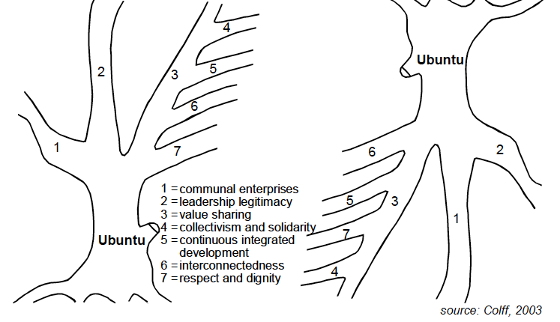
The African tree concept

Slide 10
Sharing of Case Stories
Explain how through the existing governance mechanisms your RCE:
promotes decentralised decision-making processes
enhances trust, mutuality and common identity
generates the maximum possible ESD value, greater than the sum of what each single stakeholder could achieve without collaboration
provides integrative, unrestrained and open-ended approaches to learning

Slide 11
Group Discussions
What governance and coordination challenges face RCEs in their pursuit to implement collaborative ESD activities in their contexts?
Based on your experience what governance and coordination structures are best suited to take advantage of the diverse expertise within an RCE network to address sustainability issues?
What has worked well for your RCE in terms of governance and coordination of ESD activities?

Slide 12
Social Network Analysis
List the core partners of your RCE
How does the cooperation and coordination between the partners work?
How many new partnerships have been created in your RCE since acknowledgement?

Slide 13

Social Network Analysis

