Slide 1




MetESD
Methods for
Education for sustainable development (ESD) competencies and curricula
Friesoythe, Germany 2016
Detlev Lindau-Bank
Lukas Scherak
Margit Stein
RCE Oldenburger Münsterland
Kompetenzzentrum für nachhaltige Bildung Regional Centre of Expertise

Slide 2
Background of MetESD
Employment market changes fundamentally
TVET and students with learning difficulties
TVET schools need USP (unique selling point)
ESD as a framework to face the challenges
Only single projects and activities on ESD in TVET

Slide 3
Guiding lines of MetESD
From single activities to ESD curricula
From project to structure
From teaching to learning
learner learn from learner
Put it from theory to practice

Slide 4
Goals of MetESD
Development of curricula for ESD
  matching every subject and training of TVET
  Appropriate methods and didactical concepts
Further training for teachers
Raising awareness

Slide 5
Further training modules
Systems thinking skills
Design thinking/sustainability entrepreneurship skills
value und needs biography
Play the game – walk the talk

Slide 6
ESD framework
guiding principles
fields of action
related topics
Policy
Democratic negotiation

Slide 7
Framework of ESD competences
Dimensions Competence | Knowledge | skills | attitude
Issue competence | About vocational fields related to ESD | Working with methods and instruments | Global learning Green economy saving environment
Social competence | Communication, teamwork | Solving conflicts Steering dialogues | Open-mindness Empathy Solidarity
Self competence | Personality, emotion behavior | Designing own life- and carreer curriculum | Courage and heart authenticity
Design competence Handlungskompetenz Competence to perform | About process designing structure building | Designing processes and products | Dealing with variety and difference

Slide 8
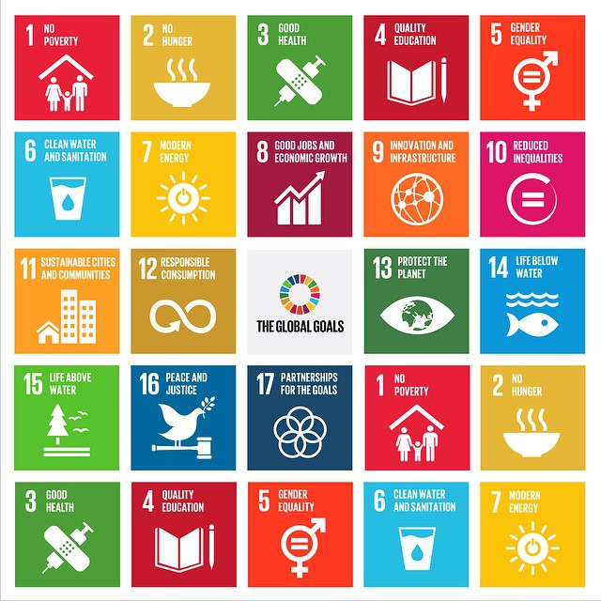
Global goals as
the pratice fields
for MetESD

Slide 9
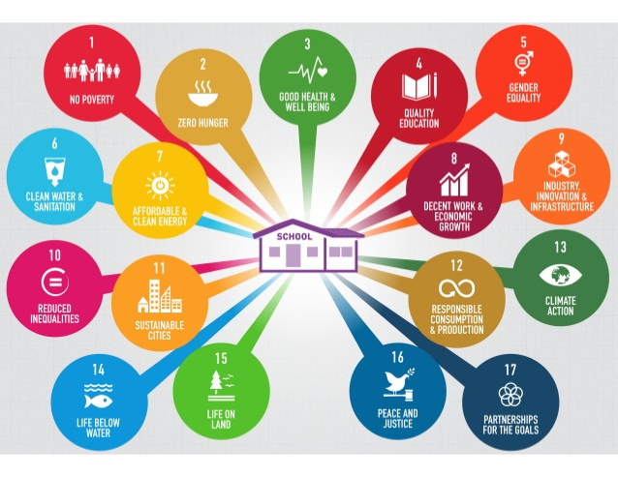
Global goals as the pratice fields for MetESD

Slide 10
WHAT ARE THE
SUSTAINABLE DEVELOPMENT GOALS (SDGs)?
The 17 Sustainable Development Goals (SDGs) and targets are “global” in nature taking into account different national realities, capacities and levels of development and respecting national policies and priorities.
The SDGS call for building peaceful, inclusive and well-governed societies with responsive institutions as the basis for shared prosperity. Fundamentally, they recognize that we cannot reach our development goals without addressing human rights and complex humanitarian issues at the same time.
The SDGs are people-centered and planet-sensitive. They are universal, applying to all countries while recognizing different realities and capabilities. The goals are not independent from each other; they need to be implemented in an integrated manner.

Slide 11
WHAT ARE THE
SUSTAINABLE DEVELOPMENT GOALS (SDGs)?
The SDGs are the result of a three year long transparent, participatory process inclusive of all stakeholders and people’s voices. They represent an unprecedented agreement around sustainable development priorities among 193 Member States. They have received worldwide support from civil society, business, parliamentarians and other actors.
The decision to launch a process to develop a set of SDGs was made by UN Member States at the United Nations Conference on Sustainable Development (Rio+20), held in Rio de Janeiro in June 2012.
The Goals and targets will stimulate action over the next 15 years in areas of critical importance: People, Planet, Prosperity, Peace and Partnership.

Slide 12
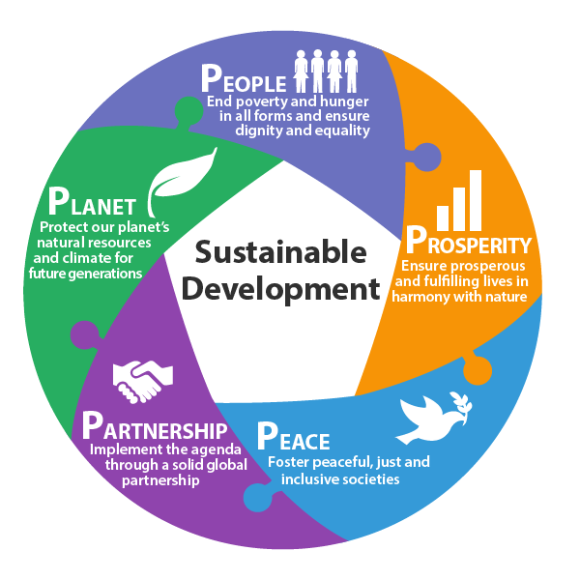
WHAT ARE THE ELEMENTS UNDERPINING THE SUSTAINABLE DEVELOPMENT GOALS (SDGs)?
The Goals will stimulate action over the next 15 years in 5 areas of critical importance:
People,
Planet,
Prosperity,
Peace
Partnership.

Slide 13
The 17 SDGs are …
A set of 17 goals for the world’s future, through 2030
Backed up by a set of 169 detailed Targets
Negotiated over a two-year period at the United Nations
Agreed to by nearly all the world’s nations (193 member states), on 25 Sept 2015

Slide 14
What is new and different about the 17 SDGs?
First, and most important, these Goals apply to every nation … and every sector. Cities, businesses, schools, organizations, all are challenged to act.
Universality

Slide 15
What is new and different about the 17 SDGs?
Second, it is recognized that the Goals are all inter-connected, in a system. We cannot aim to achieve just one Goal. We must achieve them all.
Integration

Slide 16
What is new and different about the 17 SDGs?
And third, it is widely recognized that achieving these Goals involves making very big, fundamental changes in how we live on Earth.
Transformation

Slide 17
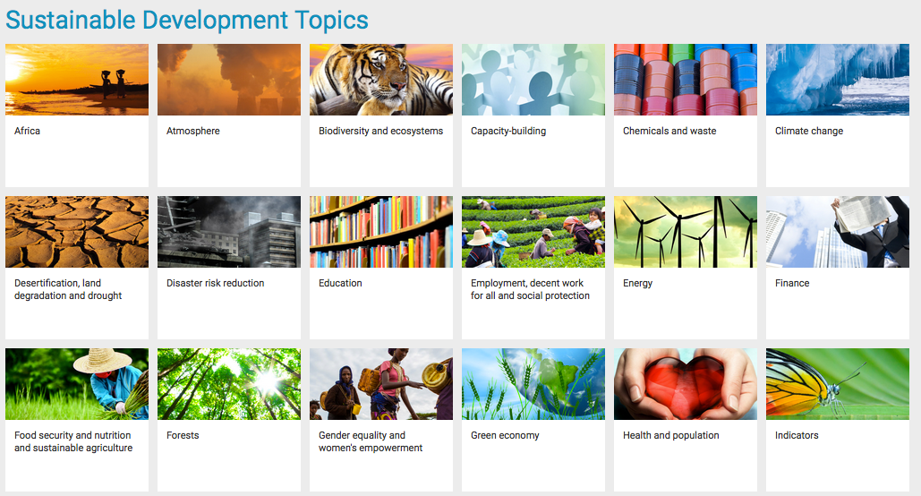
https://sustainabledevelopment.un.org/topics

Slide 18
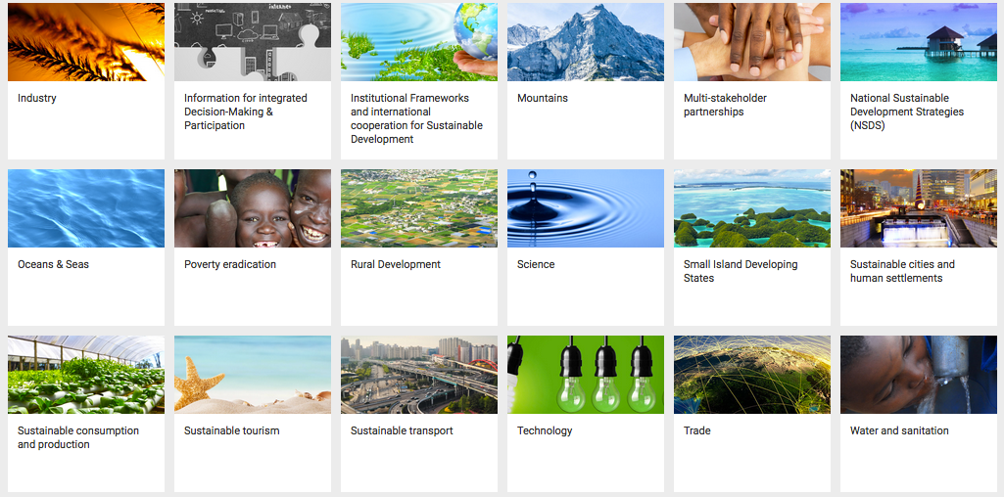
https://sustainabledevelopment.un.org/topics

Slide 19
Fix a plan,don´t stick to it
What to do next three years?
Building a steering group to enhance the curriculum development process
Providing teacher further training during the transnational conferences
Further training for the school management
Evaluating the process from the beginning (Glenn Strachan Ltd.)
Building critical friends-group for self-evaluating and school visits
Bring it into action

Slide 20
General information about ERASMUS+ Project
MetESD
Methods for Education for sustainable development (ESD) competencies and curricula

Slide 21
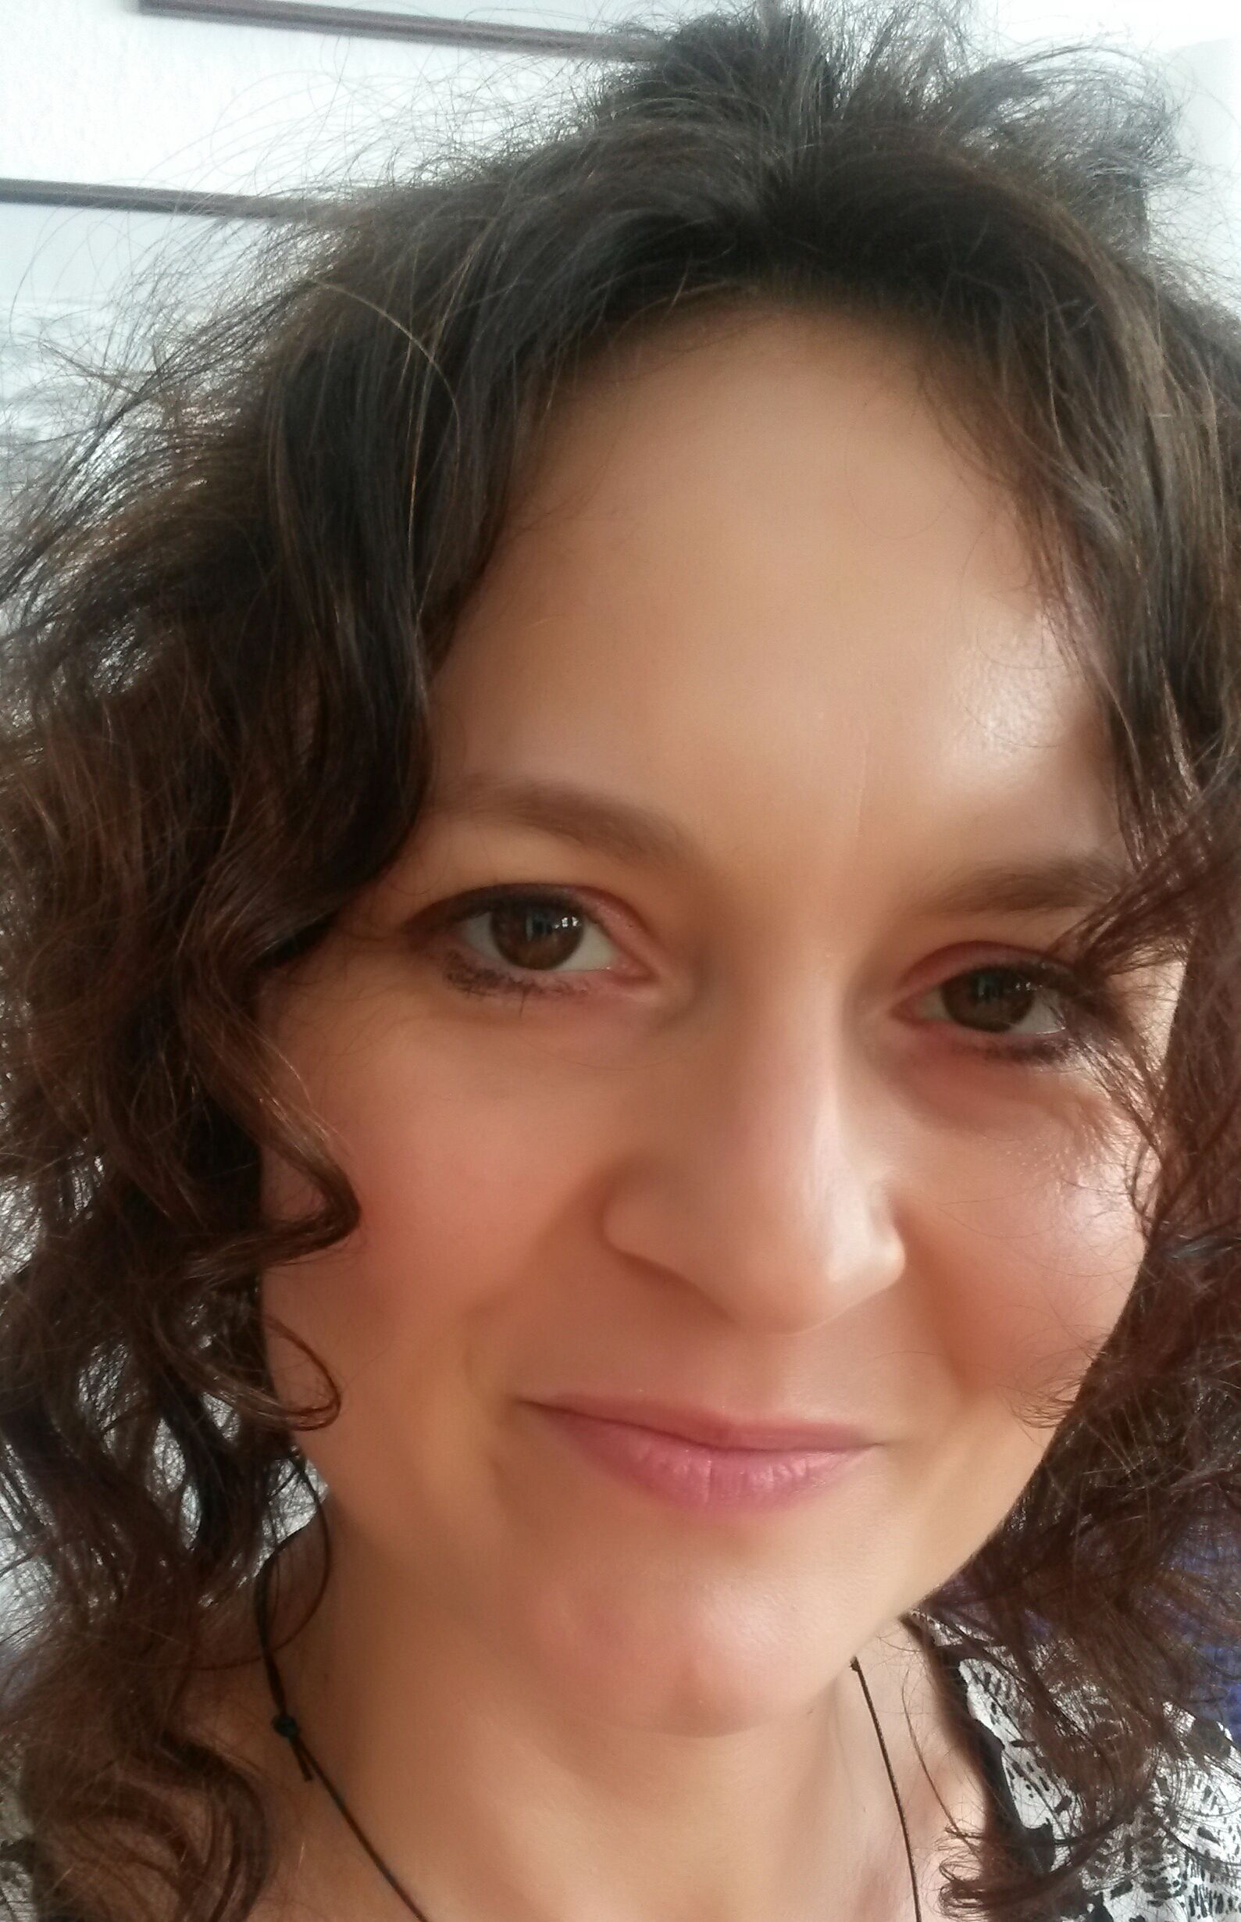
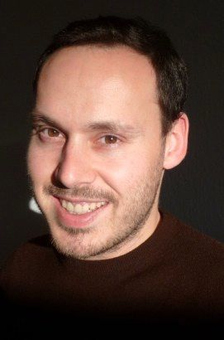
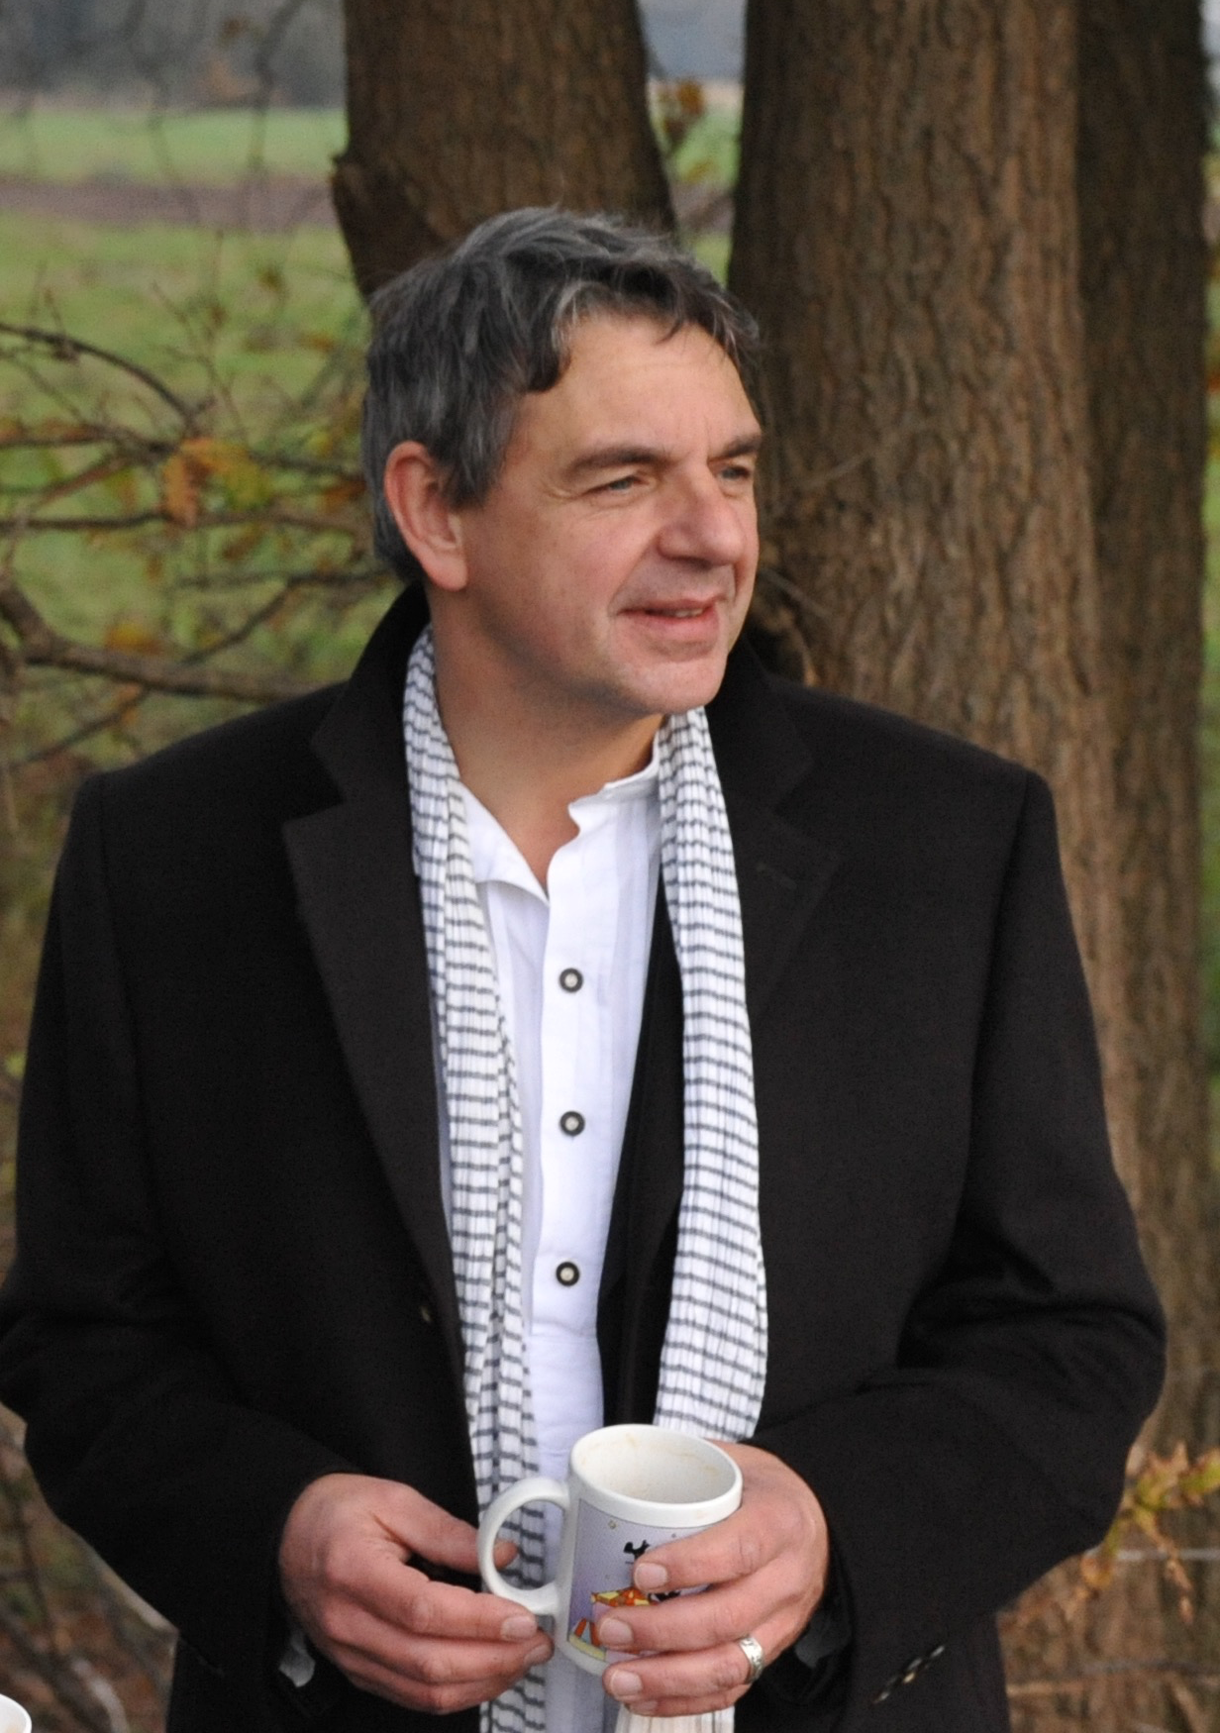
MetESD-Projectmanagement
Prof. Dr. Margit Stein
Lukas Scherak
Detlev Lindau-Bank

Slide 22
ERASMUS+-Projekt: MetESD
Laufzeit: September 2015 – August 2018
Fördersumme: 415.145 €
Projektkoordination: Universität Vechta
Projektpartner
        Berufsbildende Schulen:
        BBS Friesoythe
        Berufsbildende Schule, Kerkrade
        Technische Berufsschule Daugavpils, Lettland
Projektevaluation und –auswertung:
        Universität Daugavpils, Lettland
        Glenn Strachan Ltd, Großbritannien
Curriculumsentwicklung und Fortbildung:
        BEnE München e.V
        RCE Oldenburger Münsterland
        Stichting Expertise Centrum Leren voor Duurzame Ontwikkeling (RCE Rhine-Meuse)
        Kirchlich Pädagogische Hochschule Wien/Krems
        Umweltdachverband GmbH, Österreich

Slide 23
General Information about
RCE Oldenburger Münsterland

Slide 24
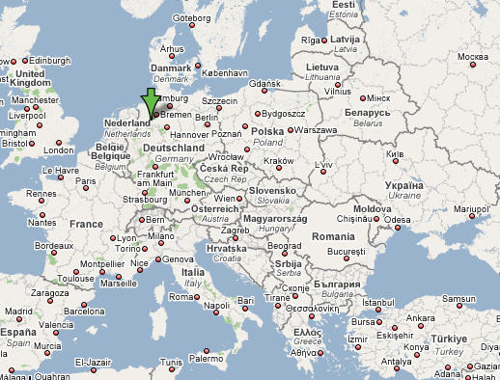
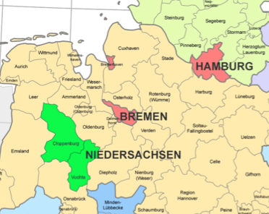
in the centre of North-Western Germany became a boom-region in Lower Saxony in the 1990s. In the last 10 years
the intensive livestock farming has increased by 62%,
the service sector by 63%.
the export quota by 137%.
The main lines of industry are food and luxury foodstuffs with a share of 49% of the industrial turnover, followed by plastic processing with a share of 14%.
These main lines of industry offer “complete solutions” from one region for the world market.

Slide 25
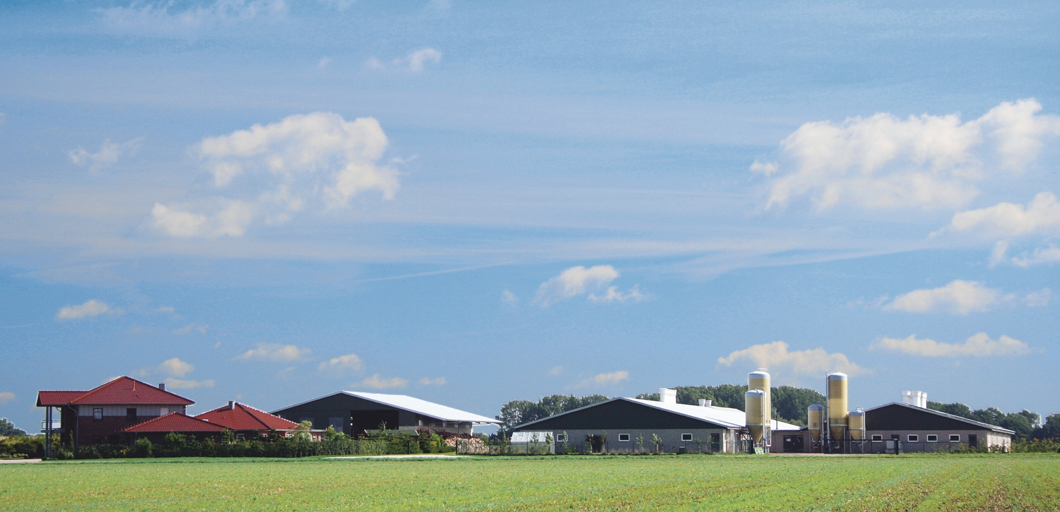
RCE Oldenburger Münsterland
Kompetenzzentrum für nachhaltige Bildung Regional Centre of Expertise
Our Region – Oldenburger Münsterland
(Daten von 2007, aus: Klohn & Voth 2008)

Slide 26
Project partner
Vocational schools
District of Vechta
  Councilor Herbert Winkel
  Youth department
  Economic department
University of Vechta
Companies and enterprises

Slide 27
INTRODUCTION
Over 150 Heads of State & Government are confirmed to attend the UN Sustainable Development Summit in New York from 25-27 September 2015 for the adoption of an ambitious, bold and universal sustainable development agenda that will end poverty and promote prosperity by 2030, while addressing the environment.
The summit outcome document, entitled “Transforming our World: The 2030 Agenda for Sustainable Development,” was agreed on by the 193 Member States of the United Nations, and includes 17 Sustainable Development Goals.
This momentous agenda will serve as the launch pad for action by the international community and by national governments to promote shared prosperity and well-being for all over the next 15 years.
The agenda is unique in that it calls for action by all countries, poor, rich and middle-income. It recognizes that ending poverty must go hand-in-hand with a plan that builds economic growth and addresses a range of social needs.

Slide 28
WHAT ARE THE
SUSTAINABLE DEVELOPMENT GOALS (SDGs)?
The 17 Sustainable Development Goals (SDGs) and targets are “global” in nature taking into account different national realities, capacities and levels of development and respecting national policies and priorities.
The SDGS call for building peaceful, inclusive and well-governed societies with responsive institutions as the basis for shared prosperity. Fundamentally, they recognize that we cannot reach our development goals without addressing human rights and complex humanitarian issues at the same time.
The SDGs are people-centered and planet-sensitive. They are universal, applying to all countries while recognizing different realities and capabilities. The goals are not independent from each other; they need to be implemented in an integrated manner.

Slide 29
WHAT ARE THE
SUSTAINABLE DEVELOPMENT GOALS (SDGs)?
The SDGs are the result of a three year long transparent, participatory process inclusive of all stakeholders and people’s voices. They represent an unprecedented agreement around sustainable development priorities among 193 Member States. They have received worldwide support from civil society, business, parliamentarians and other actors.
The decision to launch a process to develop a set of SDGs was made by UN Member States at the United Nations Conference on Sustainable Development (Rio+20), held in Rio de Janeiro in June 2012.
The Goals and targets will stimulate action over the next 15 years in areas of critical importance: People, Planet, Prosperity, Peace and Partnership.

Slide 30
WHAT ARE THE ELEMENTS UNDERPINING THE SUSTAINABLE DEVELOPMENT GOALS (SDGs)?
The Goals will stimulate action over the next 15 years in 5 areas of critical importance:
People,
Planet,
Prosperity,
Peace
Partnership.

Slide 31
HOW ARE THE SUSTAINABLE DEVELOPMENT GOALS DIFFERENT FROM THE MILLENNIUM DEVELOPMT GOALS?
The 17 Sustainable Development Goals with 169 targets are broader in scope and will go further than the MDGs by addressing the root causes of poverty and the universal need for development that works for all people.
Building on the success and momentum of the MDGs, the new global goals will cover more ground with ambitions to address inequalities, economic growth, decent jobs, cities and human settlements, industrialization, energy, climate change, sustainable consumption and production, peace and justice.
The new goals are universal and apply to all countries, whereas the MDGs were intended for action in developing countries only.
A core feature of the SDGs has been the means of implementation – the mobilization of financial resources – as well as capacity–building and the transfer of environmentally sound technologies.
The new goals recognize that tackling climate change is essential for sustainable development and poverty eradication. SDG 13 aims to promote urgent action to combat climate change and its impacts.

Slide 32
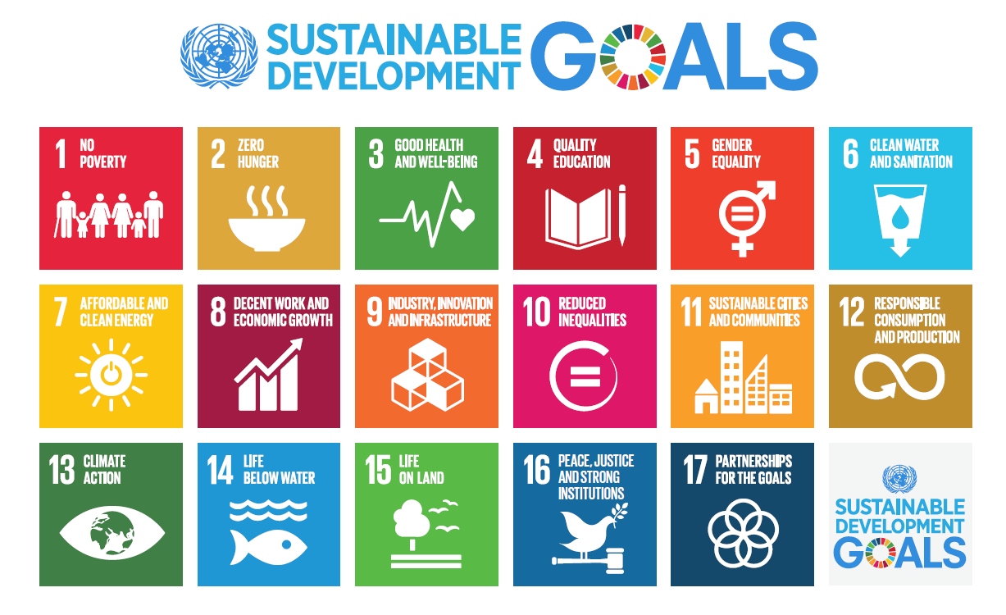
THE 17 SUSTAINABLE DEVELOPMENT GOALS

Slide 33
10 KEY FACTS ABOUT THE SUSTAINABLE DEVELOPMENT GOALS (SDGs)
or “GLOBAL GOALS”
The Global Goals need you - It’s not only up to governments, but it’s up to all of us to take action. Even little things can make a big impact.
The Global Goals will change the way the world does business – They want to transform the world economy so it works without violating workers rights and harming the environment.
The Global Goals are one for all and all for one - No goal is more important than the other and they all complement each other.
The Global Goals will address climate change - Climate change is one of the most pressing issues of our time and it affects every country on every continent.
The Global Goals will eradicate extreme poverty – The predecessors of the Global Goals, the MDGs, have helped cut extreme poverty by half from their establishment in 2000 until today. That is a great achievement but it is not enough! The Global Goals aim to end poverty in all its forms and everywhere by 2030.
The Global Goals will leave no one behind – They are for young and old people, for small and big countries, for people living in rural areas and people in busy cities. They will leave no one behind.
The Global Goals are hands-on - They contain concrete plans on how to change the world, how to pay for it and how to make sure that everybody is on board.
The Global Goals are “Global” – They tackle challenges for all countries across the globe.
The Global Goals are the people’s goals – The goals have been developed by all the 193 UN Member States, NGOs and people like you, all working together.
The Global Goals are the world’s ultimate to-do list for the next 15 years - The 17 goals are for making this planet a better place by 2030 which includes ending extreme poverty, fighting inequality and fixing climate change.

