Slide 1

Oil Recycling Project
Sustainable Education for our Future
St. Catherine Community School

Slide 2
Outline of Presentation
Students will outline reasons why it’s important to have this Project
Student Information
An overview of how the project originated, benefits, and future opportunities
Past, Present, Future
Discussion of positive impact on the community, students, and school
Community Impact
RCE Recognition
Highlighting the importance of RCE Recognition and future impact of this type of program by special guest Mr. Lyle Benko

Slide 3
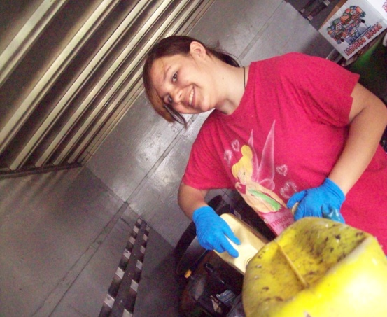
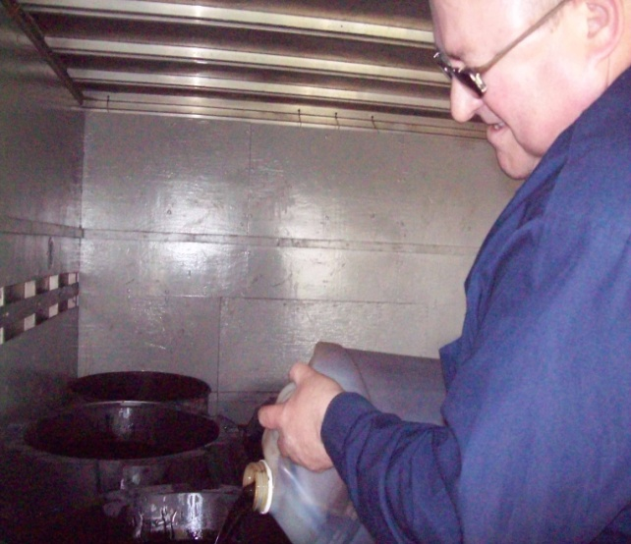
Making a Difference!
Thank you for the opportunity to be here to share our story this evening!
Our local efforts are making a global difference!
For our third consecutive year we will be again operating our Oil Recycling Day at St. Catherine Community School. We the students lead the day by welcoming members of the community by recycling used oil products .

Slide 4

Water Preservation
Did you know? One litre of oil could contaminate up to one million litres of water? We’re very proud of what we’ve accomplished so far
We’re preserving the world’s most precious resource, Fresh Water
We know it’s important for the Environment and Industry

Slide 5

Why is it so important?
Ensure the proper disposal
Save beaches and sand
Protect Wildlife
Welcome the community and be leaders in preserving the environment

Slide 6
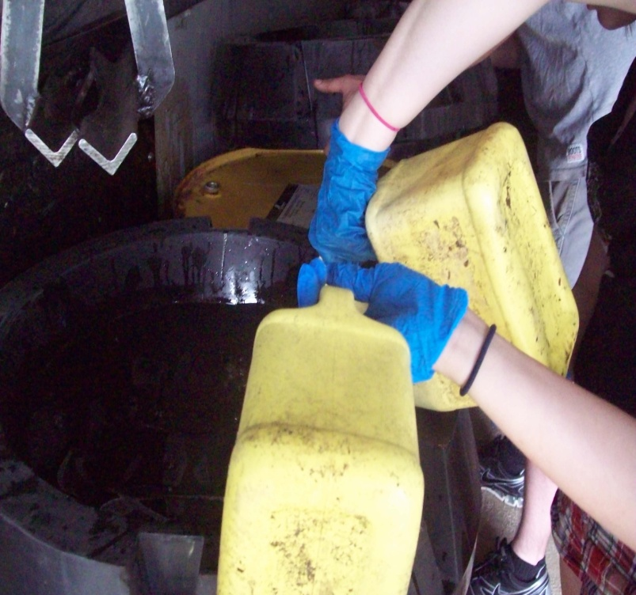
Where have come from?
Where are we going?
We initially wanted to make a program that was easy to be involved in, be rewarding for the students, and easy for the community to get involved in.

Slide 7

Celebrating Success!
 | Oil | Filters | Containers
May 2010 | 100 | 14 | 0
May 2011 | 450 | 45 | 419
May 2012 (goal) | 1000 | 100 | 750
TOTALS | 1550 | 154 | 1169
If we achieve our goal this year we would have prevented the contamination of up to 1,550,000,000 litres of water

Slide 8
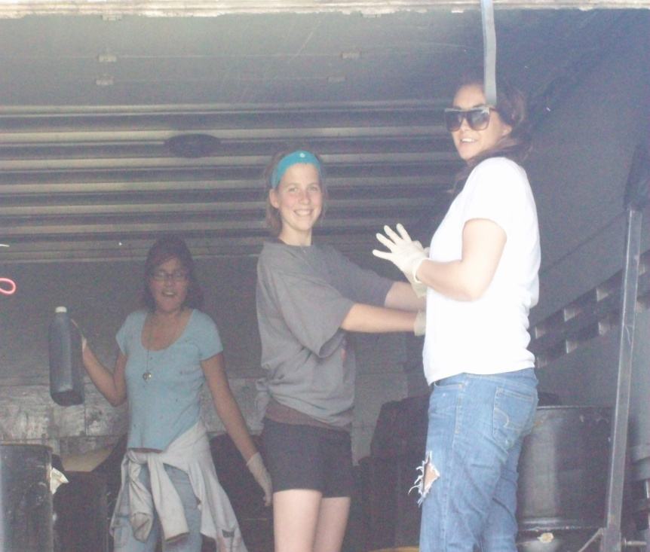
Curricular Connection
This project reaches Outcomes across the Curriculum in Math, Science, ELA, Career Development, Religious Education, and Health Education.
The project shows the power of partnering with our students.
Shows how easy it is to
make a big difference!
Some places talk about
making a difference,
together with our partners,
at St. Catherine we go out
and make a difference!

Slide 9


Partnerships and the Community
SARRC - Saskatchewan Association for Resource Recovery Corp.
Funding for our project has come from RBC’s Blue Water Project. There is opportunity to grow this program to other schools through this initiative as well as other initiatives.
Partnered with one of the members of SARRC
(Re-Solvv) in 2012 we are aligned with the Provincial Oil Recycling Agency.
Receiving recognition for the event is meaningful and reinforces the importance of doing what we do.

Slide 10
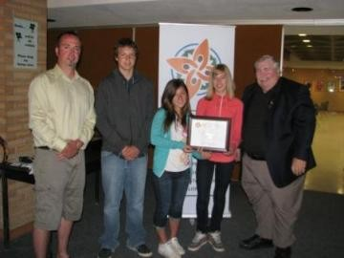

2011 RCE Provincial Recognition Award
Mr. Garinger and three students went to Moose Jaw
to receive this recognition award.

Slide 11
Learning for Sustainable Future (LSF Canada)
Ministry of Saskatchewan approved Resources (R4R)
National Conference: November 15 & 16, 2011 (Toronto)
Importance for the Future
Regina Catholic Schools with Sustainability and Education Academy (SEdA) International Conference
ACTION PLAN: May 1-4, 2011, Elk Ridge
GLOBAL TO LOCAL PERSPECTIVE
United Nations University
RCE Saskatchewan
Local to Global Perspective

Slide 12
Questions? Need More Information?
Presenting Team (In order)
Donnelyn Morrison
Amber Glover
Melissa Lozinski
Mr. Lee Garinger
Mrs. Jackie Peat
Mr. Lyle Benko
St. Catherine Community School
150 Brotherton Avenue
Regina, SK S4N 0J7
Email: l.garinger@rcs.sk.ca

