Slide 1


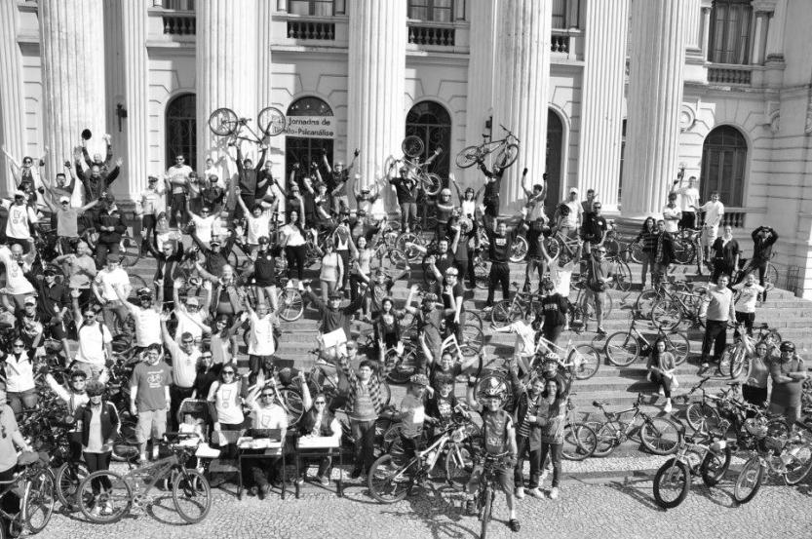


PROGRAM CICLOVIDA PHASE I
Brazil
DEVELOPING SUSTAINABLE MOBILITY CULTURE
Project Coordinator: Mr. José Carlos Belotto
RCE coordinator in the project: Marcelo R. Errera, Ph.D.
RCE support in the project: Eloy Casagrande, Ph.D. (UTFPR)

Slide 2
PROGRAM CICLOVIDA: PHASE I
PROGRAM LIFE-ON-CYCLES: PHASE I

Slide 3
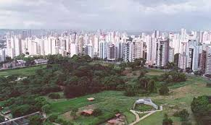
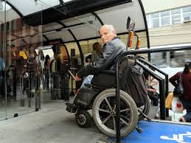
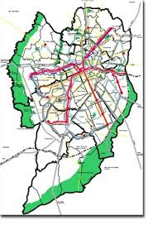
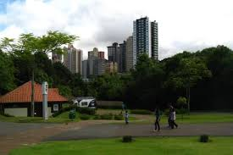
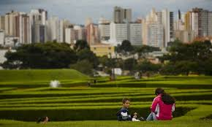
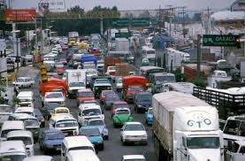
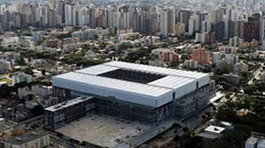
Cu
Curitiba
Notes:
3

Slide 4
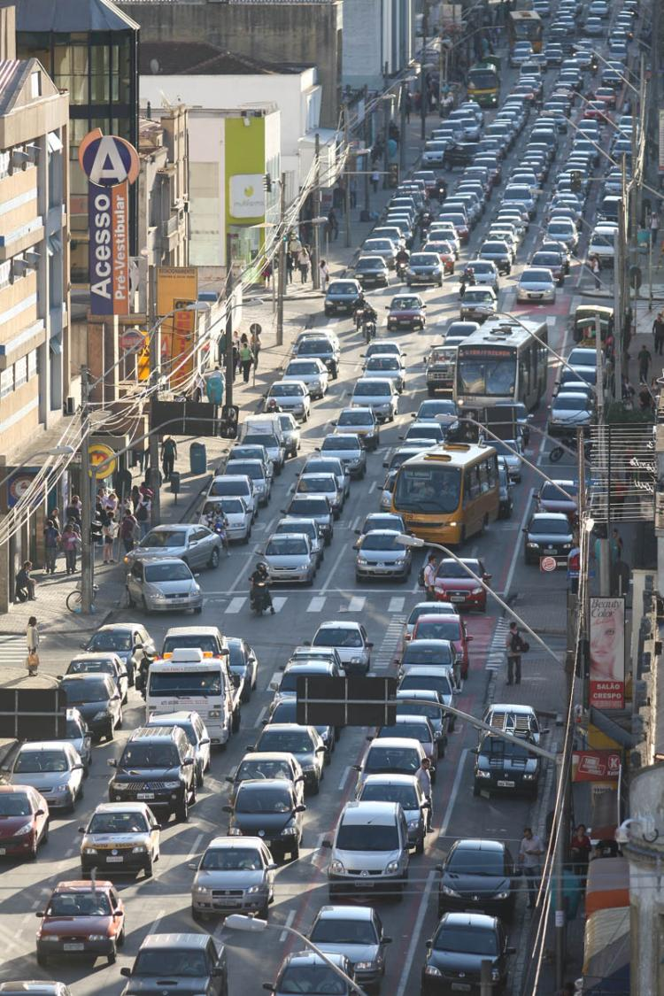
Scenario
Beginning of actions: 2003,
fomalization as an Extension Program: 2008
POLLUTION
TRAFFIC
HEALTH
http://2.bp.blogspot.com/-fVYHw0Fkexo/Tq59oS78LFI/AAAAAAAALb8/5nsh6zLt3rE/s1600/IMG_6860.jpg

Slide 5
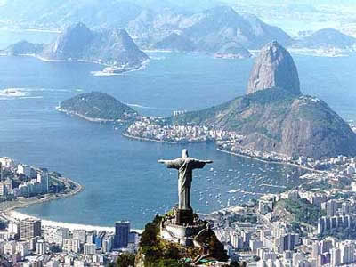
How is Brazilian mobility ?
3% modal bicycle
35% on foot journey
32% public transportation
28% automobiles
Source: ANTP 2010
IS IT POSSIBLE
TO CHANGE?

Slide 6
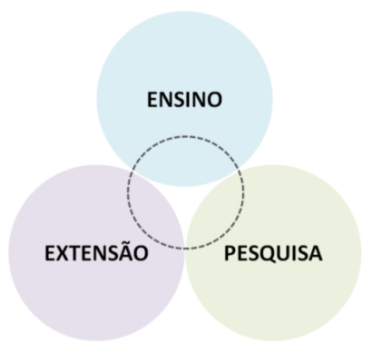
OBJECTIVE:
TRANSFORM UFPR INTO A IRRADIATIOR NUCLEUS OF SUSTAINABLE URBAN MOBILITY CULTURE
emphasis on bicycle usage
target-audience: UFPR community
50,000 people: Students, technical and teaching
staff, outsourced employees.
activities: projects and actions integrated to
academy, research and extension

Slide 7
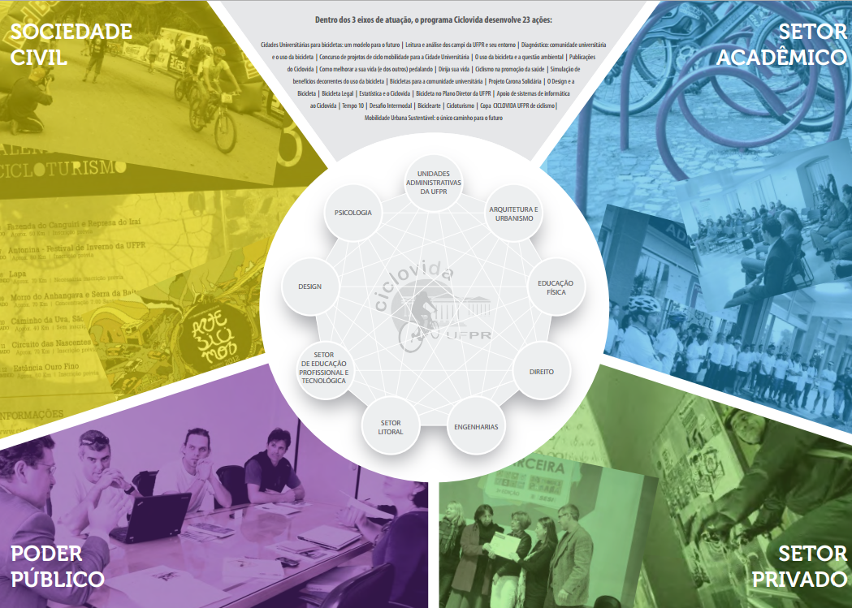
ONG’s
Ciclo Iguaçu
Brazilian Cyclist Union
Public/Private Higher Education Institutions
NEMUS - Interinstitutional study nucleus
UFPR Higher Education Courses
Peatonal Society
Bicicletada
Human Energy Institute
etc.
City Ministery
SETRAN
URBS / IPPUC
FIEP
Public Companies
Workshops
Bike Shops
Agenda 21
Suppliers
PMC
SEMA / SETI

Slide 8
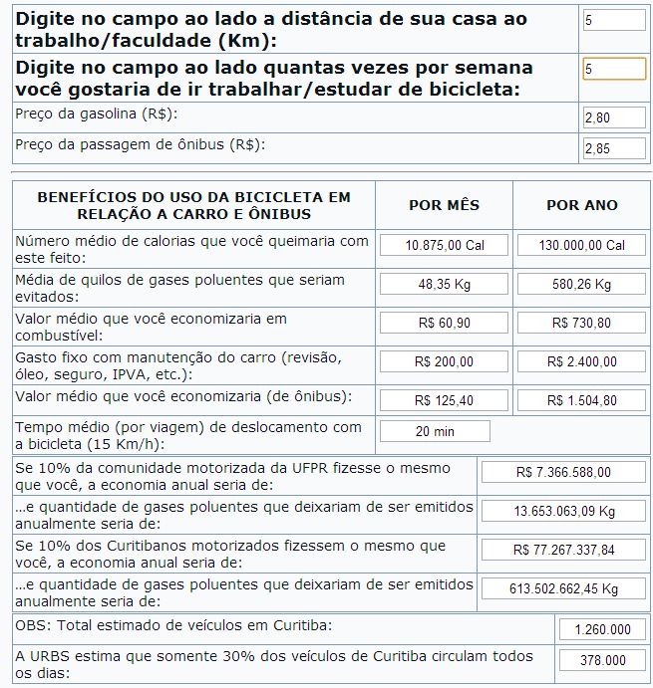
SIMULATOR
www.ciclovida.ufpr.br/?page_id=504r
The “active mobility simulator” calculates the amount of calories one would burn, avoided gaseous pollutants and also savings to commute to work or college by bicycle.
One only needs to type in the distance between your house and work/college and how many times a week one would like to use bicycle as transportation.
DIFUSION/SENSIBILIZATION

Slide 9
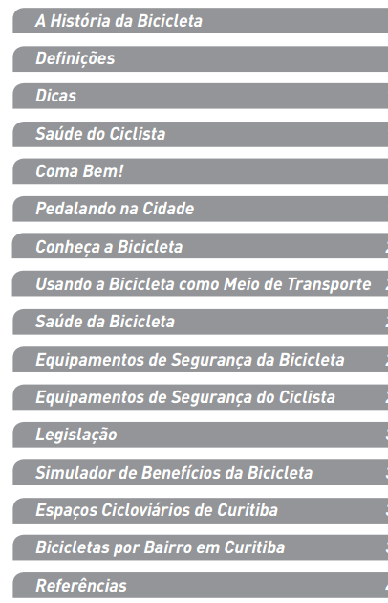
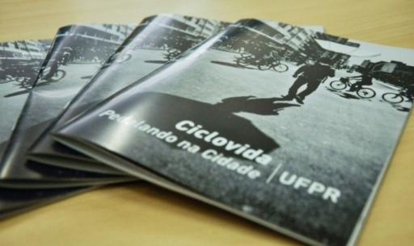
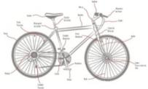
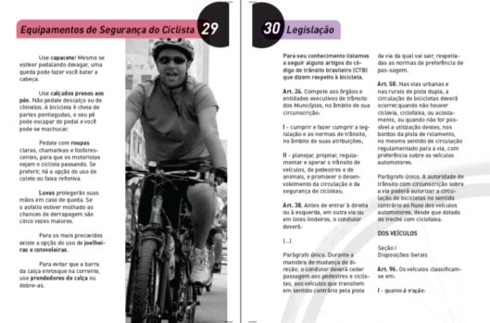
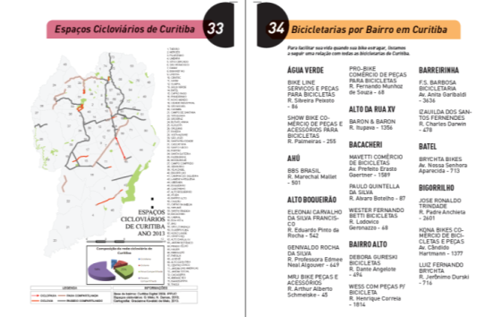
PUBLICATIONS - Guide: Bike-riding in the City
DIFUSION/SENSIBILIZATION

Slide 10
PUBLICATIONS - BOOK: THE CITY IN BALANCE
Theoretical Contributions to the Third World Bicycle Forum
DIFUSION/SENSIBILIZATION

Slide 11
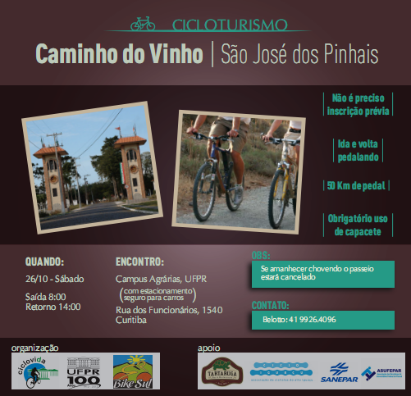
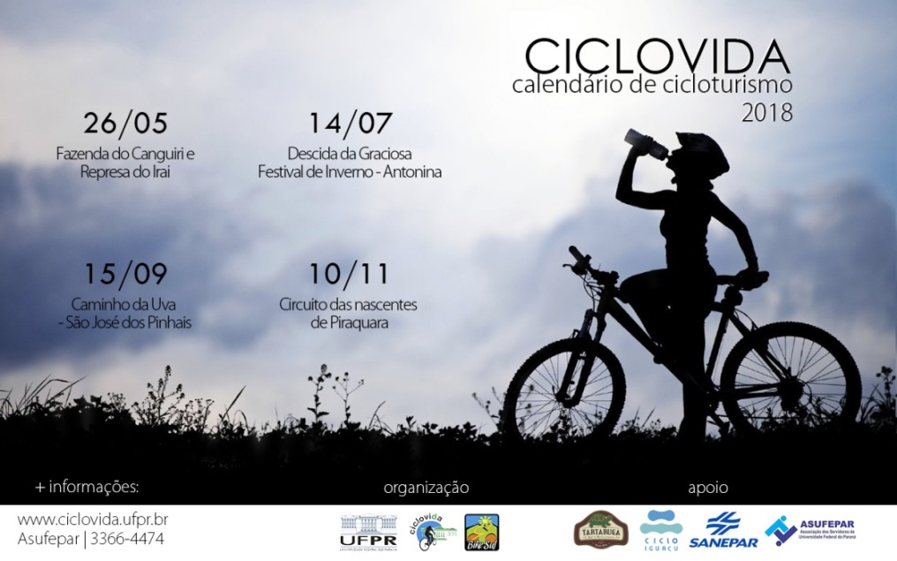
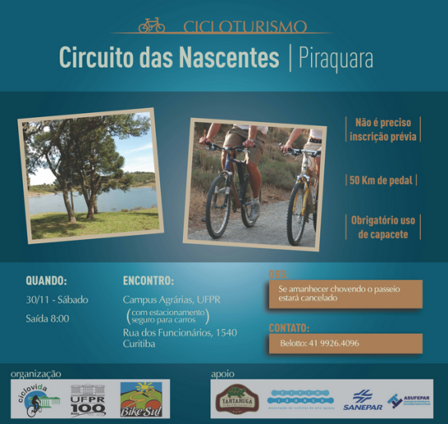
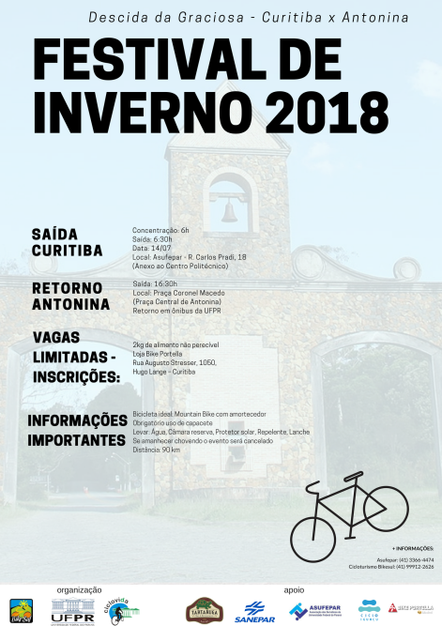
ACTIONS FOR CICLOTOURISM
DIFUSION/SENSIBILIZATION

Slide 12
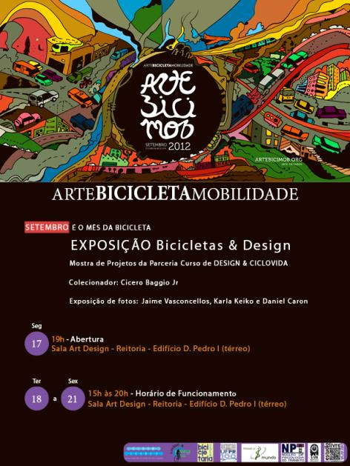
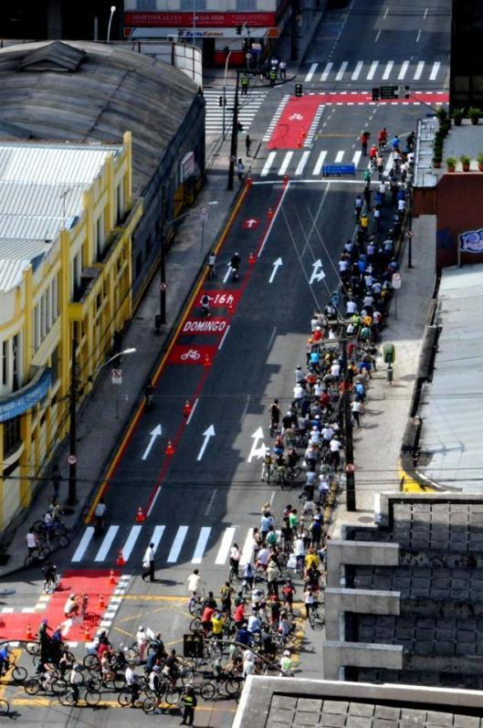
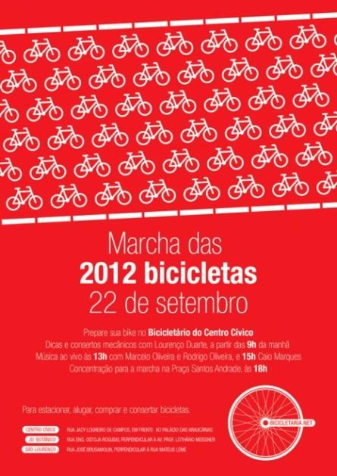

PARTNERSHIP: CICLOACTIVISM INNITIATIVES - EVENTS
Arts, bicycle and mobility
DIFUSION/SENSIBILIZATION
March of Bikes
March of Bikes

Slide 13

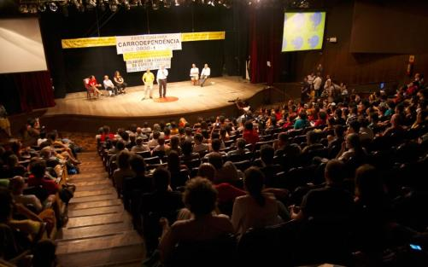
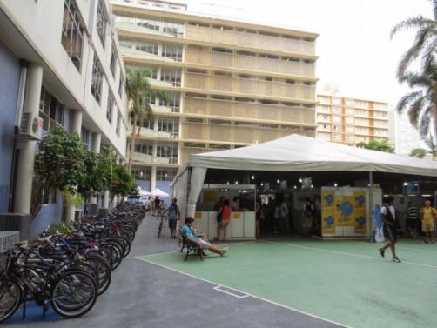
BACKING - BICYCLE WORLD FORUM
DIFUSION/SENSIBILIZATION

Slide 14
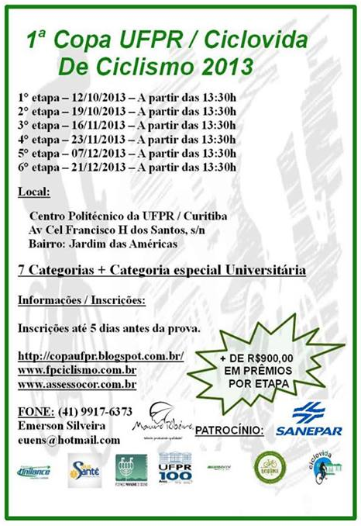


SUPPORT - SPORTING EVENTS
DIFUSION/SENSIBILIZATION

Slide 15
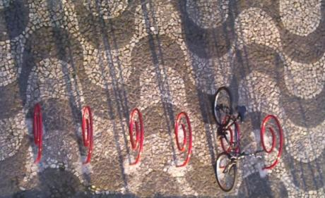
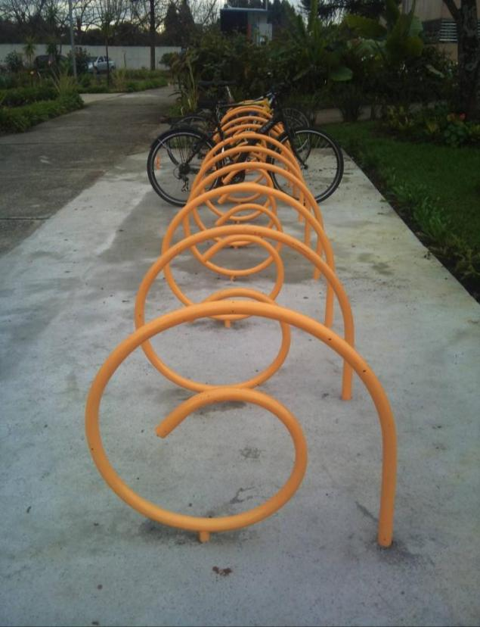

STRUCTURE – BIKE RACKS at UFPR
ACADEMIC PROJECT - DESIGN/UFPR
DIFUSION/SENSIBILIZATION
ANA CAROLINA
Áurea Bike Stop
ENZO MOROSINI
Bike Stop I
Bike Stops UFPR
600 SPOTS FOR BICYCLES
Partnership with supplier
Industrial Property Registration - UFPR

Slide 16
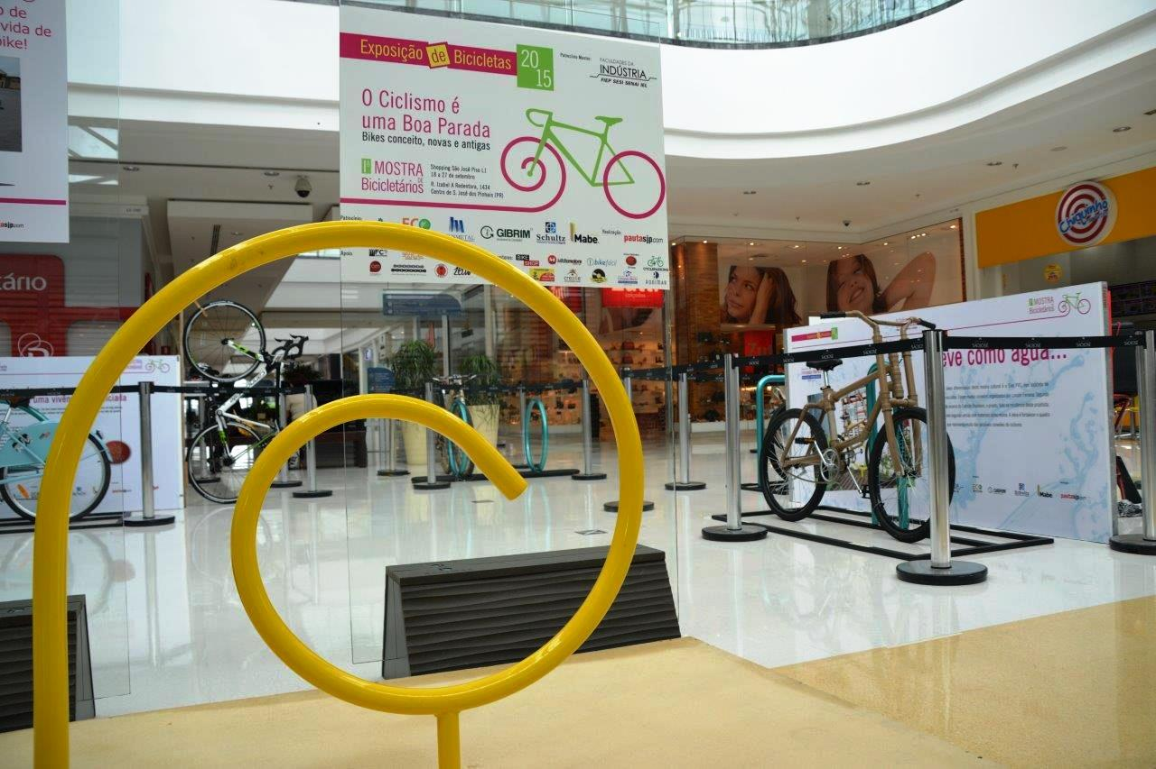
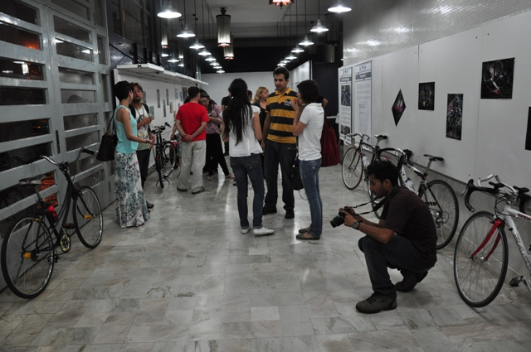
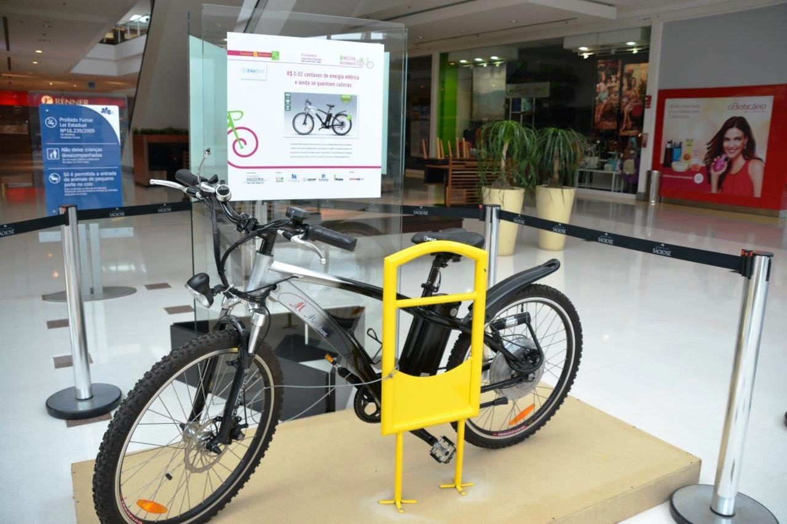
EXPOSITION - BICYCLES AND PHOTOGRAPHIES
São José Mall Exposition
September of 2015
DIFUSION/SENSIBILIZATION
Private collector collection and photography exhibition regarding the urban mobility and bicycle thematic
Location: Art & Design Room – SCHLA/UFPR - SET2012

Slide 17

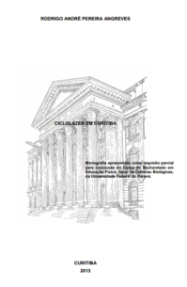
RESEARCH PROJECTS
Support for monographies/ dissertations/ theses
UNDERGRADUATE / GRADUATE
ACADEMY/RESEARCH/EXTENSION
Mobilidade
sustentável
UTFPR
UP
UFPR
PUCPR
Brasil/Holand Agreement
Development of ciclomobility in Curitiba (2016)
Active Mobility Forum, 11 IES (2018)
Monography: Ciclo-leisure in Curitiba
Rodrigo André Pereira Angreves
Physical Education - UFPR
Research project
PICTOGRAMAS - Collective Creation
Prof. Dr. Marcel Pauluk
Design - UFPR

Slide 18
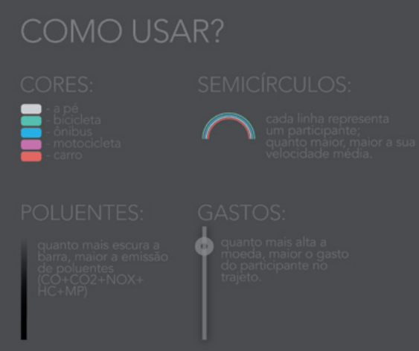
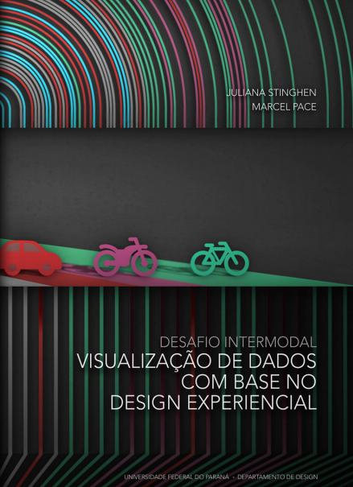
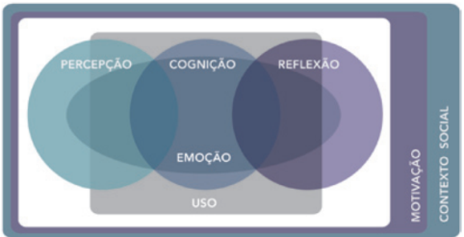
GRAPHIC DESIGN GRADUATION PROJECT – INTERMODAL CHALLENGE
DESIGN/UFPR - Marcel Pace / Juliana Stinghen
ACADEMY/RESEARCH/EXTENSION

Slide 19
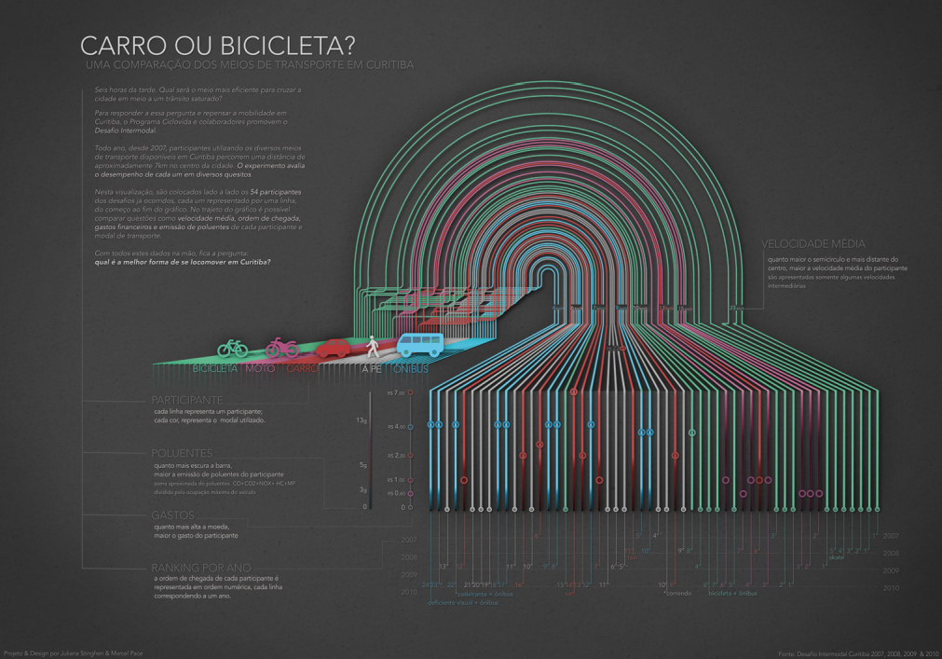

Slide 20
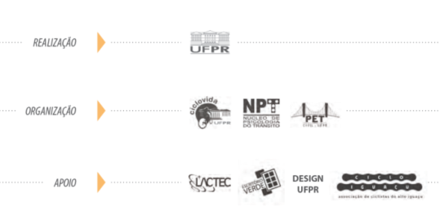
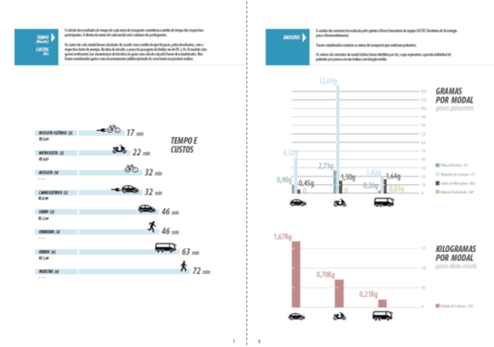
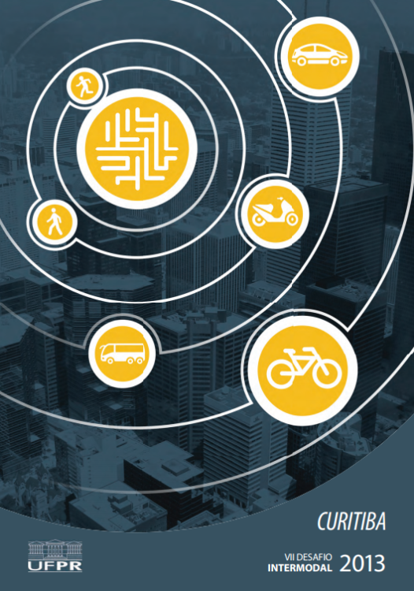
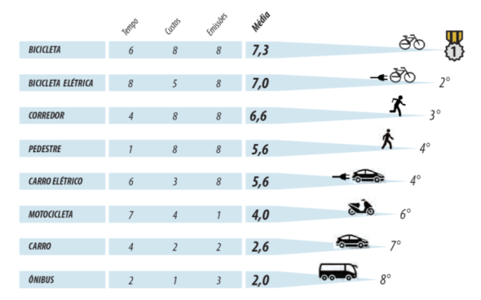
INTERMODAL CHALLENGE - Performed by Ciclovida since 2008
More than establishing winners, the contest promotes awarenes of urban mobility issues (pollutant emissions, costs, etc)
DIFUSION/SENSIBILIZATION

Slide 21
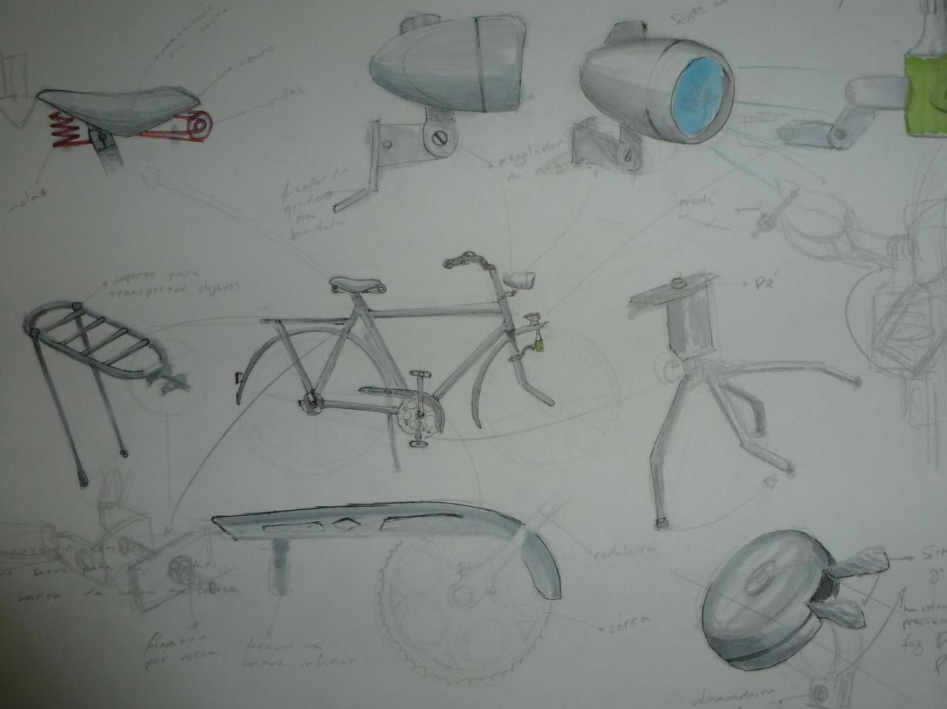
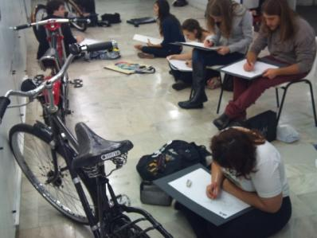
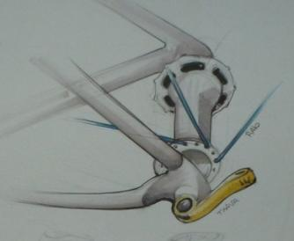
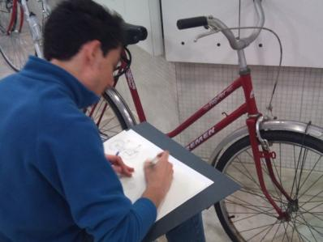
SUBJECT INTEGRATION
Design - Graphic Representation III - Bicycle exposition
ACADEMY/RESEARCH/EXTENSION

Slide 22
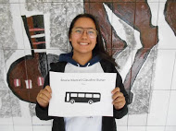
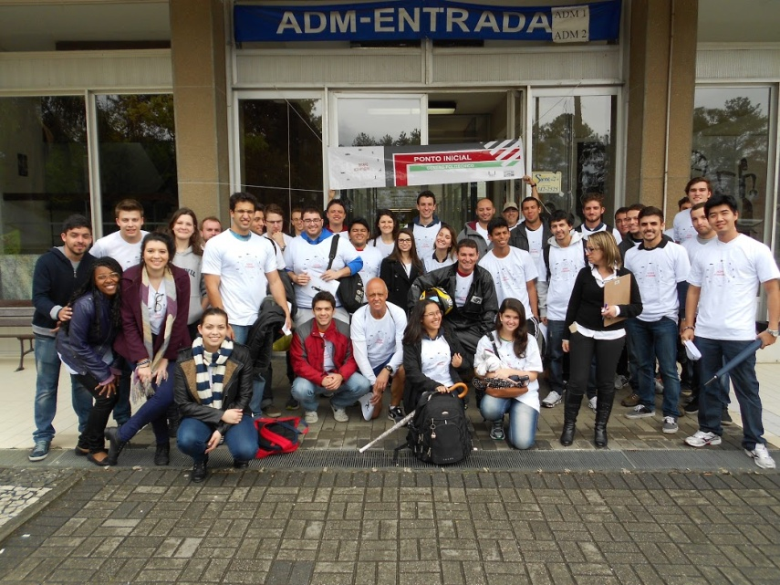
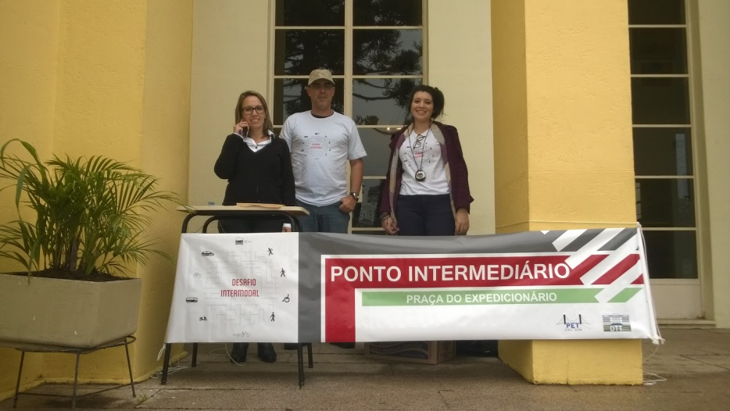
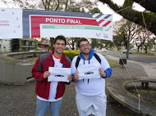
SUBJECT INTEGRATION
Civil Engineering - Traffic Engineering Subject - Intermodal Challenge
Architecture and Urbanism - City and Environment Subject - Intermodal Challenge
ACADEMY/RESEARCH/EXTENSION

Slide 23

15 years of work yields some results
Graduation work, Monographs, theses, dissertations, events, public policy participation, infrastructure implementation….. and behavioral and culture changes
3% modal bicycle
35% on foot journey
32% public transportation
28% automobiles

Slide 24
15 years of work yields some results
The inseparable: Teaching, Reasearch and Extension
Recently, the publication “The Bicycle Economy in Brasil” was released, and the bicycle usage research is addressed in one of the chapters
Paraná is the second in applied resources and number of researches in this field
From the applied resources in bicycle research in Paraná (R$ 646.200,00) 93% are from UFPR
From the 67 researchers mapped in the State, 75% are from UFPR
Source: LABMOB – UFRJ - 2018

Slide 25



THE UNIVERSITY MUST LEAD THE
TRANSFORMATIONS SOCIETY NEEDS
www.ciclovida.ufpr.br

