Slide 1



Coming Together for Sustainability:
Meeting the Goals of the Agenda 2030
RCE Global Webinar #2 ‘Achieving the Sustainable Development Goals: action through learning in a time of global crises’ 08.00 – 10.00 BST (i.e. GMT +1) on Tuesday 08th June 2021
This presentation showcases examples of university engagement in community initiatives and reports on the results from research and from a variety of institutional projects and programmes. As a whole, this illustrates how actors at the community (micro level) and other levels (meso and macro) can make valuable and concrete contributions to the implementation of the Sustainable Development Goals (SDGs) and, more specifically, to achieving the objectives defined at the 2030 Agenda for Sustainable Development. Also, the main focus of this work is for the UNESCO ESD Roadmap Priority Action Area 5: Accelerating local-level actions.
By RCE Salisbury Co-Directors: Dr. Brittany Foutz and Dr. Brian Polkinghorn
and
The HONR 311 class: Kieran Bethke, Jared Galley, Sean Kelly, Christopher Lankford, Sarah Lester, Courtney Martin, William Seymour, Haley Taylor, Micah Weber, and Taylor Windmiller

Slide 2
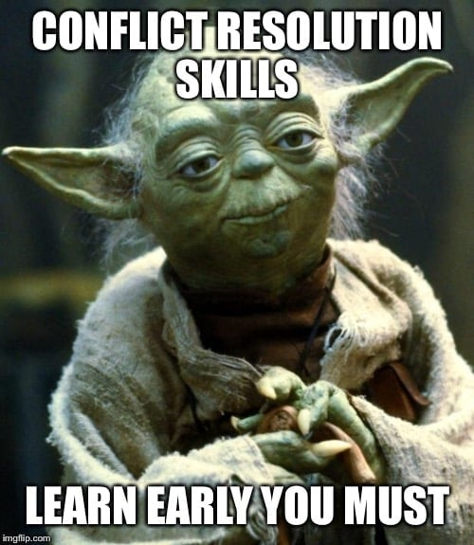
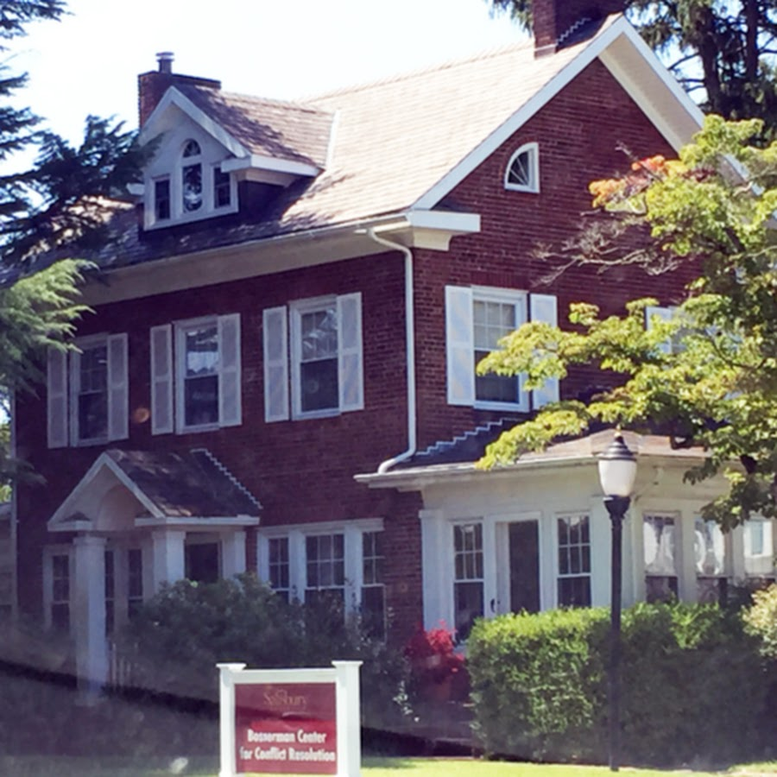
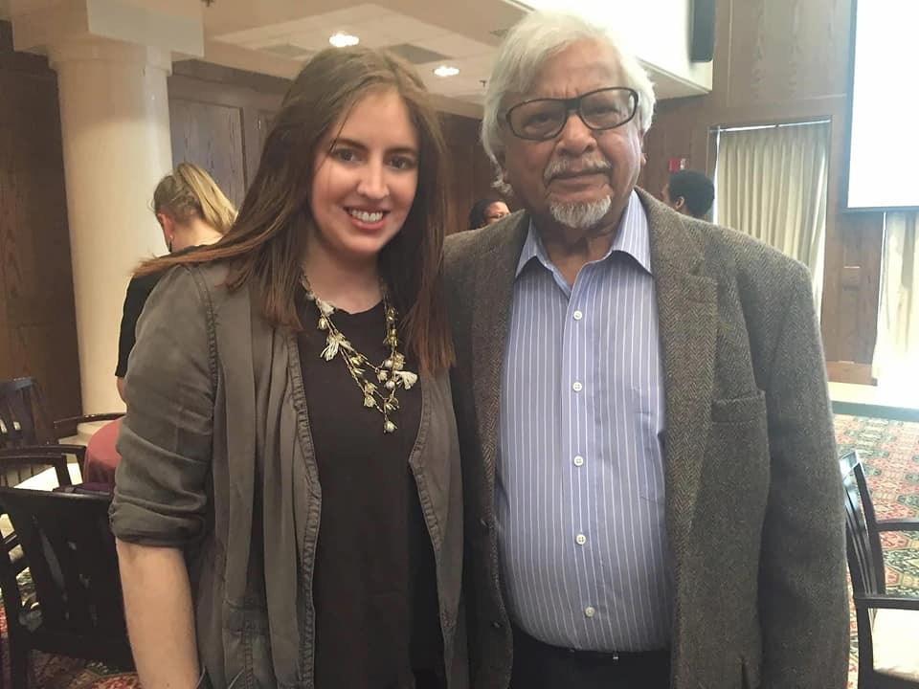
RCE Salisbury
Housed within the Bosserman Center for Conflict Resolution, Salisbury, Maryland (USA)
Conflict prevention and creative problem solving
Teaching hospital model
Dr. Arun Gandhi, Senior Practitioner
Top image from: http://bossermancenter.com/.
Yoda image from:: https://www.facebook.com/guconflictresolution/photos/a.10153921364660226/10161663709135226/?type=3.
Personal photo of Dr. Brittany Foutz and Dr. Arun Gandhi, from Dr. Brittany Foutz.

Slide 3

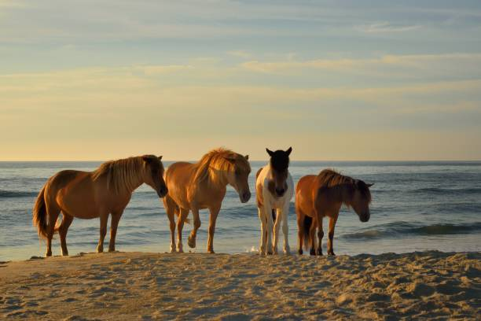
Our region
Personal photo from Dr. Brittany Foutz.
Photo from: https://www.istockphoto.com/photos/chincoteague-pony

Slide 4
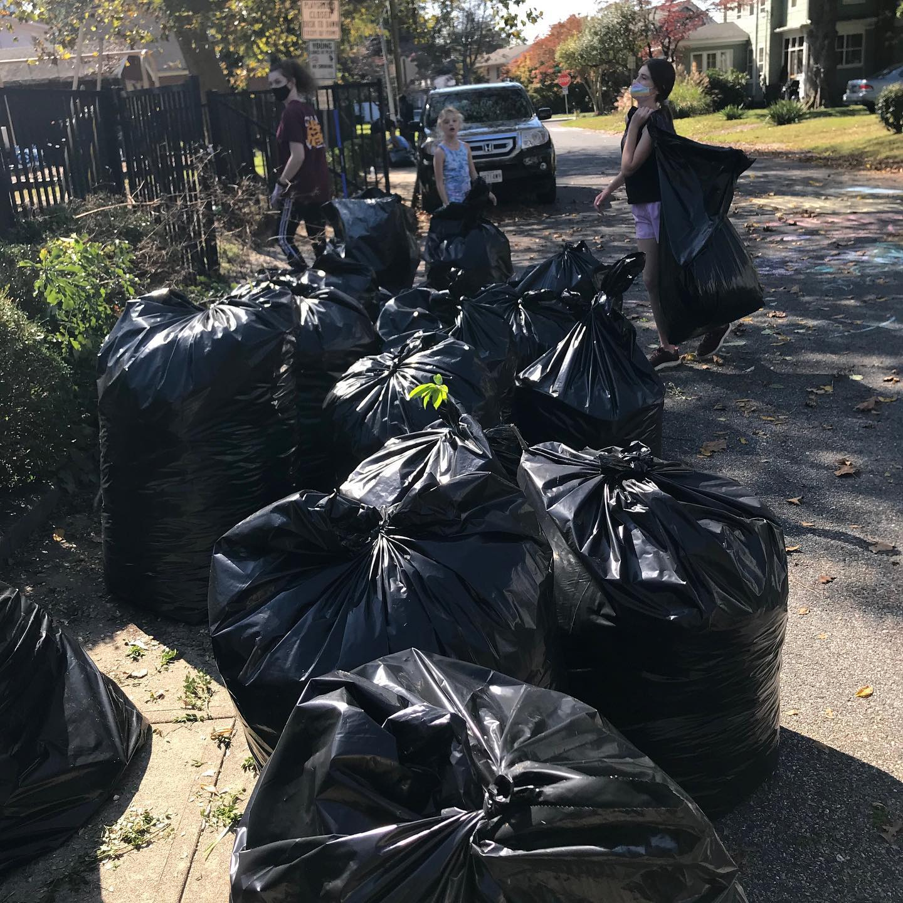
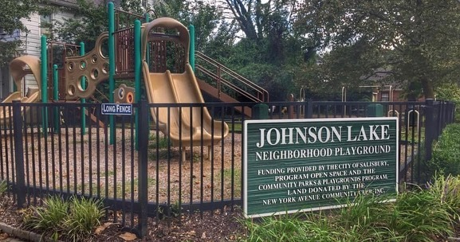
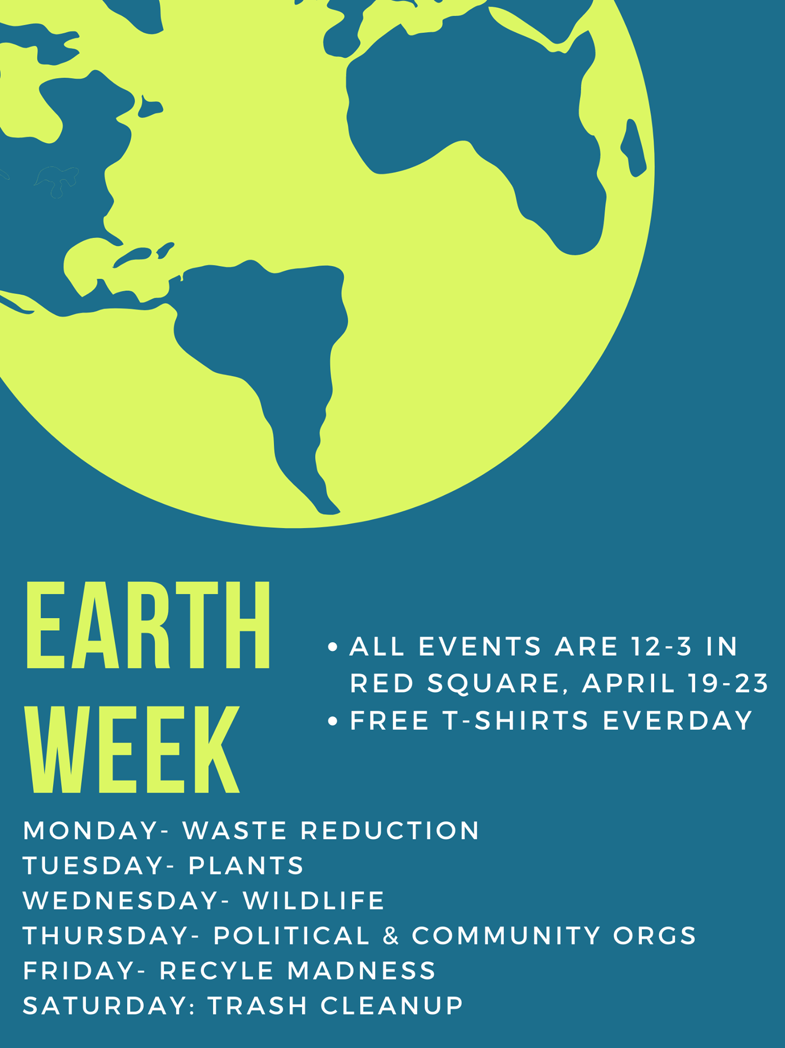
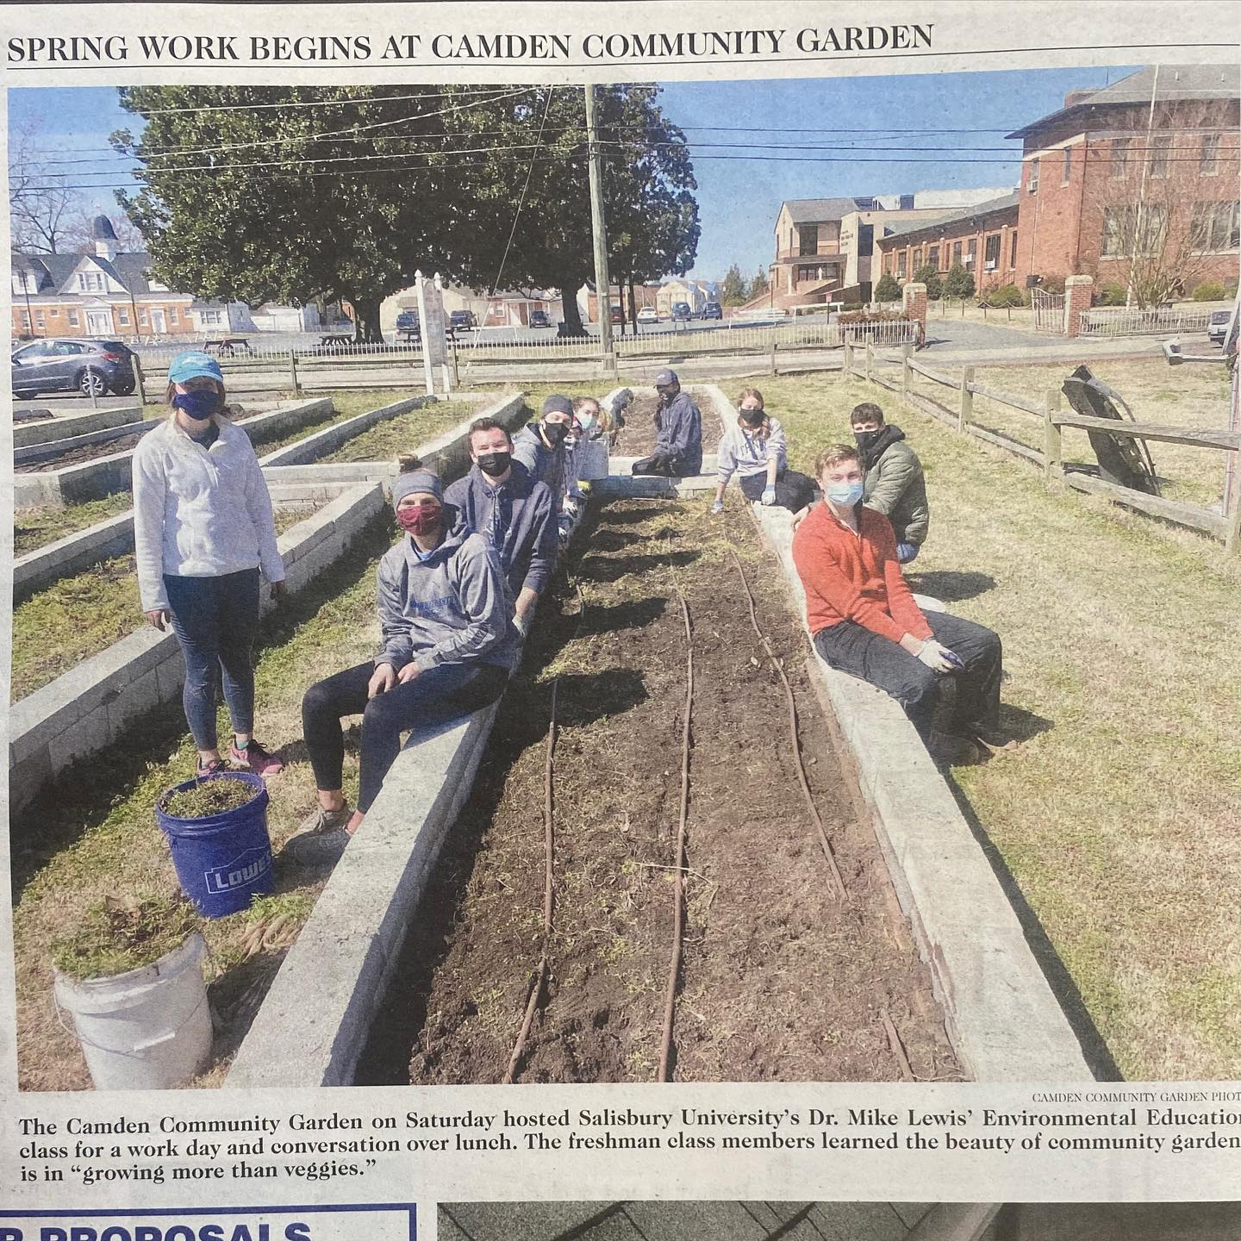

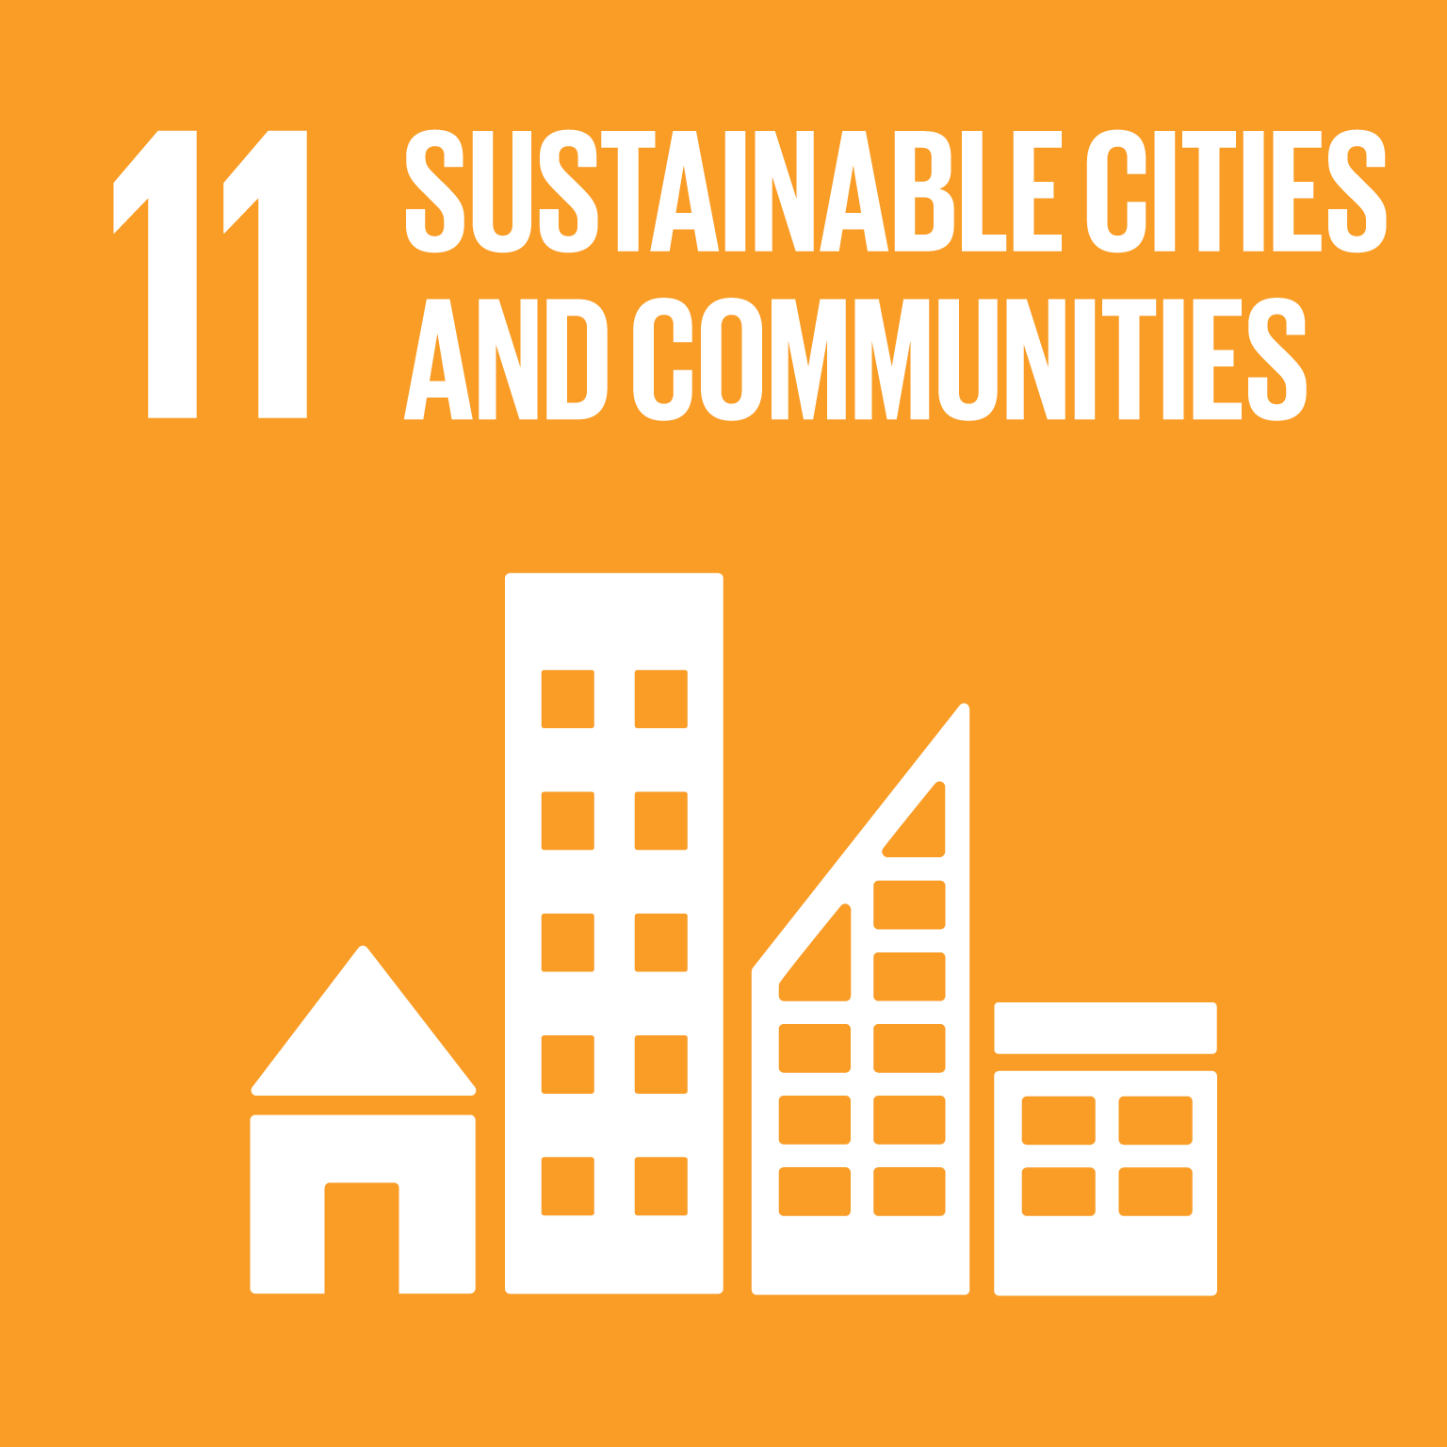

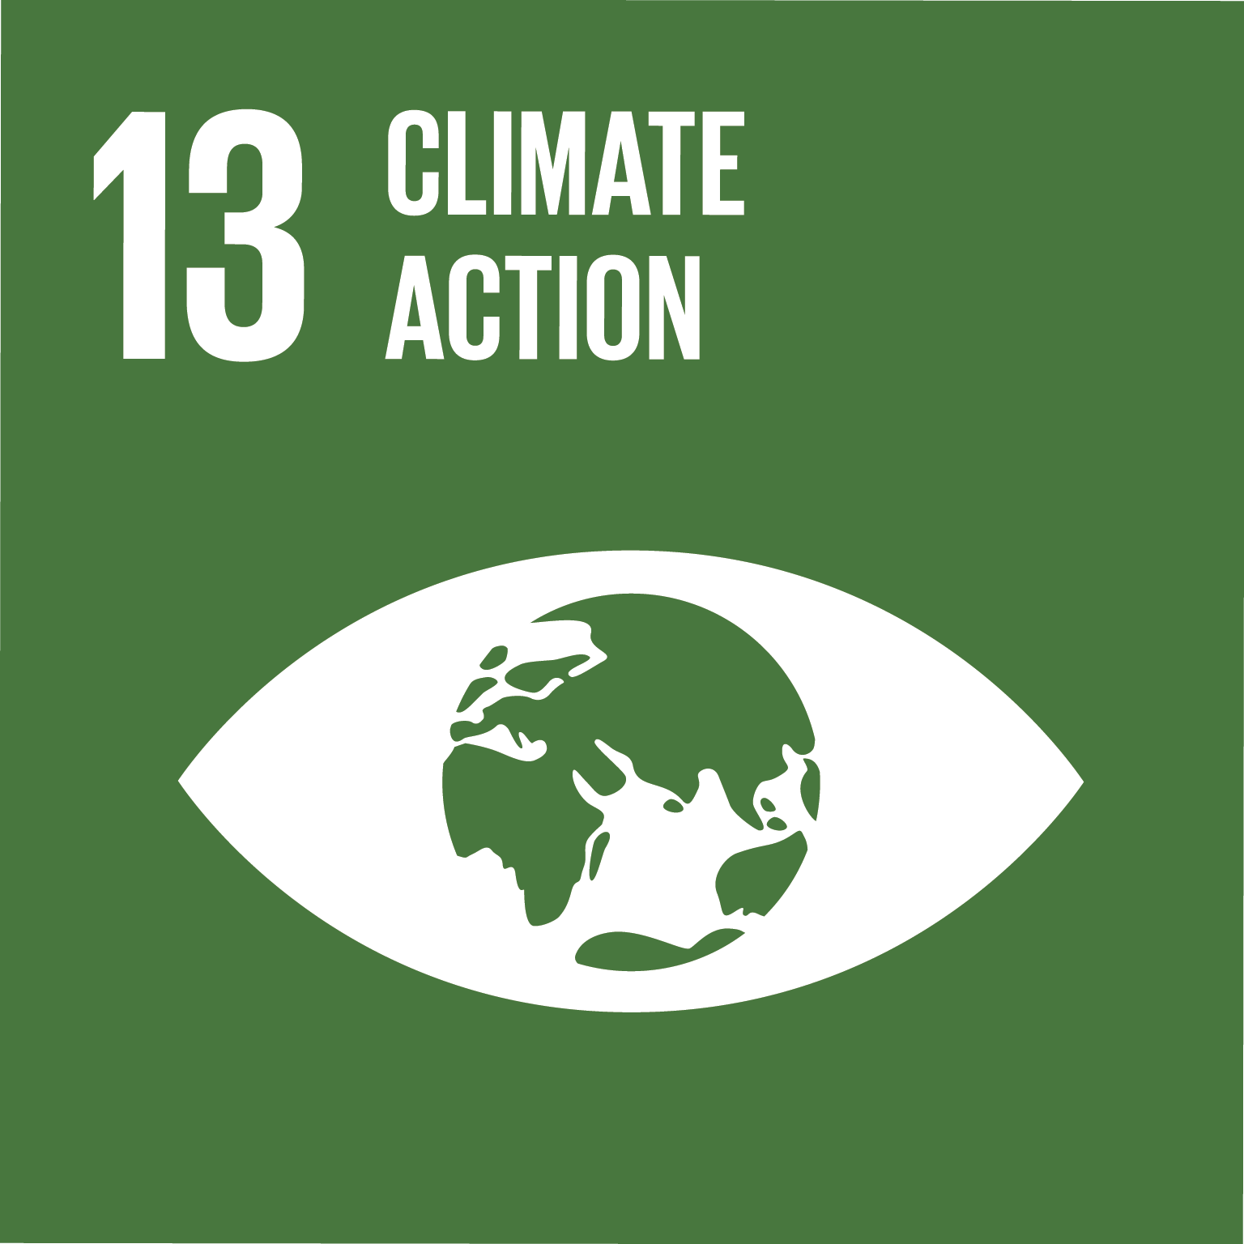
How we brought about action on climate change through learning
Combination of research to identify trends, correlations, gaps, and best practices between efforts within the City and the Campus.
Analytic induction methodology.
Then, practitioner involvement to address to gaps.
Photos provided from the Clarks Honors College.

Slide 5
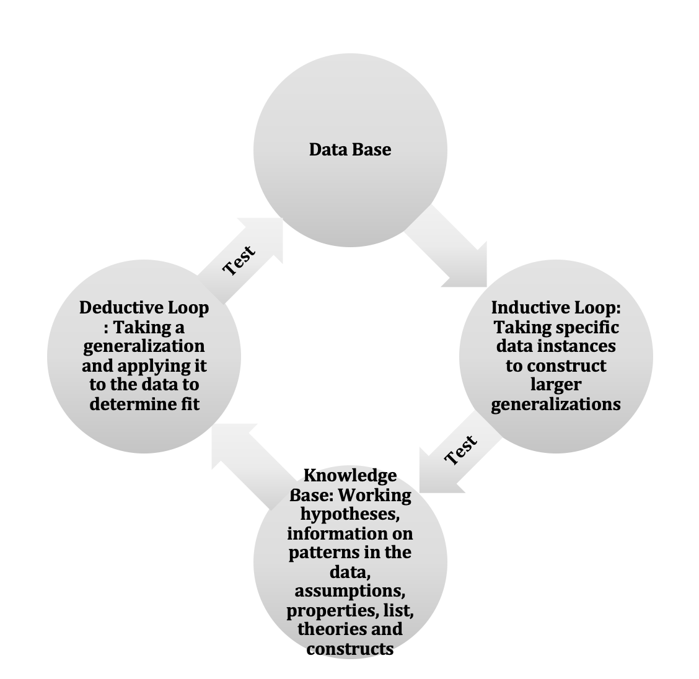
Methodology for our study

Slide 6
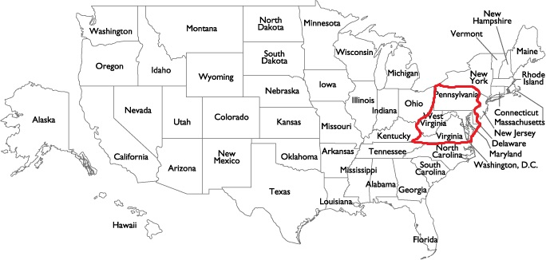
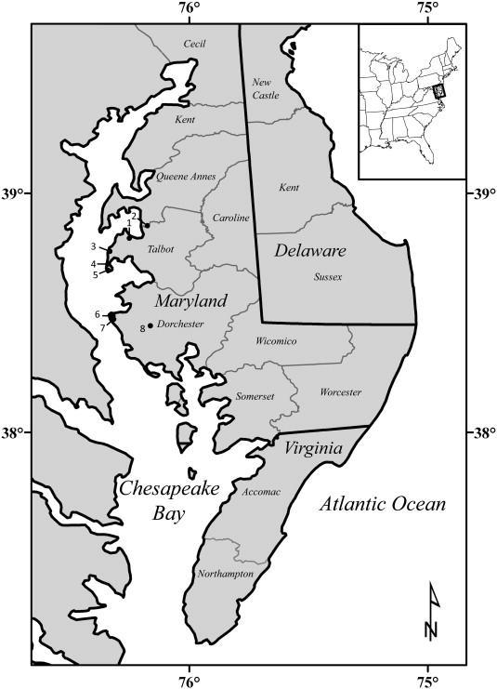
How this is relevant to UNESCO ESD Roadmap Priority Action Area 5: Accelerating local-level actions
The SDGs can provide a framework for local development policy - especially in our region
We live in the largest city on the Eastern Shore of the Chesapeake Bay and the fastest growing city in Maryland
Our findings:
  What makes this region unique is also its challenge:
    Open land for farming and chicken farms with their runoff into the Bay which threatens the watermen — and climate change, which threatens the tourist industry and population on the islands and coastal areas.
    Migrant workers whose children begin the school year and are often gone by Christmas
    Diversity and lack of education and poverty
    Proximity to large cities, where young people tend to flock, an aging population
    The resulting stress on local institutions all serve up many issues that we need to address.

Slide 7
Our Progress and How this will inspire other RCEs
Research
Practice
Training
Best practices with other RCE locations and new applicants
Engaging with other RCE locations on projects
“Train the Trainer”, Workshops, Webinars with RCE locations

Slide 8
Thank you
Our emails:
Dr. Brittany Foutz at blfoutz@salisbury.edu
Dr. Brian Polkinghorn at bdpolkinghorn@salisbury.edu

