Slide 1
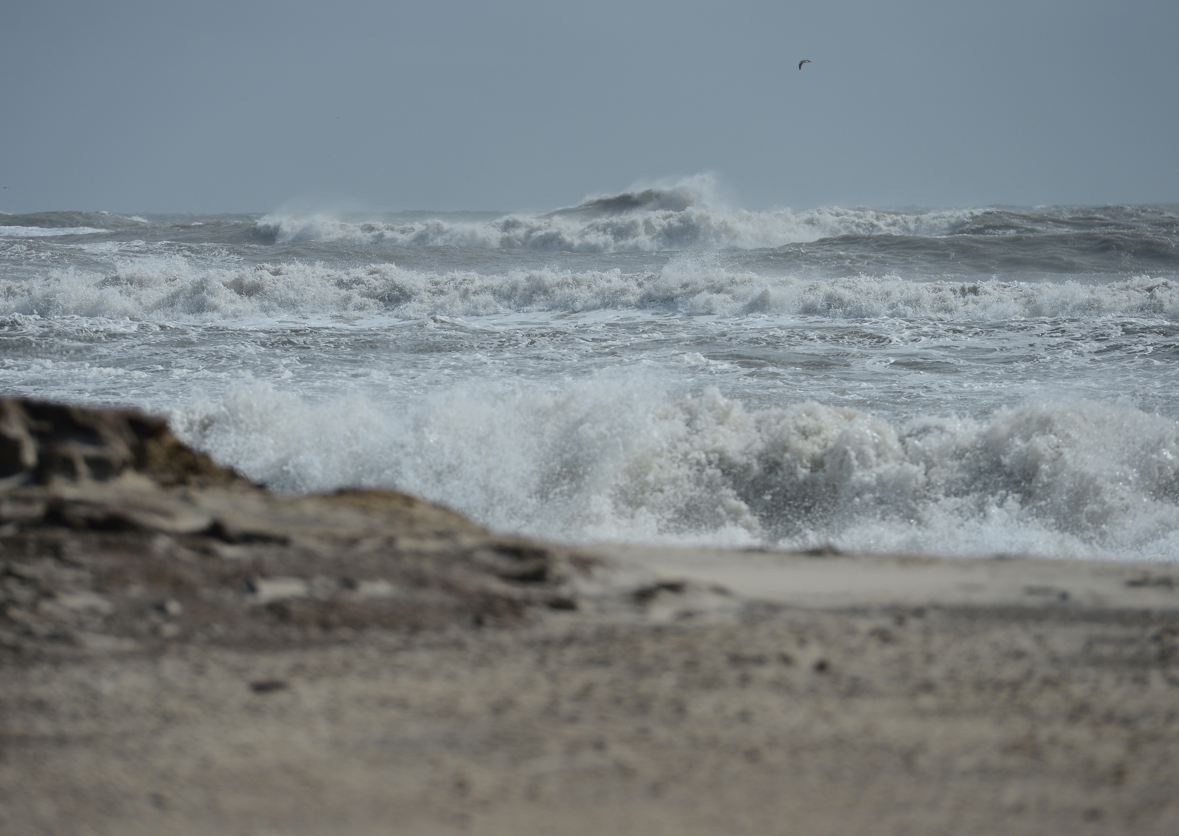
RCE Salisbury’s
Youth Initiatives at Assateague Island
Presentation by: RCE Salisbury Co-Director Brittany Foutz
RCE Salisbury specializes in Conflict Prevention and Creative Problem Solving.

Slide 2
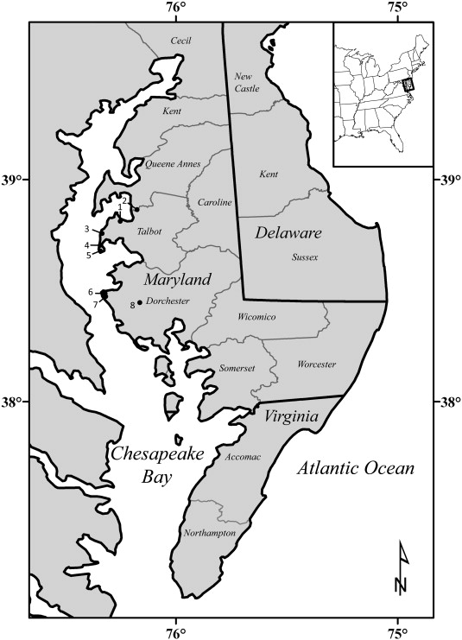
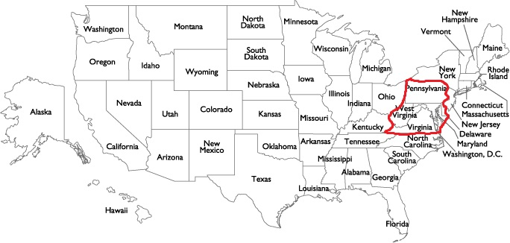
RCE Salisbury Geographic Location
While Salisbury is the largest city on the Peninsula it is not the sole focus of RCE Salisbury. The scope of the region encompasses most of the Delmarva Peninsula: Maryland, Delaware, Virginia - and then Washington, D.C.

Slide 3
Recent projects
-The creation of truthjustice.org for SDG#16 and partnership with the nonprofit Strength to Strength
-Lessons from Post-Conflict Nation Building Applicable to Ukraine's Post-War Reconstruction with the US State Dept.
-Bringing together after a post-tragedy the Ocean Pines and coastal communities
-Developing a website of businesses and organizations in our region committed to the SDGs
-SGD year-long long lecture series and staff recycling program at Salisbury University
-Global Issues Fellowship
-Ukrainian horses and safely evacuating them
-Reintegration of Nepalese military

Slide 4
Assateague Island Brief Info.
Maryland and Virginia
Used to be connected to Fenwick Island until 1933. Was going to be a town called “Ocean Beach” but in 1962 another storm hit. After the storm, the developers for Ocean Beach decided the area may be too difficult to build on. They sold the land to the state of Maryland.

Slide 5
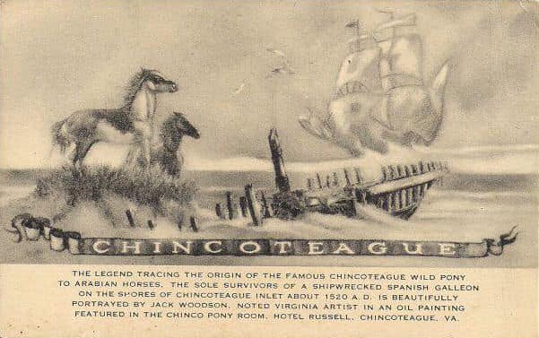
Assateague Island is known for…

Slide 6
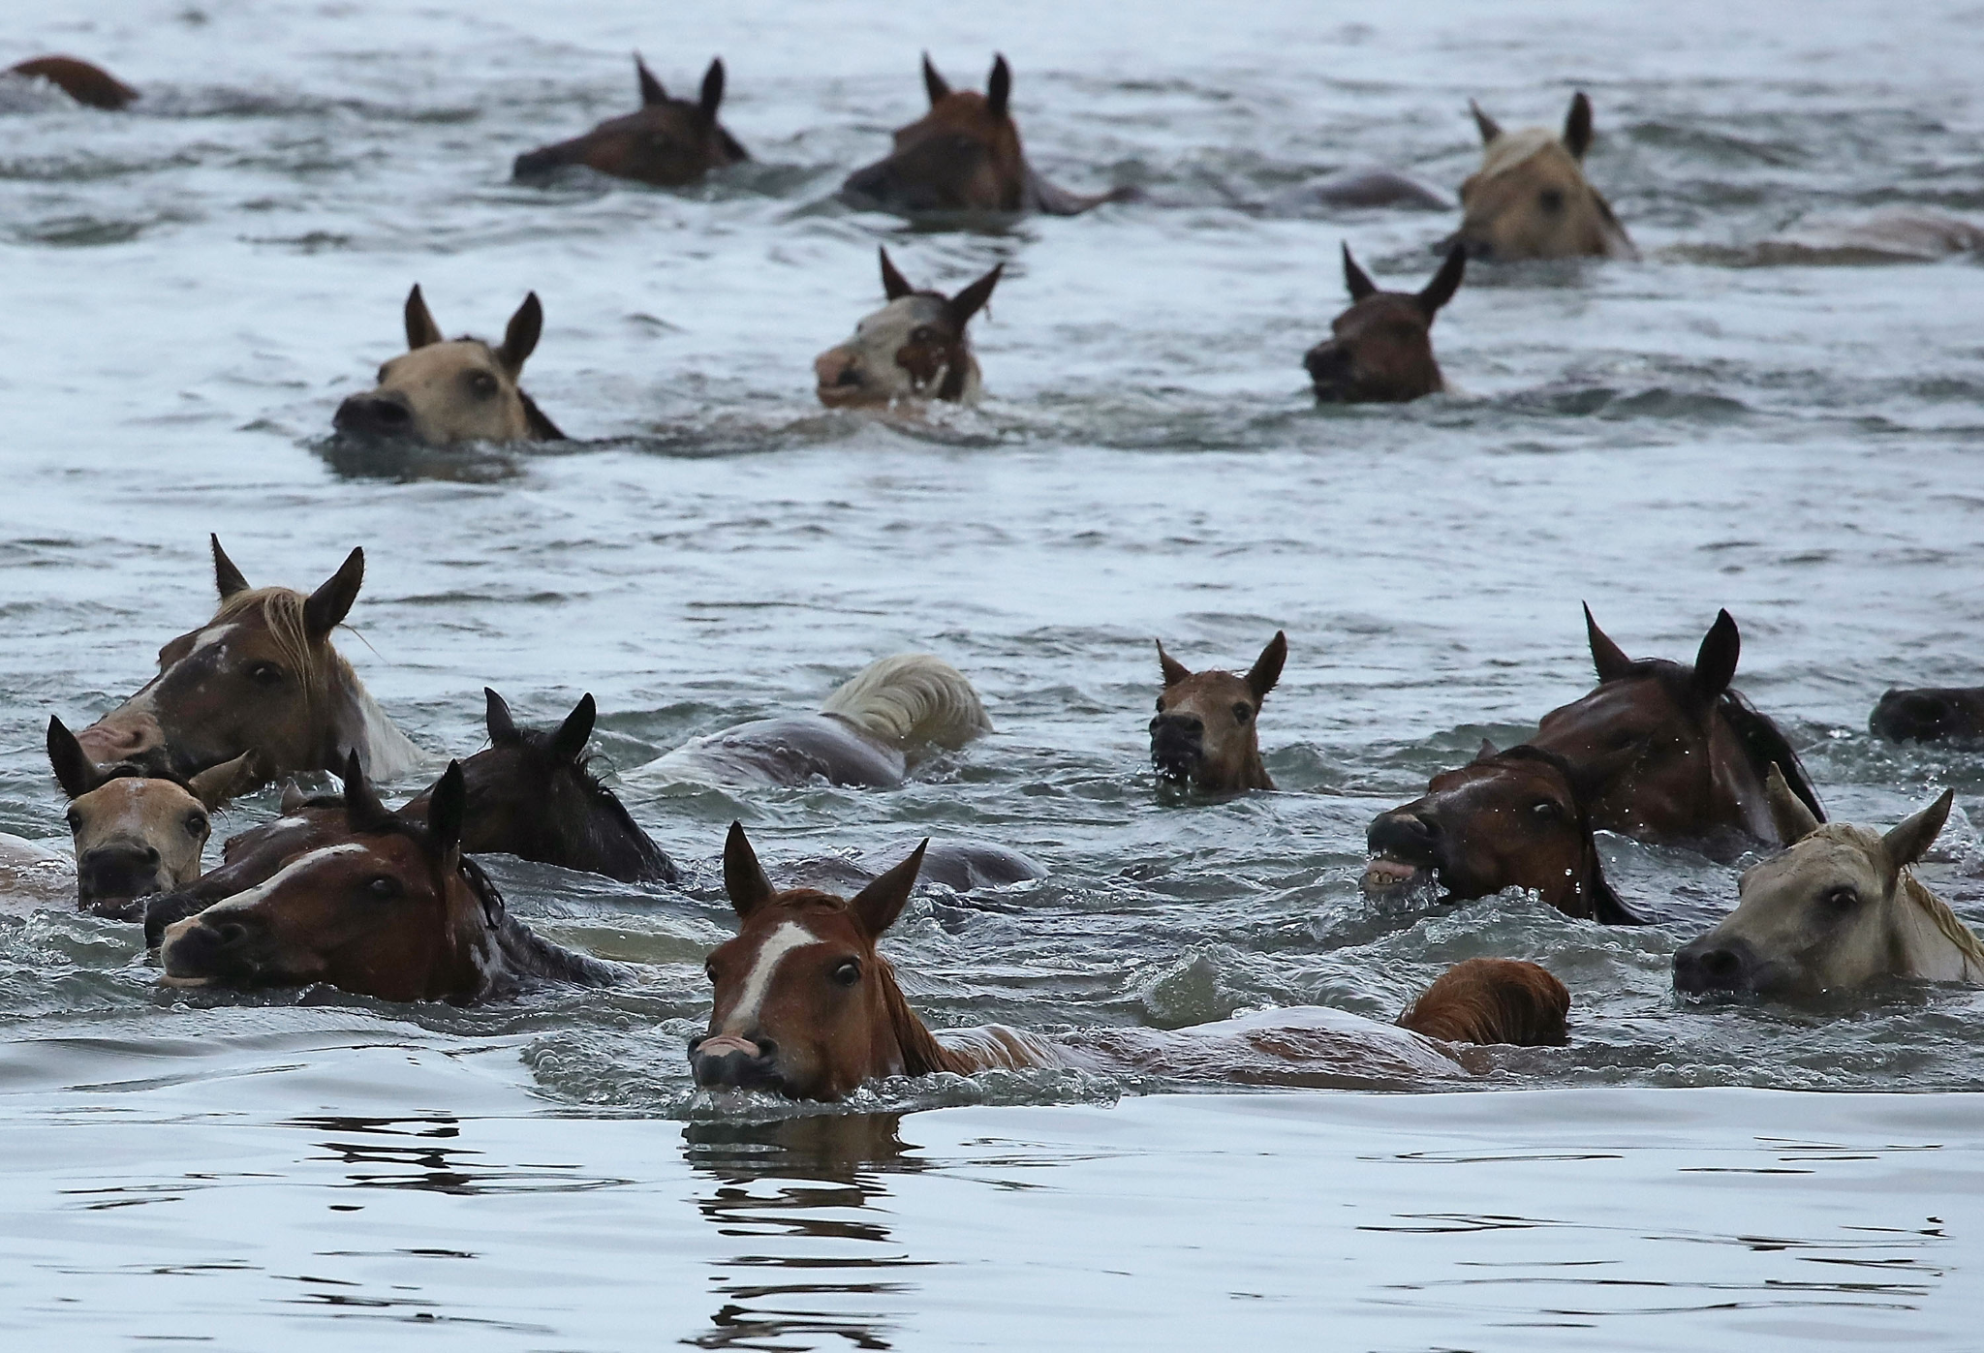
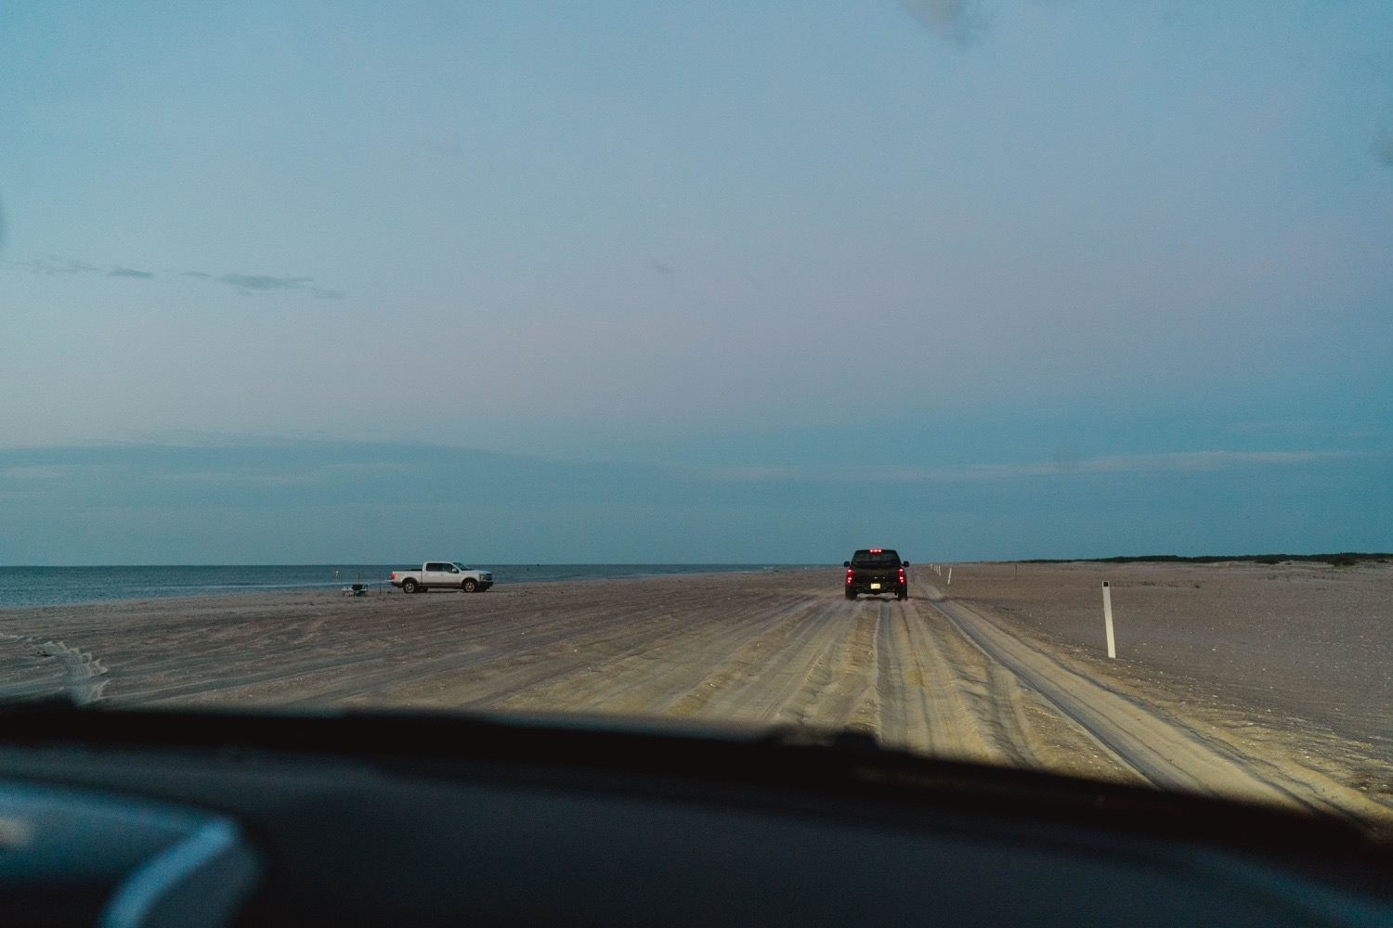
Assateague Island is known for…

Slide 7
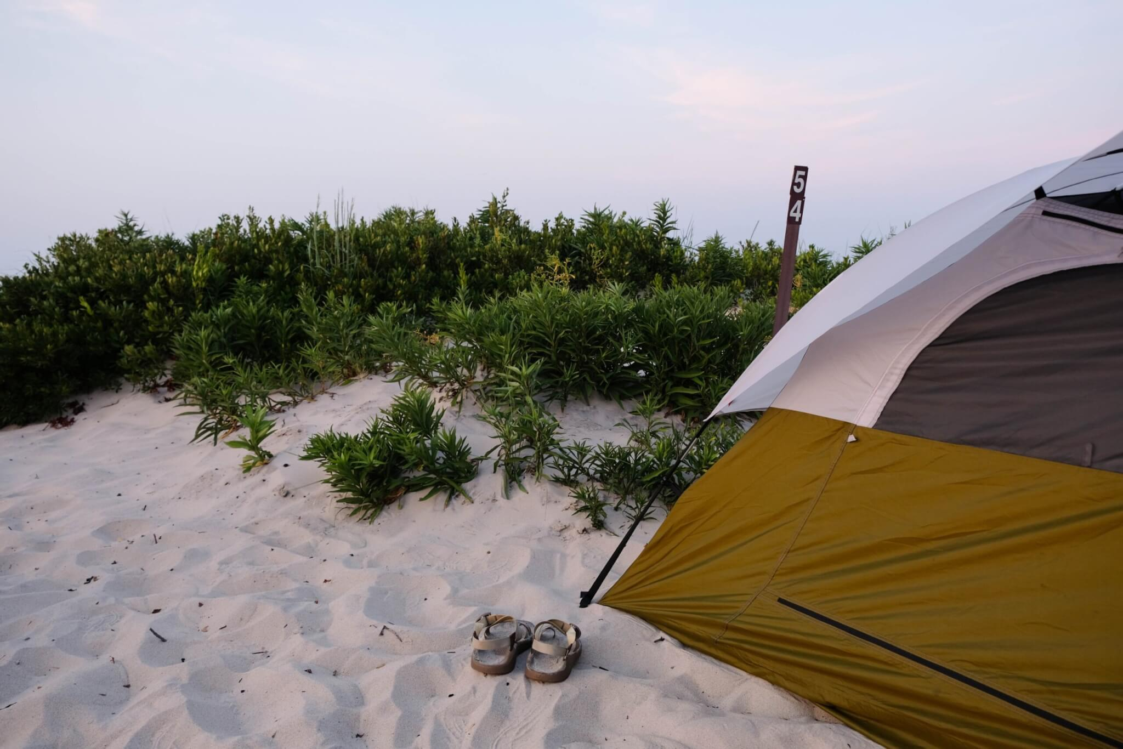
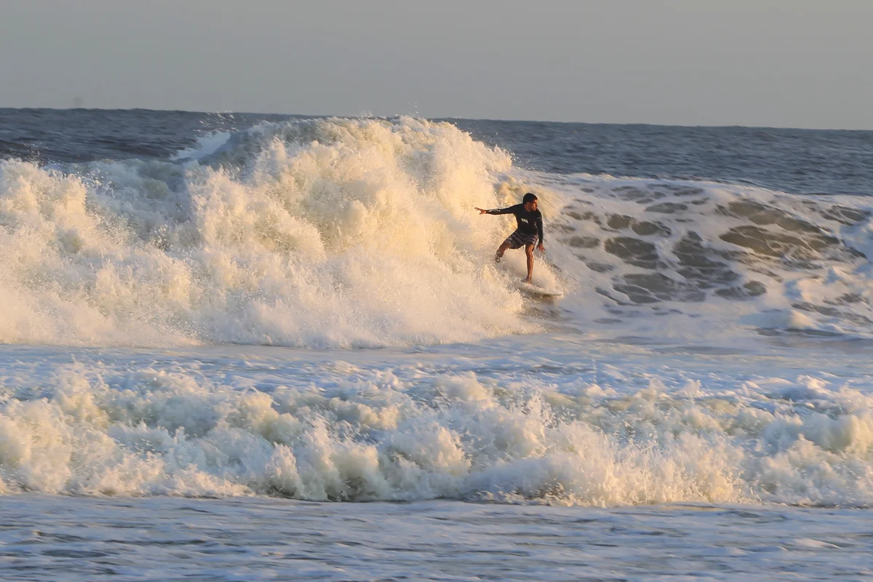
Assateague Island is known for…

Slide 8
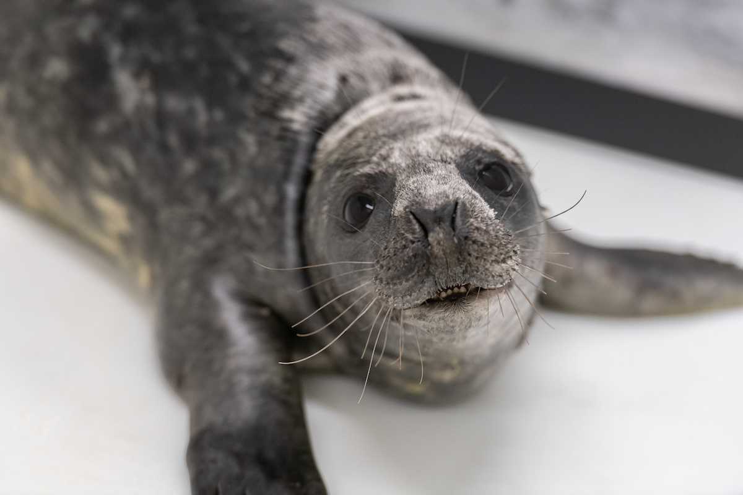
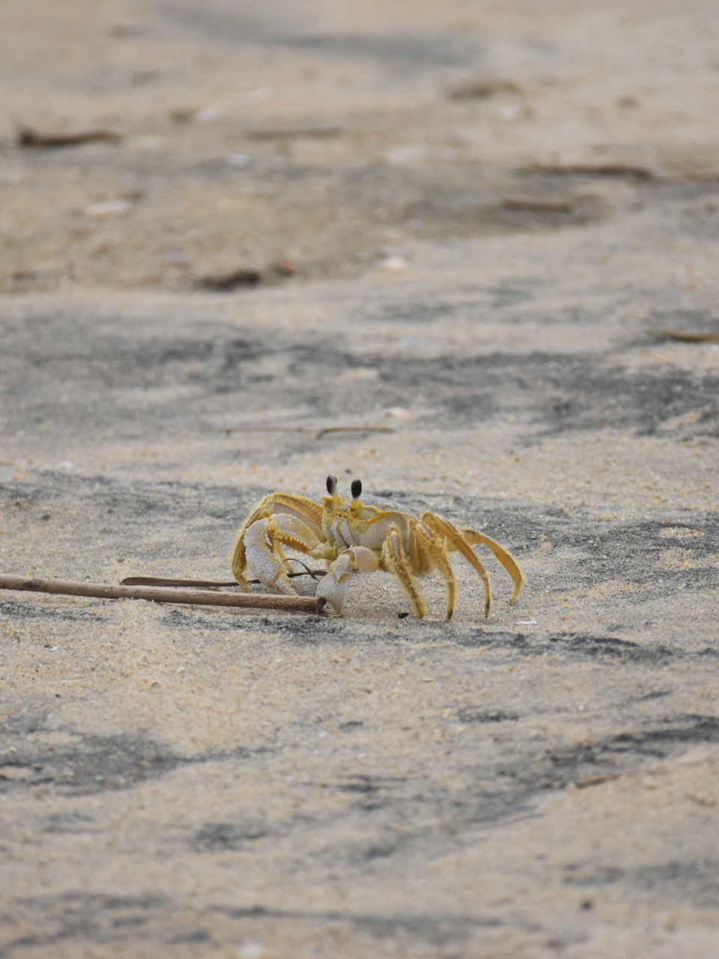
Assateague Island Critters

Slide 9
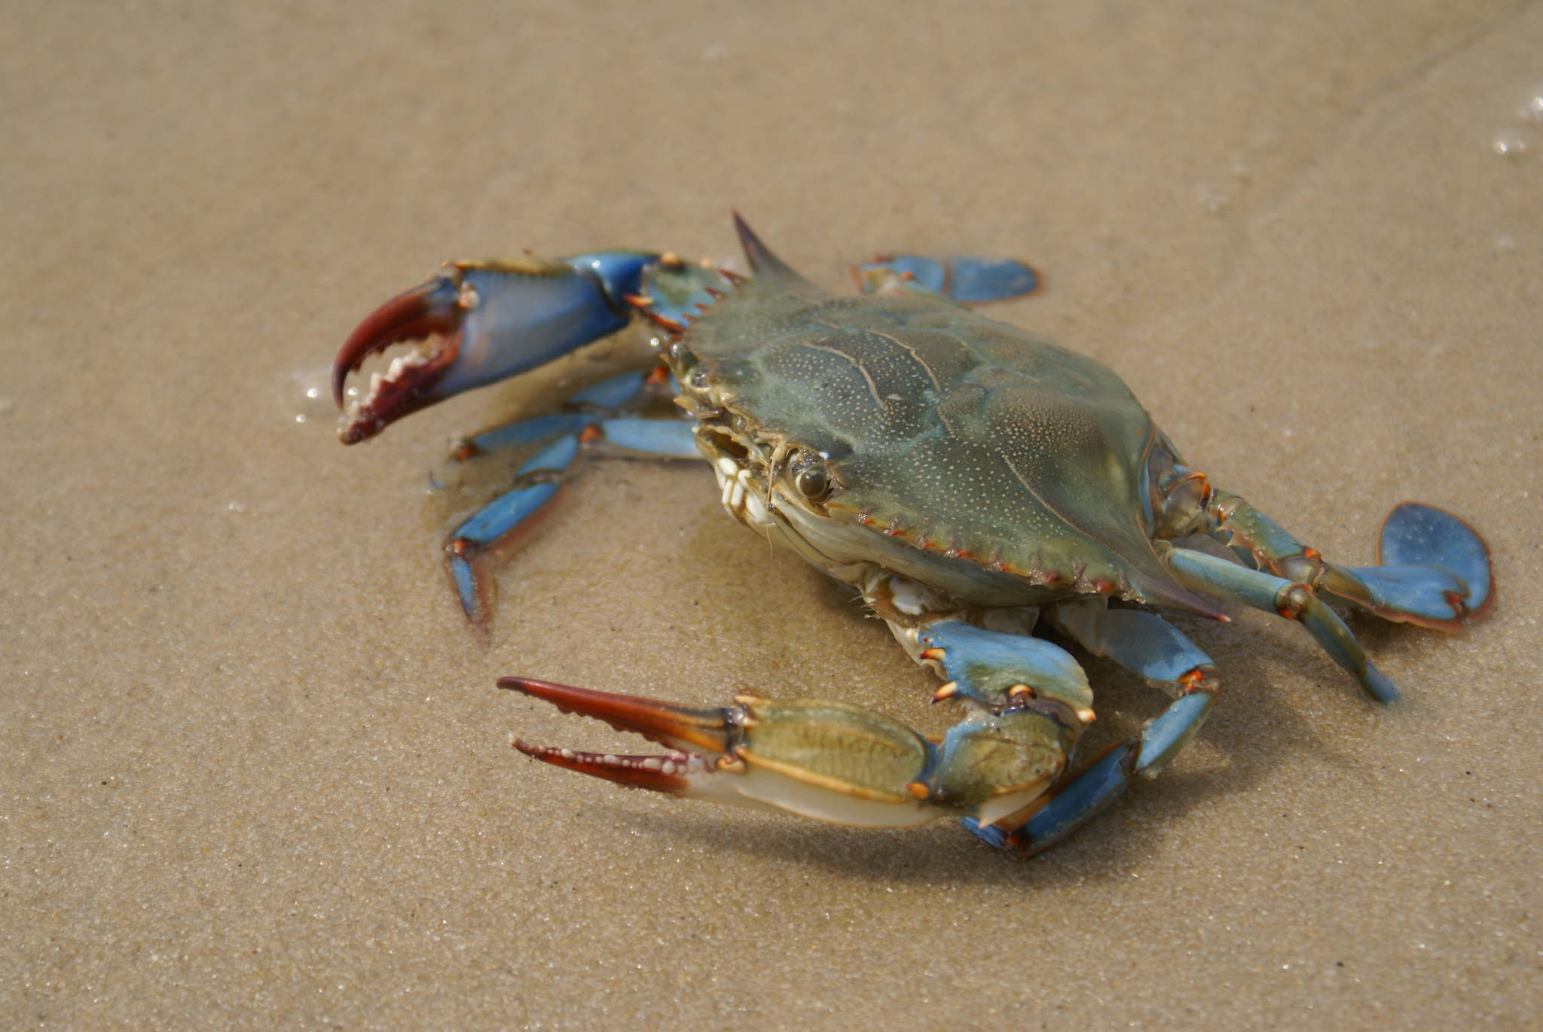
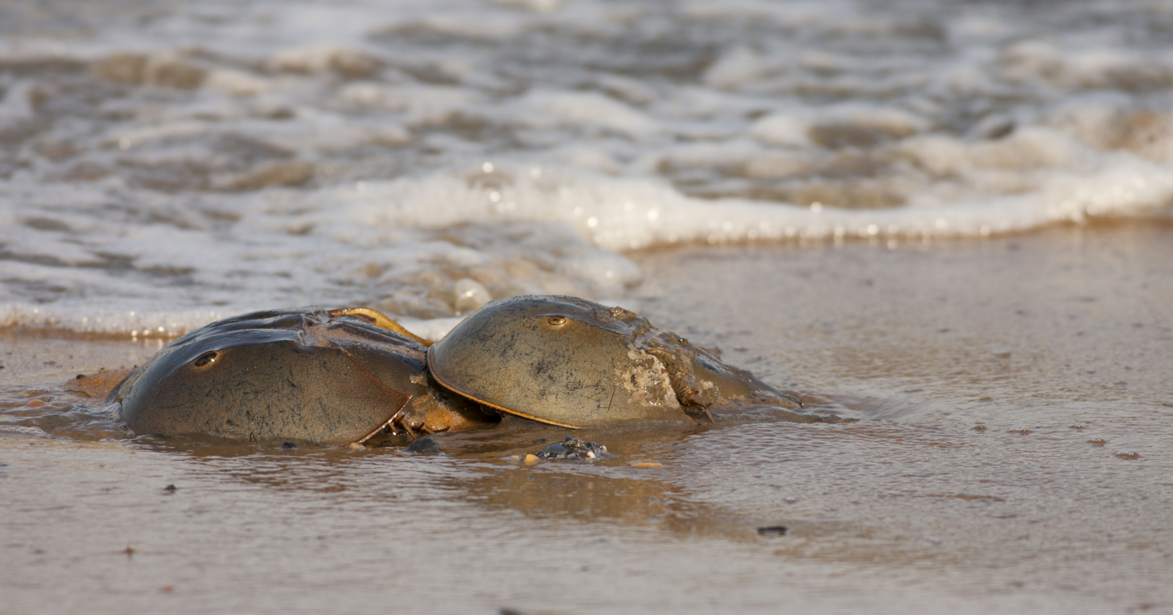
Assateague Island Critters

Slide 10
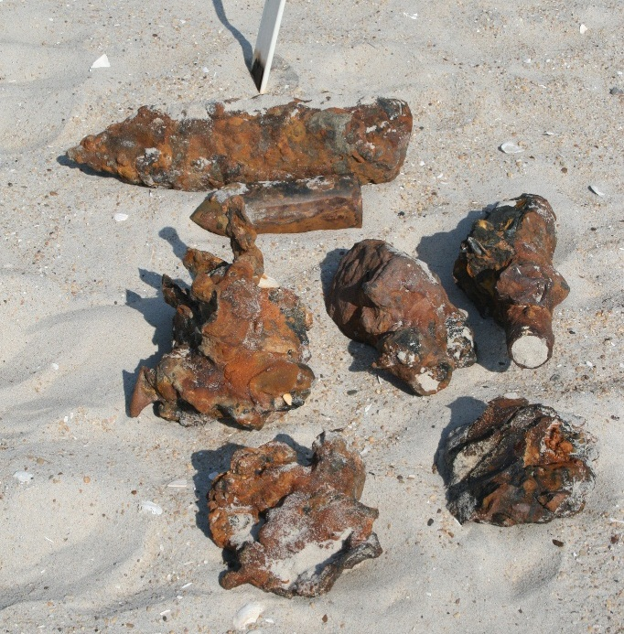
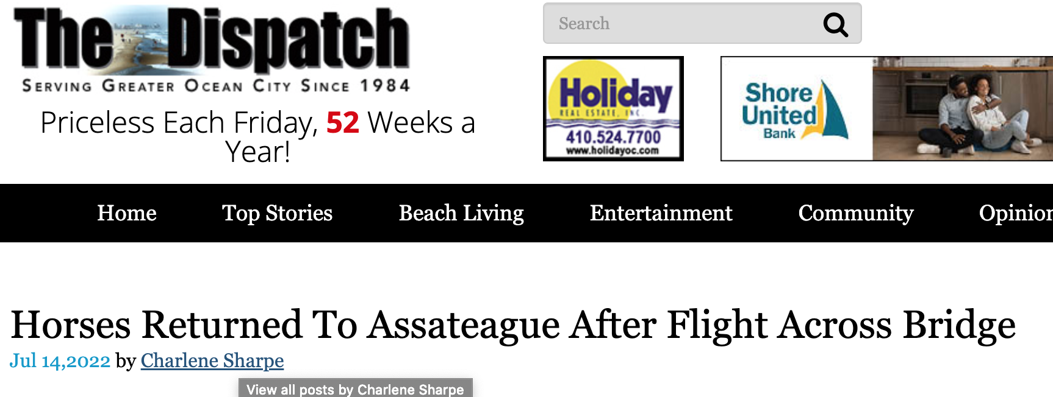
Tourism and Assateague Island v. Sustainability
2.3 million visitors in 2022 for national. 2.2 million visitors for state.
World War II-era munitions
The island is moving westward as a result of sea-level rise and the force of the surf.

Slide 11
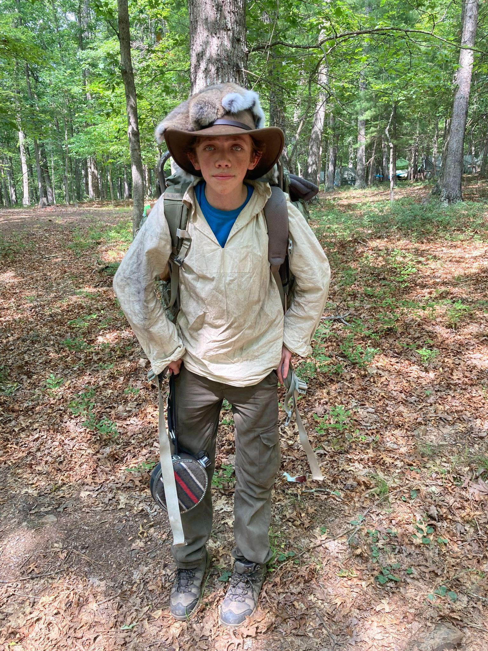
Youth Initiatives
-Youth climate action research through vulnerability assessments and tools with the Maryland Department of Natural Resources Chesapeake and Coastal Service: sea-level rise, degrading water quality, tree loss, increased code red days, disease, invasive species
-Participation in International Coastal Cleanup Day
-Outdoor Leadership Program
-SDG mapping
-Local facilitation of govt. Agencies, nonprofits, researchers, etc.

Slide 12
Featuring one of our youth representatives Nnaemeka Eke-okocha (Phil)
From the International Conference for Sustainable Development (ICSD)
1. Skilling Youth for Sustainable Development Goals: The Case of the Local Pathways Fellowship
2. Youth at the Midpoint: An Examination of the Opportunities and Barriers for Youth Empowerment in the Sustainable Development Solutions Network - Youth

