Slide 1


SDG Cities Challenge
University of Melbourne
ICLEI USA
University of Texas at Arlington

Slide 2



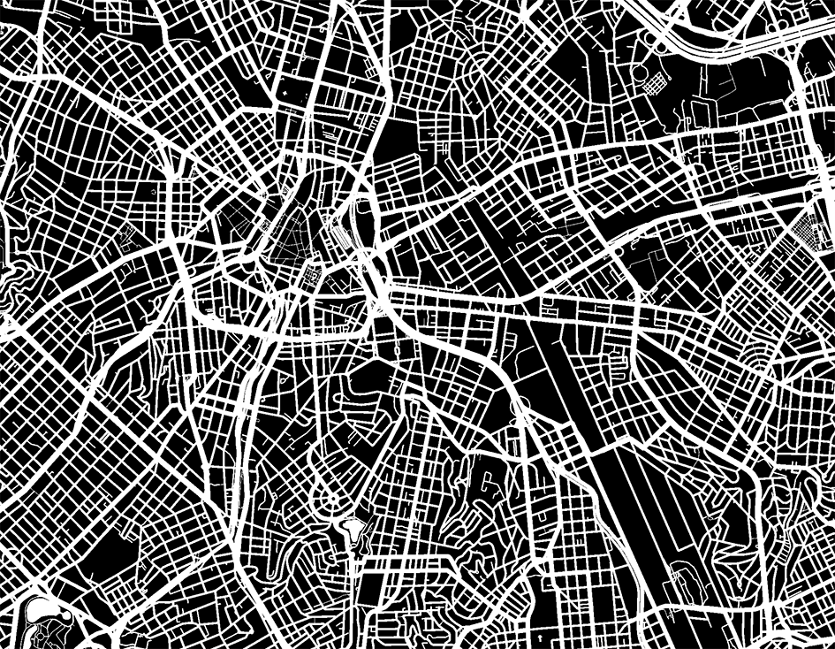
The United Nations Global Frameworks

Slide 3
The United Nations Sustainable Development Goals

Slide 4

What is the SDG Cities Challenge
The SDGs Cities Challenge asks interested cities to align an existing or new project to a key urban SDGs target. Solutions relating to this project are worked through via a collaborative process, using knowledge and practical expertise in local government, academia and business, offering each city the opportunity to produce an implementation plan, and ultimately a voluntary local review (VLR) aligned to the SDGs.
The SDGs Cities Challenge is a comprehensive, long-term program aligned with the 2030 Development Agenda. The ten-month program is centered around an annual five-day workshop, which gives participating cities the opportunity to share their experiences and urban challenges and their progress in mapping their work against the SDGs with expert support from a diverse group of urban stakeholders

Slide 5




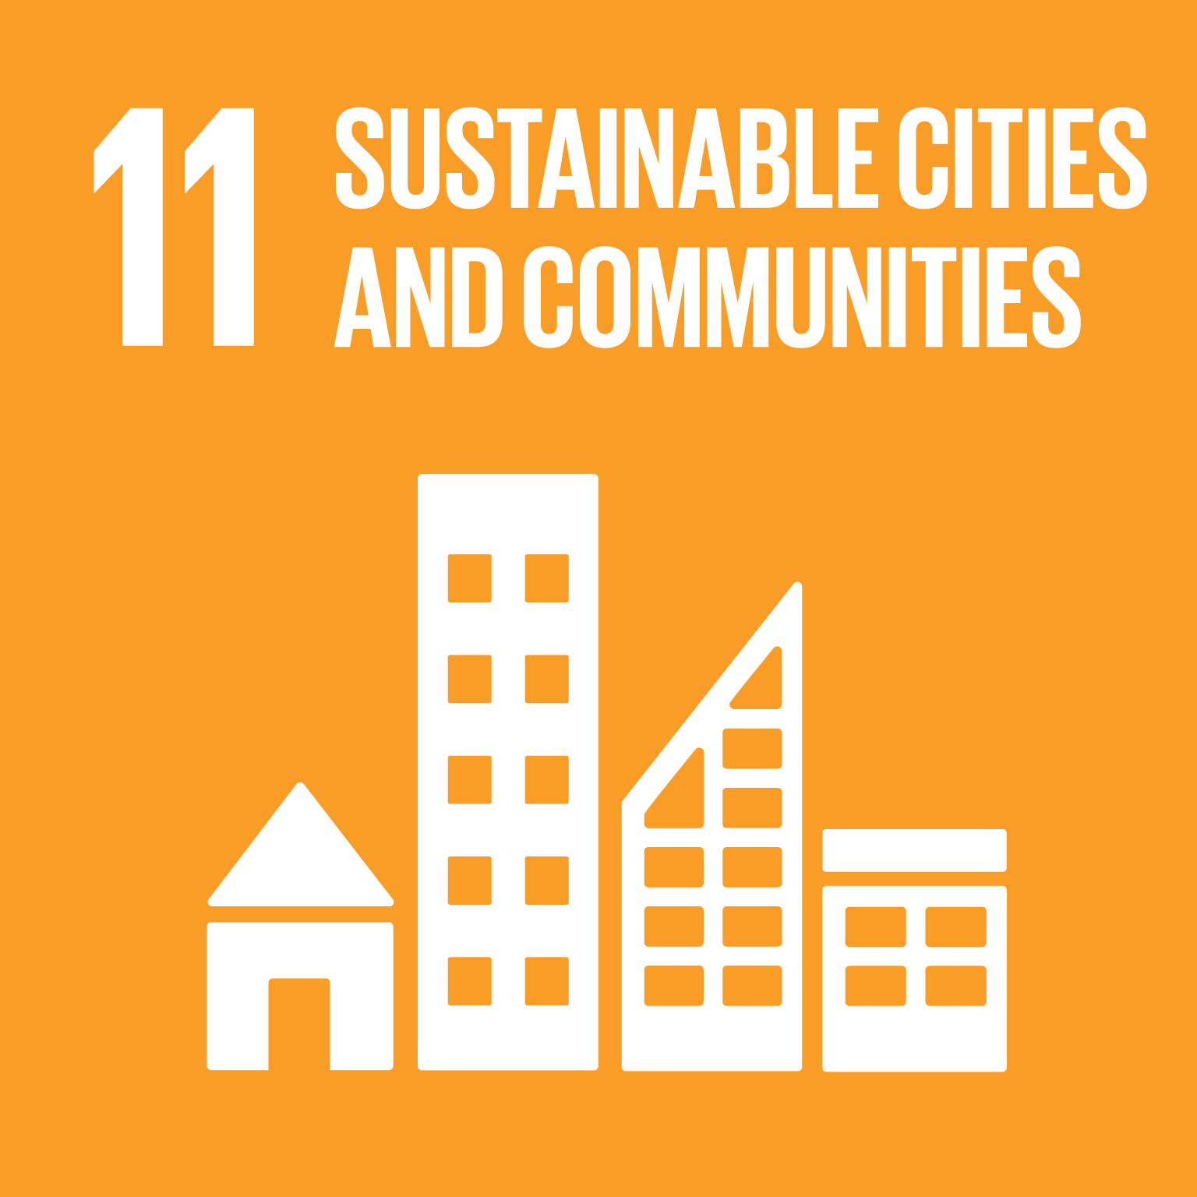


Cities as a solution, not just a problem…
80% global economy
60+% energy consumption
70% greenhouse gas emissions
70% global resource use
50+% global population
Cities account for…
﻿https://unhabitat.org/sites/default/files/documents/2019-05/sdg_booklet_to_printer4.pdf​
Klopp, J. M., & Petretta, D. L. (2017). The urban sustainable development goal: Indicators, complexity and the politics of measuring cities. Cities, 63, 92–97.https://doi.org/10.1016/j.cities.2016.12.019
(UN-Habitat) United Nations, 2017, The ​New Urban Agenda,​ United Nations Conference on Housing and Sustainable Urban Development (Habitat III), Quito, Ecuador, report, http://habitat3.org/wp-content/uploads/NUA-English.pdf​.

Slide 6
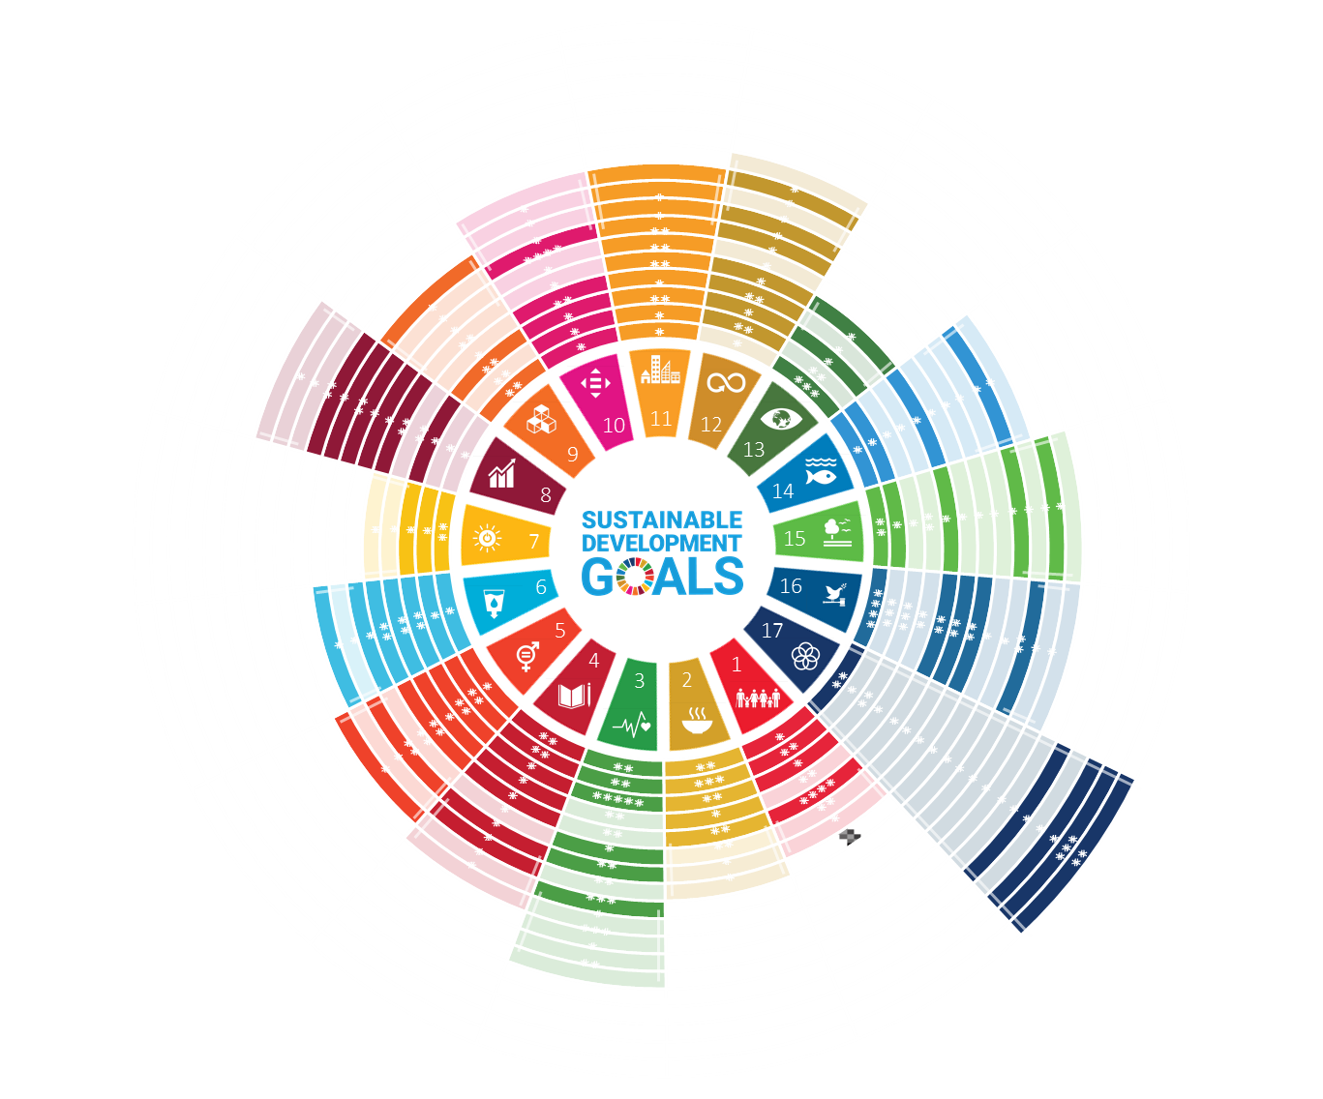
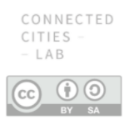
The ‘urban’ targets
Indicator
*
Urban Target
Non-Urban Target
https://sites.research.unimelb.edu.au/cities/projects/sdgs-melbourne

Slide 7
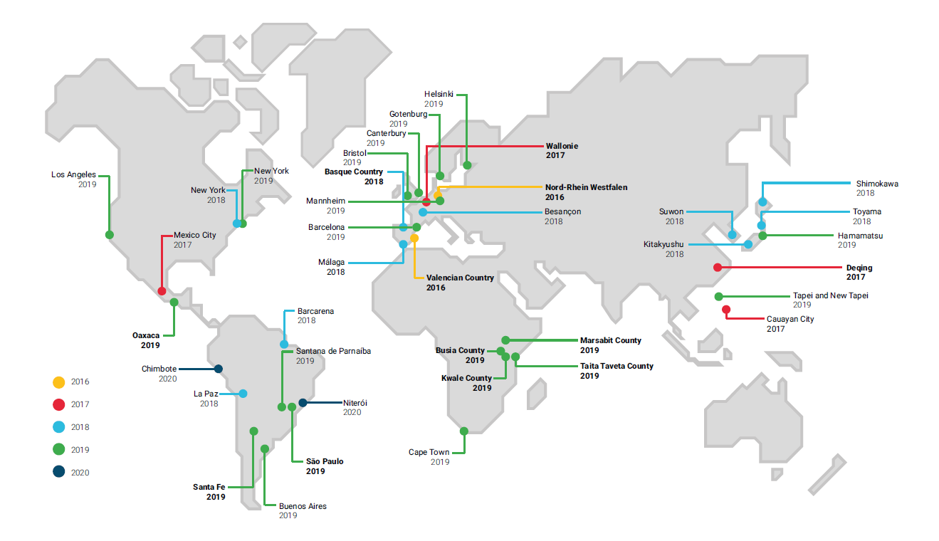
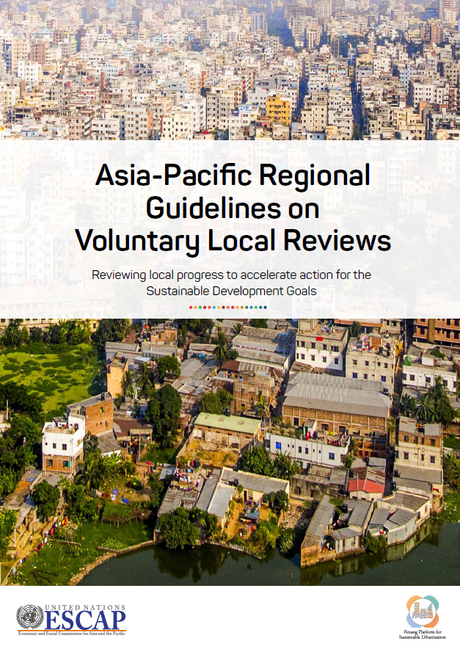
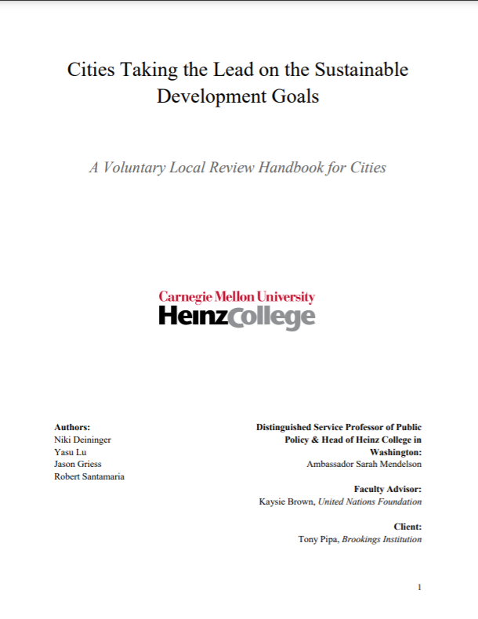

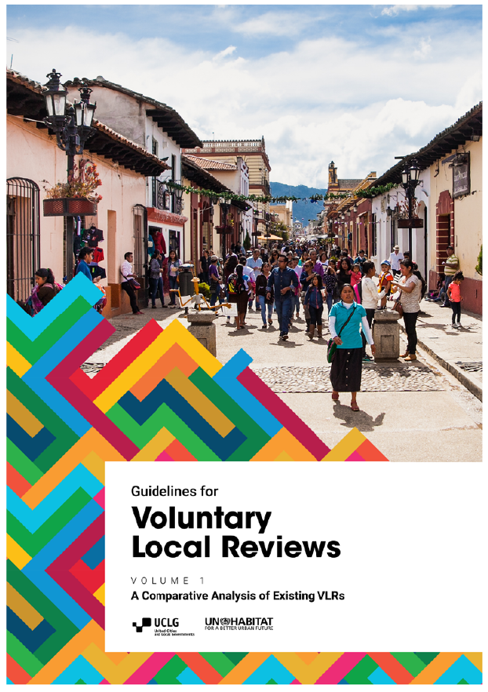
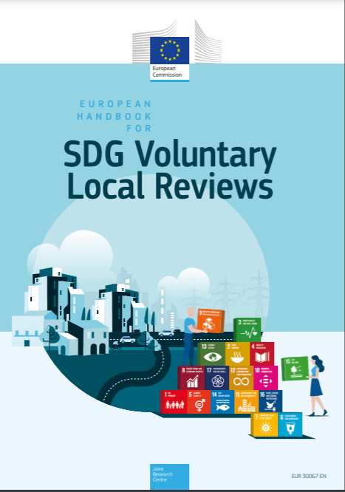
Localising the SDGs – Voluntary Local Review
~39 Voluntary Local Reviews Complete
> 210 cities signed up to the New York City VLR Declaration
Andrea, C., Fernández, A., Calvete, A., Miraglia, M., & Herrera-Favela, L. (2020). Guidelines for Voluntary Local Reviews: Volume 1 - A Comparative Analysis of Existing VLRs. https://doi.org/10.1017/CBO9781107415324.004
https://sites.research.unimelb.edu.au/connected-cities/projects/sdgs-cities-challenge

Slide 8
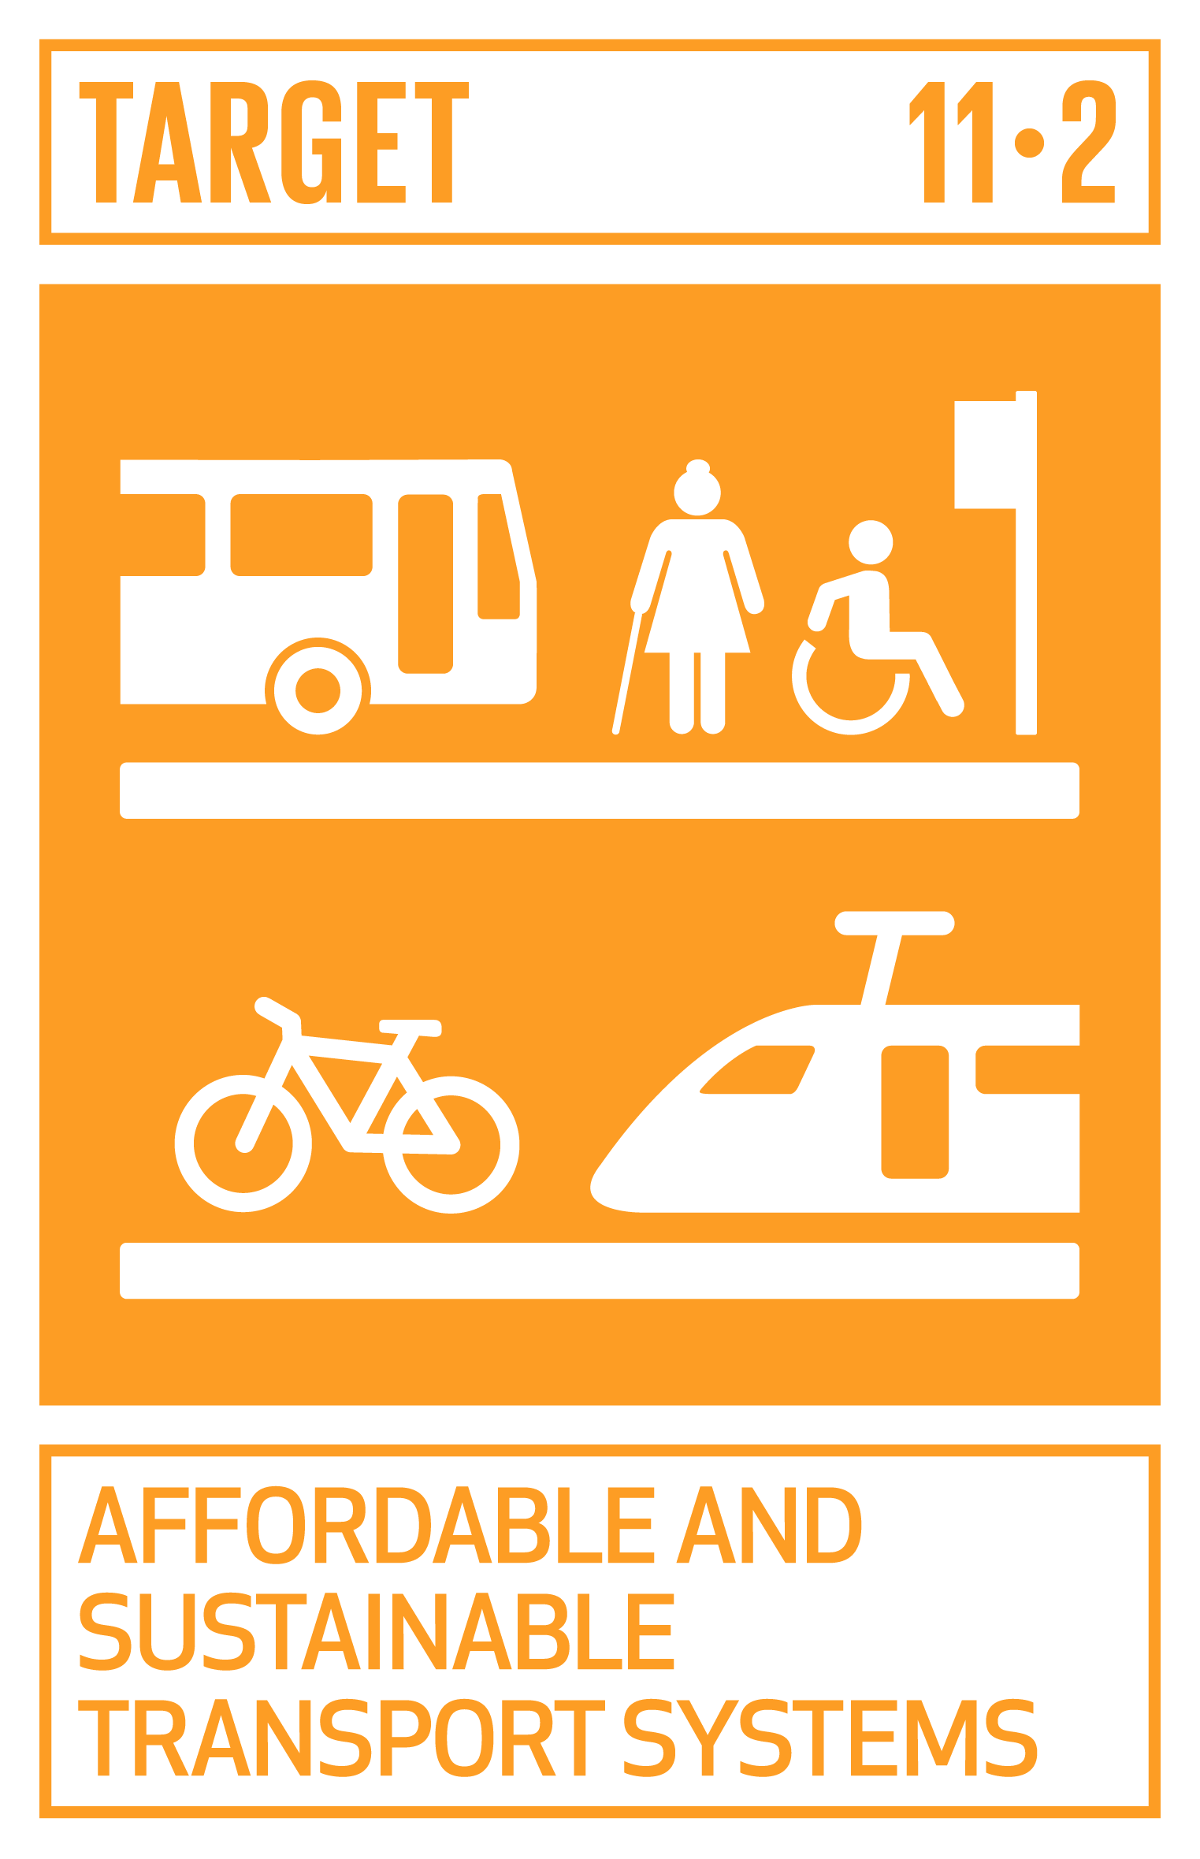
Same goal… different approaches
Three local government areas from the Asia-Pacific, participants from the 2020 SDG Cities Challenge, took very different approaches to localising SDG11. The difference between approaches within the goal – even within each target – is noticeable, but also reflects how translating a global framework into local context can be a challenging process. Hence why we have the Challenge!
DEHRADUN, India | WOOLLAHRA, Australia | WHITEHORSE, Australia
Child-friendly mobility system | Community emissions reduction strategy | Sustainable procurement process

Slide 9
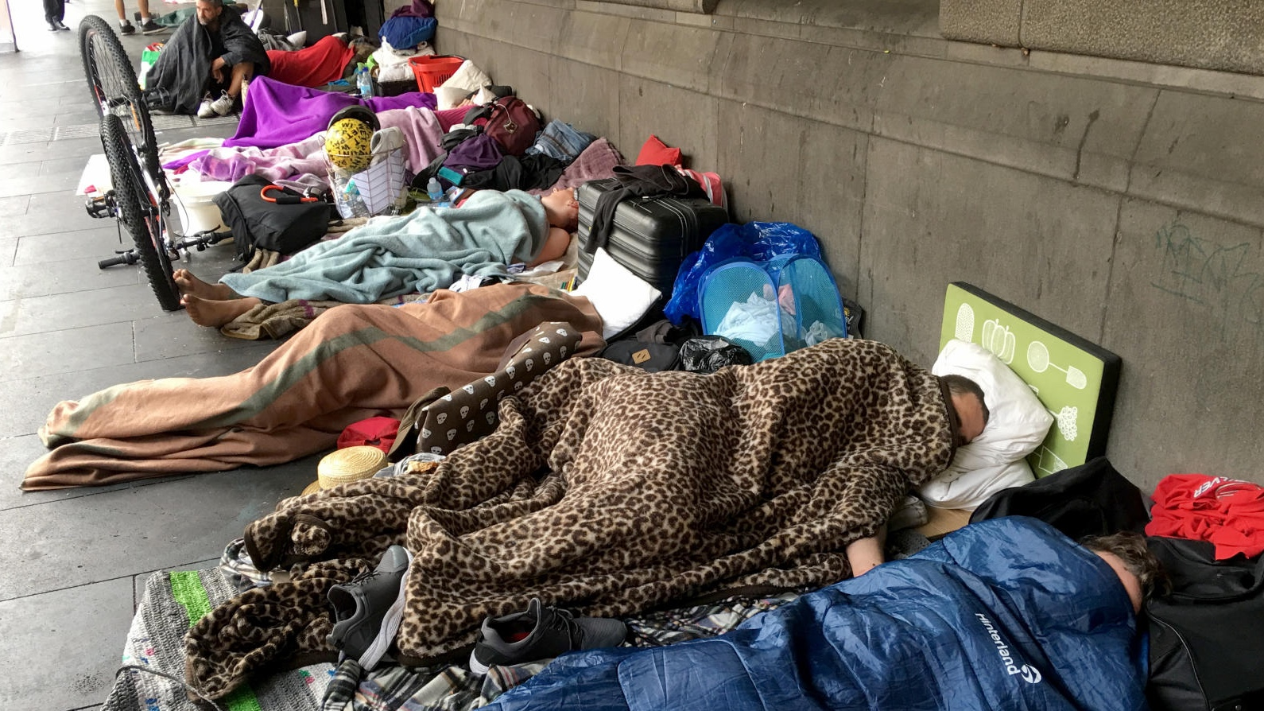
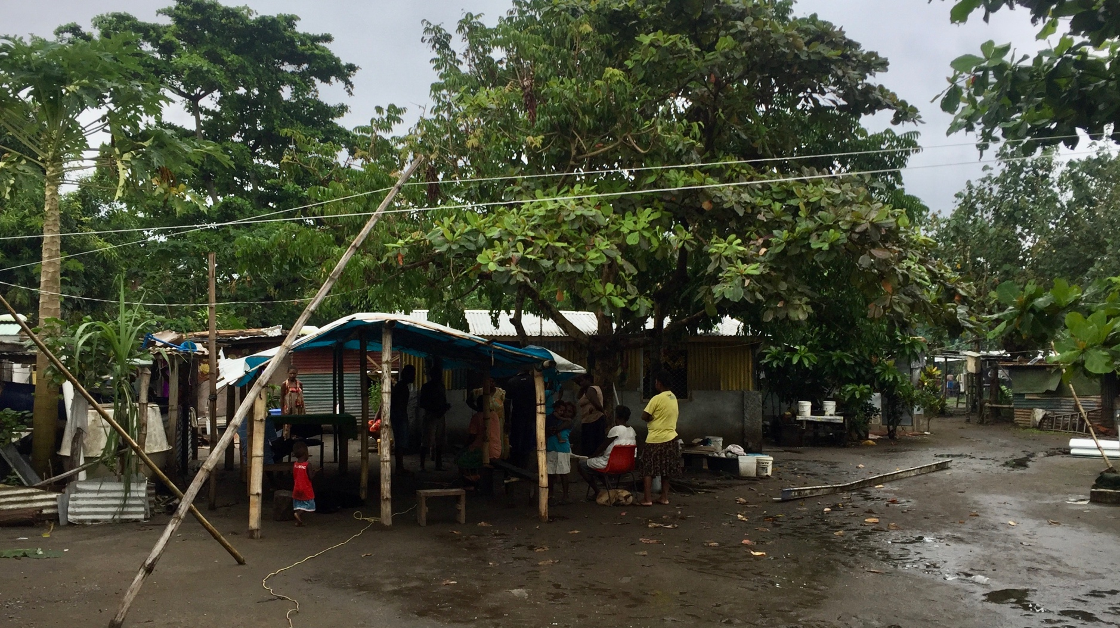
Local impacts – shared problems
Housing
Australia
Alexei Trundle & Paul Burston/University of Melbourne

Slide 10
Local impacts – shared problems
Housing
Vanuatu
Alexei Trundle & Paul Burston/University of Melbourne

Slide 11
2021 Cities
Denton
Texas
Orange County Florida
New Haven Connecticut
Atlanta Georgia
San Antonio Texas
Maui County Hawai’i
Fayetteville Arkansas
Dallas
Texas

Slide 12
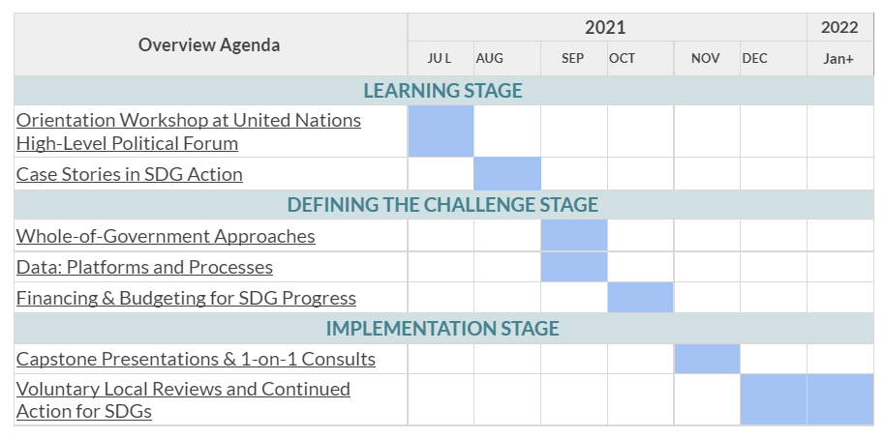

Slide 13
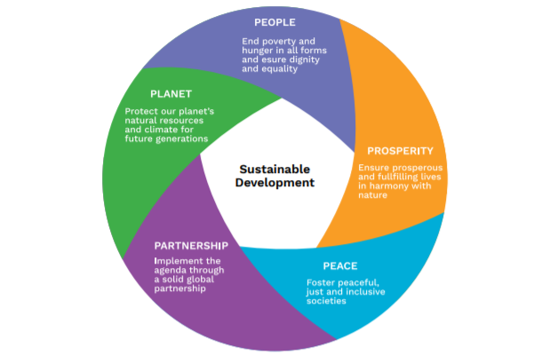
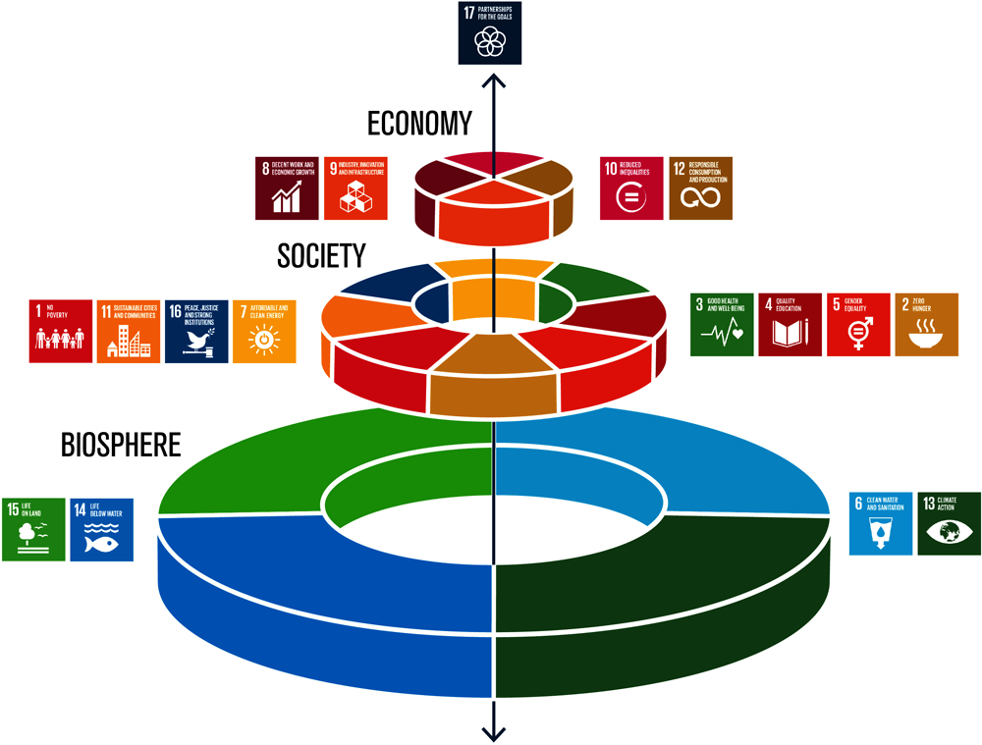

Slide 14
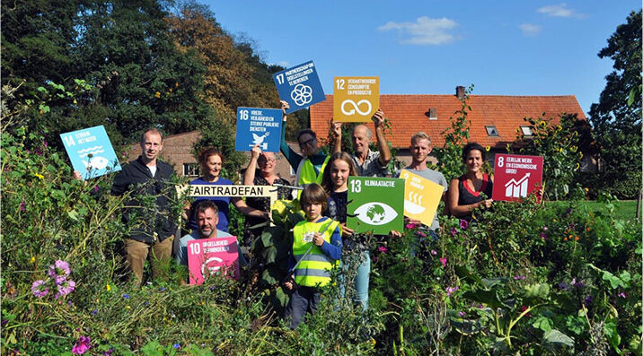
Case story: City of Orlando

Slide 15
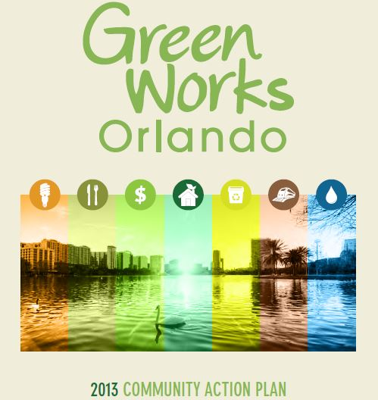
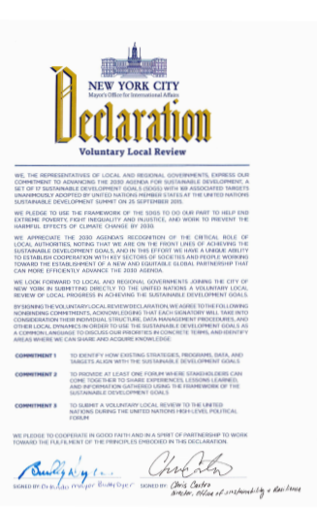

Case story: City of Orlando

Slide 16
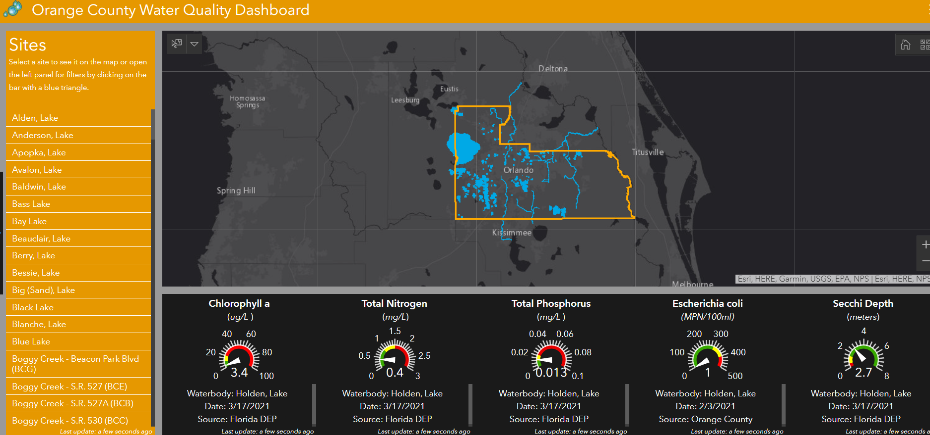
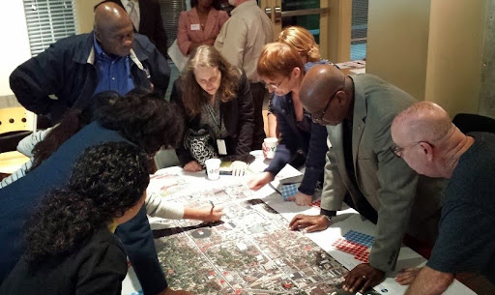
Case story: City of Orlando
Good-quality data and data-sharing
People-centered approach

Slide 17
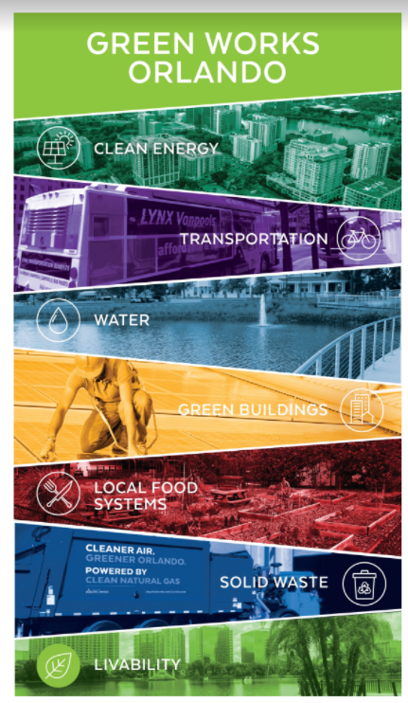
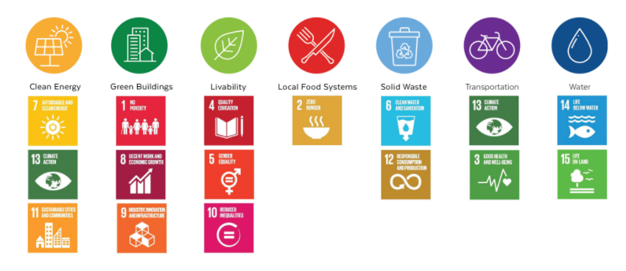

Slide 18
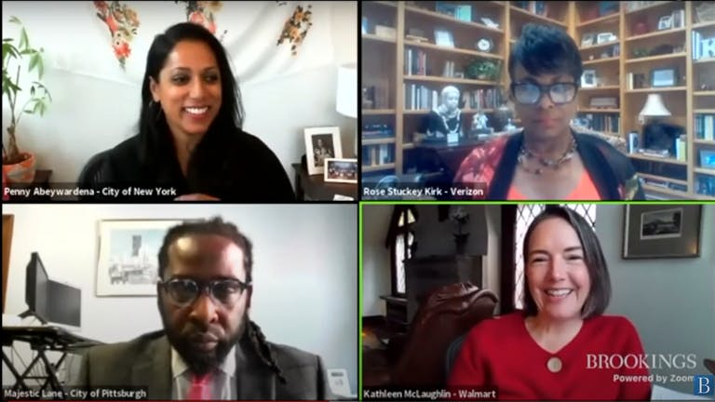
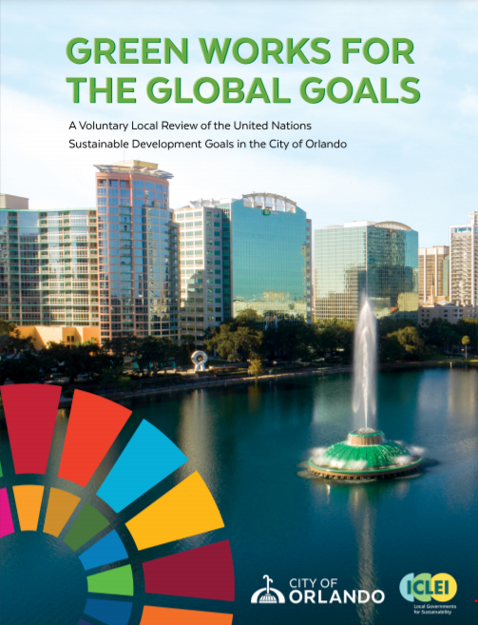
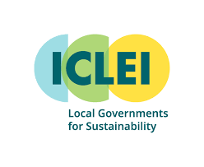
Case story: City of Orlando
Technical support and a community of practice

Slide 19

ESD is a key element of the 2030 SDGS
Goal 4 - Ensure inclusive and equitable quality education and promote life-long learning opportunities for all.
4.7 - By 2030, ensure all learners acquire knowledge and skills needed to promote sustainable development, including among others through education for sustainable development ……

Slide 20
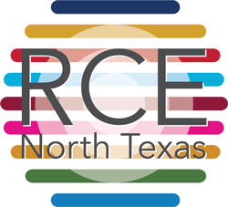
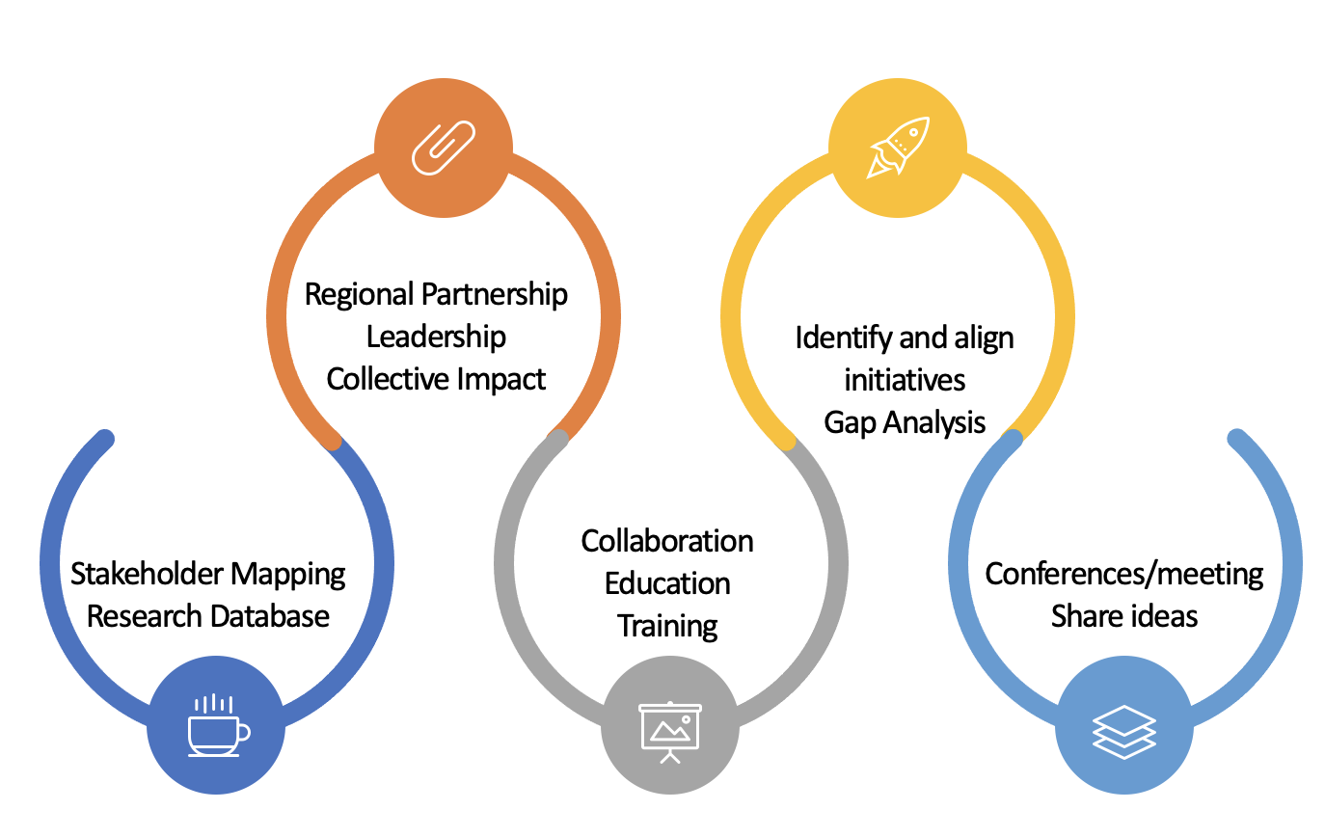
Regional Centers of Expertise (RCEs) on Education for Sustainable Development (ESD)
Think Globally Act Locally
An RCE can accelerate collective impacts over the region, and also provides opportunities to impact the global policies ESD and SDGs through the UN platforms of UNU
RCEs are networks of individuals and formal, non-formal, and informal organizations and institutions that facilitate ESD in local and regional communities, through education, training, and public awareness to build a sustainable future. Focuses on regional challenges, needs, and resources

Slide 21
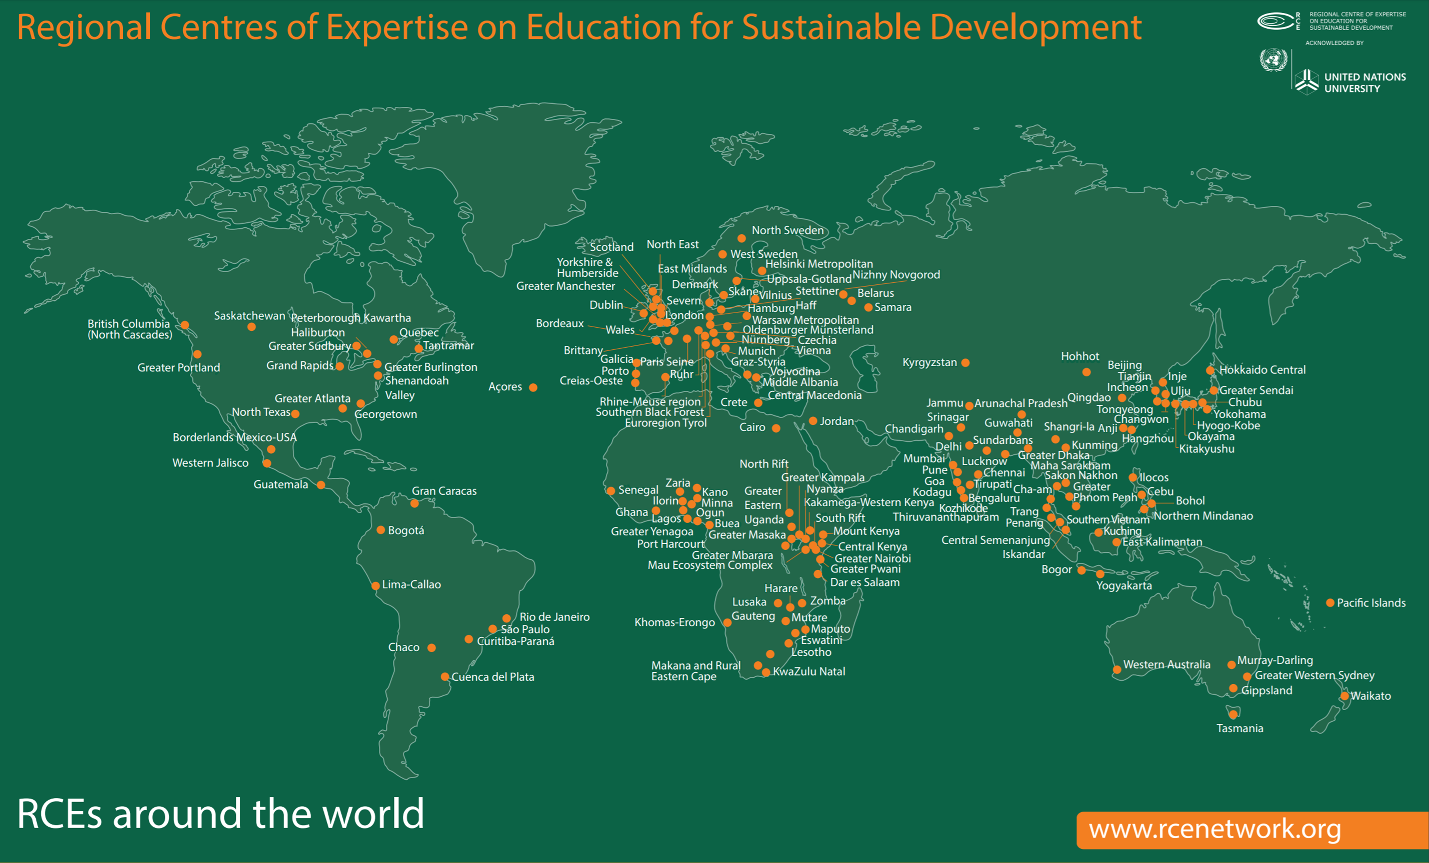

Slide 22
Thank you!
Kale Roberts kale.roberts@iclei.org
Amelia Leavesley amelia.leavesley@unimelb.edu.au
Meghna Tare mtare@uta.edu

