Slide 1
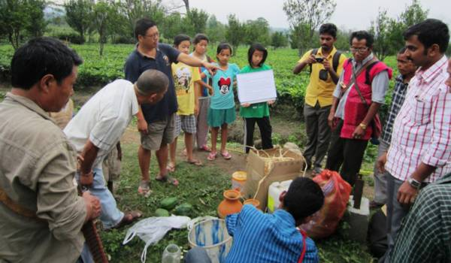
Farmers’ Training Workshop on production of bio-fertilisers & Bio-pesticides by ‘experts of Thanal’ at Wakro Organic Tea gardens, Lohit Arunachal Pradesh
Apr 25-26, 2014 organized by APNE Library, Wakro

