Slide 1





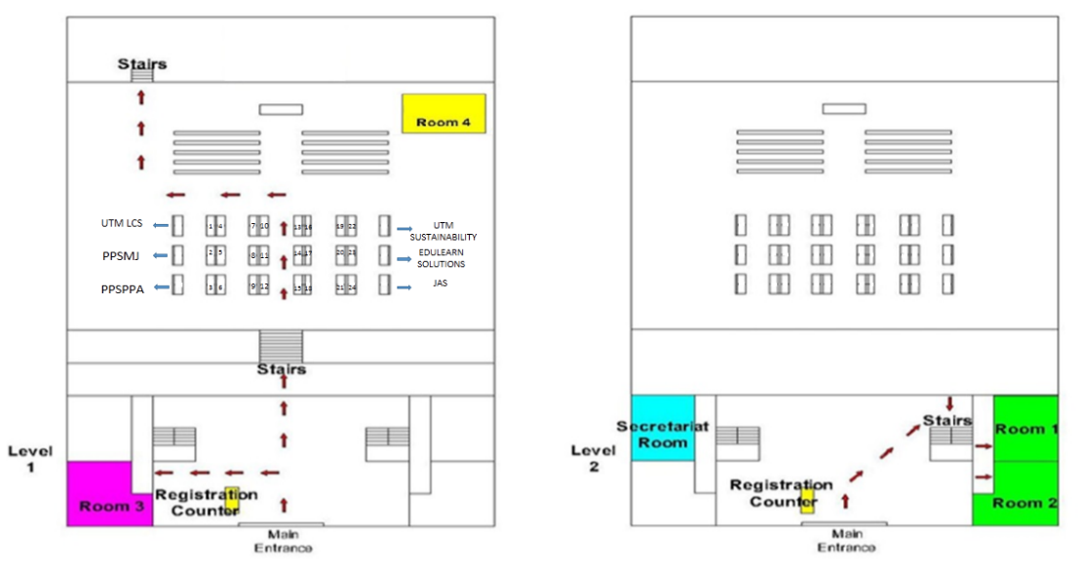






Time | Room No. | Title | Speakers
9.30 am – 11.00 am | 1 | Carbon Footprint | Mr. Vincent Chow, MNS
 | 2 | Kesedaran tentang Alam Sekitar | Mr. Hasri Paino, JAS Johor
 | 3 | Valuing Our Trees | Assoc. Prof. Dr. Kasturi Devi, UTM
 | 4 | Low Carbon School Management | Assoc. Prof. Dr Mohd Fadhil Md Din & En Mohd Rizalman Mohd Ali, UTM
11.30 am – 1.00 pm | 1 | Kawalan Pencemaran Air | Dr. Aznah Nor Anuar, UTM
 | 2 | Waste to Steam Boat | Assoc. Prof. Dr. Haslenda Hashim & Dr Lim Jeng Shiun, UTM
 | 3 | Solid Waste Management | Tn. Hj. Zulkifli Mohamad, PPSPPA
 | 4 | Green Transportation : Challenges and Practice | Dr. Gobi Krishna a/l Sinniah, UTM
2.00 pm – 3.30 pm | 1 | How to Bring Green into Classrooms | Dr. Suri S. Charles, CAE Johor
 | 2 | Conversion of Food Waste to Compost | Assoc. Prof. Dr. Lee Chew Tin, UTM
 | 3 | Climate Protection in the Waste Management Sector | Assoc. Prof. Dr. Zainura Zainon Noor, UTM
 | 4 | Green Chemistry | Dr. Corriena Abd Talib, UTM
ACKNOWLEDGED BY
JOHOR
SUSTAINABLE AND LOW CARBON
SCHOOLS EXHIBITION 2016
Dewan Sultan Iskandar, Universiti Teknologi Malaysia, Johor Bahru
20 February 2016 (Saturday)
Johor Sustainable and Low Carbon Schools Exhibition 2016 is inviting all the primary and secondary schools in Johor to participate in this exhibition which is designed to provide the opportunity for schools in Johor to showcase their efforts in creating a sustainable and low carbon schools. This is also to give recognition to their green efforts and contributions towards developing a sustainable Johor and reducing carbon emission.
Venue Layout: Dewan Sultan Iskandar
Programme Schedule
7.00am - Registration and setting up exhibition by participants
8.00am - Guests and VIPs arrival
8.30am - Opening Ceremony by YB Tn Hj Md Jais Sarday, EXCO Pendidikan, Penerangan, Koperasi & Pembangunan Usahawan Kerajaan Johor (official representative of Menteri Besar Johor)
- Book Launching – “Projek Alam Sekitar Sekolah-Sekolah di RCE Iskandar”
- Visiting Booths
9.20am - Briefing of rules and regulations by Head Judge
9.30am - Exhibition & Judging session
- Parallel workshops (see next )
3.30pm - Closing Ceremony by Prof Dr. Ho Chin Siong, RCE Iskandar Coordinator
- Review by Head Judge
- Announcement of winners and prize giving
- Photography session
A - UTM Low Carbon Asia Research Centre
B - Persatuan Pendidikan Sains Dan Matematik Johor (PPSMJ)
C - Perbadanan Pengurusan Sisa Pepejal & Pembersihan Awam (PPSPPA)
D - Malaysian Nature Society (MNS)
E - Jabatan Alam Sekitar (JAS)
F - Edulearn Solutions
G - UTM Sustainability
1 - SJK(T) KAHANG BATU 24
2 - SK KEMPAS
3 - SJK(C) KULAI 1
4 - SK NONG CHIK
5 - SK PASIR GUDANG 4
6 - SJK(C) PEI CHIAO
7 - SJK(C) PULAI
8 - SK SINAR BAHAGIA
9 - SK (P) SULTAN IBRAHIM
10 - SK TAMAN KOTA KULAI 2
11 - SJK(C) THAI HONG
12 - SJK(C) WOON HWA
13 - SMK BANDAR MAS
14 - SMK IMPIAN EMAS
15 - SMK KELAPA SAWIT
16 - SM SAINS KOTA TINGGI
17 - SMK SENAI
18 - SMK SERI AMAN
19 - SMK SULTANAH ENGKU TUN AMINAH
20 - SMK TAMAN DAYA 2
21 - SMK TAMAN JOHOR JAYA 2
22 - SMK TELOK KERANG
23 - SMK ULU TIRAM
Organized by:
To redeem your certificate of participation, please find the instruction in the questionnaire survey form.

